Slide 1


Prevention of home and leisure accidents –
Water safety
The content is based on the content of home and leisure accident prevention work and the prevention work of the Finnish Swimming Teaching and Lifesaving Federation

Slide 2

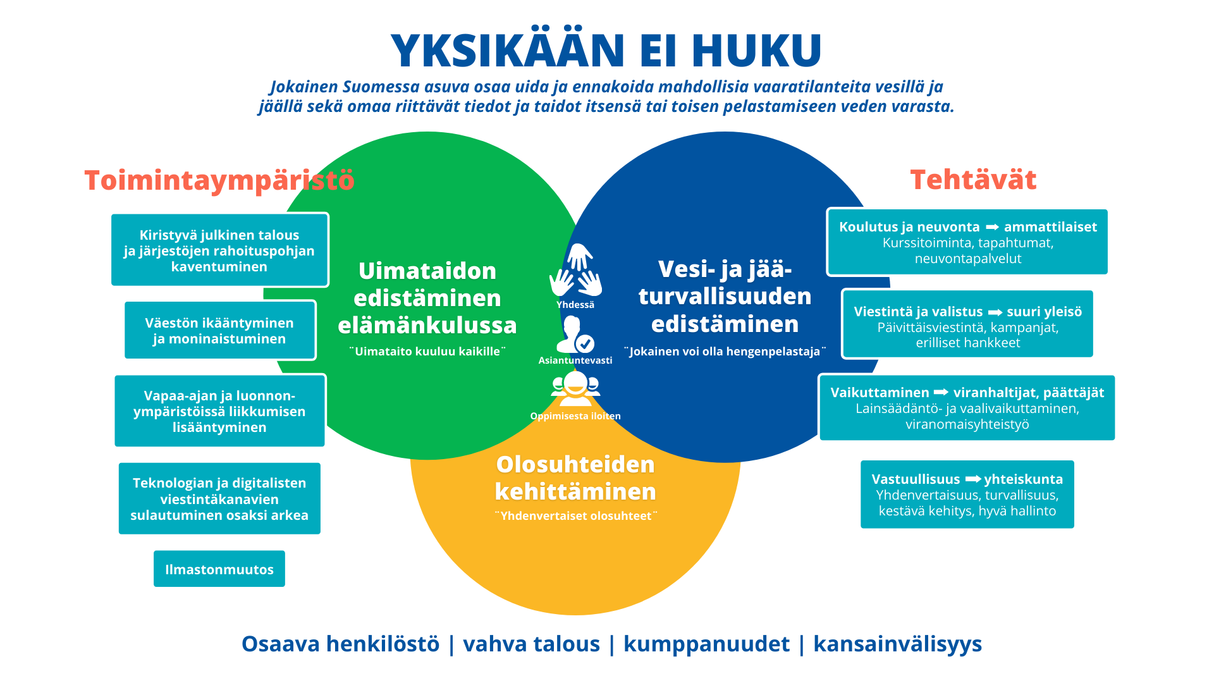
Finnish Swimming Teaching and Lifesaving Federation
NONE SHALL DROWN
Everyone living in Finland will know how to swim and anticipate potential dangers around water and ice and will possess sufficient knowledge and skills to rescue themselves or others from the water.
Training and education organisation for the promotion of swimming skills, water and ice safety and related conditions
This promotion is carried out in cooperation with member organisations, the swimming pool and spa industry, municipalities, public authorities, educational institutions and other stakeholders
Operating environment
Tasks
Tightening public finances and a shrinking financial basis for organisations
Promotion of swimming skills over the course of life
Promotion of water and ice safety
Training and advice → professionals
Courses, events, advisory services
Ageing and diversification of the population
Together
Communications, education →general public
Daily communications, campaigns, separate projects
“Everyone should know how to swim”
Competently
“Everyone can be a lifesaver”
Increase in recreational activities and activities in natural environments
Happy to learn
Influencing → authorities, decision-makers
Legislative and electoral influencing, cooperation with public authorities
Integration of technology and digital communication channels into everyday life
Development of conditions
Responsibility → society
Equality, safety, sustainability, good governance
Climate change
“Equal opportunities”
Skilled staff | strong finances | partnerships | international activities
Notes:
Finnish Swimming Teaching and Lifesaving Federation: www.suh.fi
The Finnish Swimming Teaching and Lifesaving Federation (FSL) is an organisation established in 1956. FSL directs general swimming teaching and lifesaving work nationally, provides guidance, education and information related to these activities, and develops swimming conditions, particularly the safety of public swimming pools and beaches. FSL works in close cooperation with the authorities on water safety issues. FSL’s sectors of activity include swimming teaching, lifesaving, baby and family swimming, special swimming, water training, Junior Lifesaver Club for children and young people and technical guidance on the design, construction and maintenance of swimming pools, spas and beaches.
The goal of teaching swimming and lifesaving skills and raising awareness of related issues is to make all citizens able to swim and save lives. To achieve this goal, the federation is cooperating with parties that contribute to the implementation of an educational system for swimming and lifesaving skills.
Our values: Together – Competently – Happy to learn
Our vision – none shall drown: Everyone living in Finland will know how to swim and anticipate potential dangers around water and ice, and will possess sufficient knowledge and skills to rescue themselves or others from the water.

Slide 3
Notes:
The number of drownings in Finland has been on a downward trend for a long time. In the 1970s, an average of 360 people drowned each year. This was followed by a more stable period with an average of 240 drownings per year in the 1980s and 1990s. In the first decade of the 2000s, an average of 200 people drowned each year. Over the last ten years, the average number of accidental drownings per year has been 147. Over the last fifty years, statistics show that around 12,000 people drowned accidentally. Of these people, 88% were men. (SIAF, 2021)
More accidental drowning deaths occur in Finland than in Sweden and Norway.
Downward trend since the 1950s, now around 150 drownings per year

Slide 4
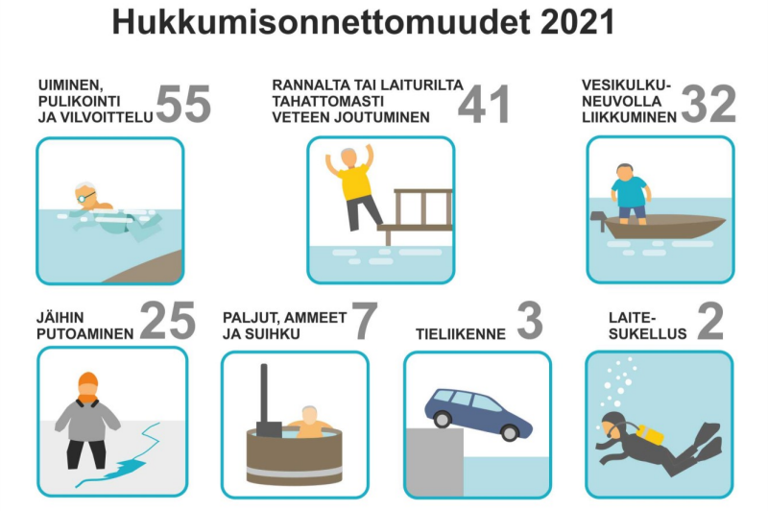
Drownings 2021: type of activity
165 deaths
Drowning accidents 2021
SWIMMING AND SPLASHING AROUND OR COOLING DOWN IN THE WATER
FALLING INTO THE WATER FROM THE SHORE OR A JETTY/PIER
TRAVELLING BY WATERCRAFT
FALLING THROUGH THE ICE
HOT TUBS, BATHTUBS AND
SHOWERS
ROAD TRAFFIC
SCUBA DIVING
Image: SIAF
Notes:
SIAF 165 https://www.suh.fi/tiedotus/hukkumistilastot
Almost all the drowning cases involved people in their leisure time, usually in the immediate vicinity of their home or summer cottage.
Around 50% of annual drownings occur during the summer. People spend a lot of time on, in and around water. A nation of cottage lovers.
Most drownings occur in inland waters.
A typical drowning occurs in a familiar body of water, close to the shore.
The majority of drowning victims in water traffic were not wearing life jackets.

Slide 5
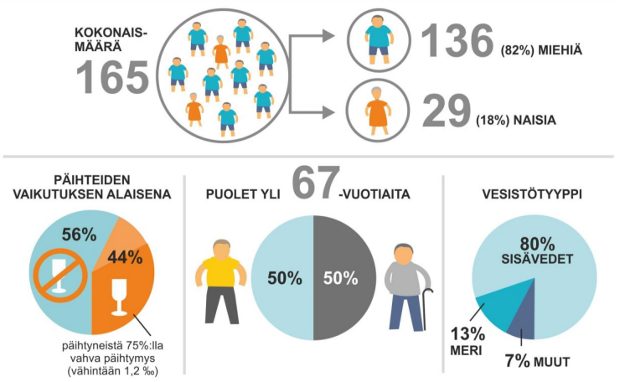
Drownings 2021
165 deaths
TOTAL NUMBER
(82%) MALE
(18%) FEMALE
INTOXICATED
HALF OVER THE AGE OF
TYPE OF BODY OF WATER
INLAND WATER
of those under the influence, 75% seriously intoxicated (at least 1.2 per mille)
SEA
OTHERS
Image: SIAF
Notes:
SIAF 165
https://www.suh.fi/tiedotus/hukkumistilastot
In the case of women, the drowning cases were concentrated around swimming, particularly splashing around in the water and cooling down after the sauna or without having been to a sauna. In addition to the above, men were particularly prone to falling through the ice, drowning while using a watercraft for various purposes and falling into the water at a marina, for example. No women fell through the ice, and all the drowning victims in cases involving water and land vehicles, fishing or hunting were men.

Slide 6
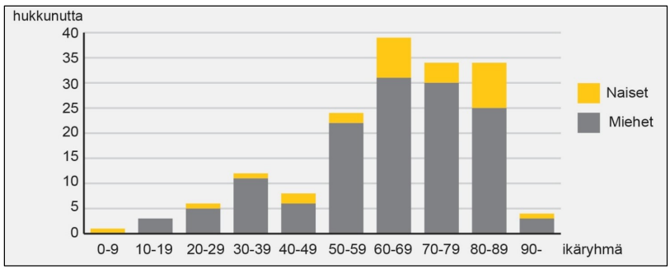
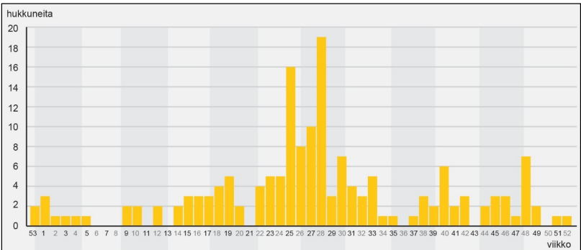
Drownings by age group & week
drowning victims
Women
Men
age group
drowning victims
week
Image: SIAF
Notes:
Drowning deaths occur mainly among middle-aged and older people. (image 2021)
The age distribution of accidental drownings was dominated by older people. The average age was 64 years. A total of 82% of those drowned were men, and their average age was 63 years, while the proportion of women was 18%, and their average age was 66 years. The median age was 67 years. This means that half of those who drowned were more than 67 years of age. Of the women, 65% were over the age of 64. The highest proportion of female drownings was in the oldest age groups. More than half of the men (54%) were over the age of 64.
Almost a third (30%) were over the age of 75. There were 38 victims aged over 80, which is 23% of the total number of victims. There were four victims over the age of 90, three of whom were male and one female. The oldest person was 94.
More than a quarter of the victims (28%) were of early retirement age (65–74 years). A total of 68 victims (41%) were of working age (18–64 years). Six of the victims (4%) were young adults (18–29 years). All six of them had an underlying medical condition or were seriously intoxicated.
Four people under the age of 18 drowned. The number of drownings among children, i.e. people under the age of 18, has decreased over the past two decades. The average between 2010 and 2020 was 5.3 child drowning victims per year.
Accidental drownings in 2021 were spread over most of the year. The weekly variation was high. The months are separated by the grey and white background. The busiest week was in July.

Slide 7
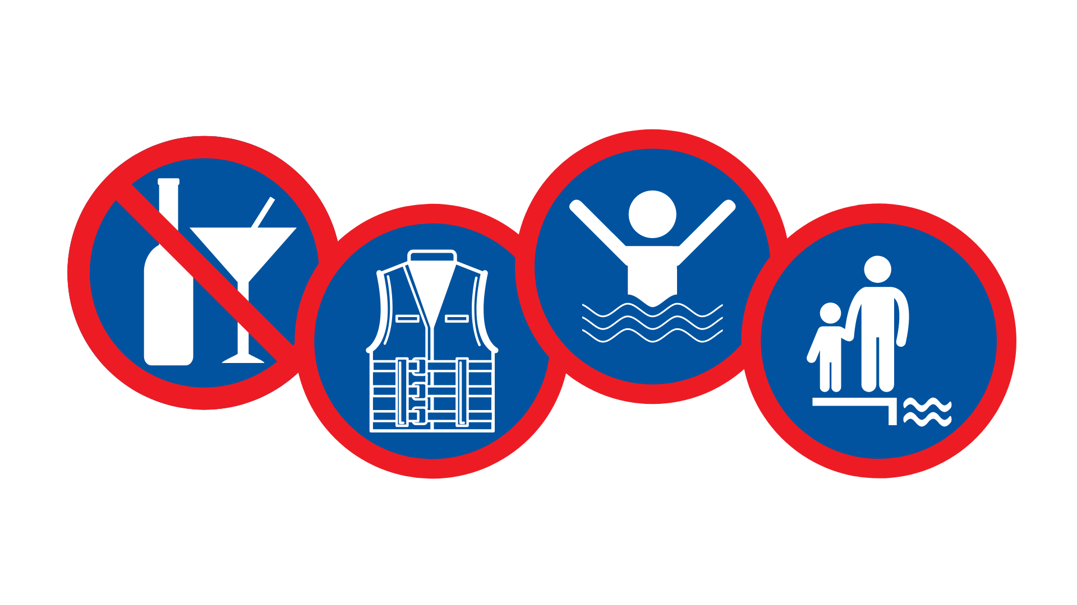
Factors in drowning accidents
Leaving children
unsupervised
near water
Life jacket
Alcohol
Personal
ability to function
ATTITUDE!

Slide 8

Factors in drowning accidents: Alcohol
Alcohol is involved in about half of all drownings.
Intoxication increases the likelihood of accidents. Dealing with an emergency can be difficult even when sober – and potentially impossible when drunk.
Alcohol
Notes:
Alcohol is one of the main factors that increase the risk of accidents. Alcohol emboldens and removes inhibitions, while weakening body control by depressing the central nervous system. Intoxication increases the risk of accidents.
Alcohol is a central nervous system depressant. Its effects can be divided into mental and motor ones. The mental effects include but are not limited to reduced caution, impaired judgement and heightened emotional reactions. The mental effects occur even at low levels of alcohol in the blood. The motor effects become more pronounced as the blood alcohol content rises. Balance and general motor coordination are negatively affected. An extremely high blood alcohol content will lead to the loss of consciousness, or passing out. Intoxication is also a major stress factor for the body, the heart in particular.
In addition to medical conditions, intoxicants affect people’s ability to function. There was some type of intoxicant, most commonly alcohol, in the blood of 71 of the drowning victims (44%). In the majority of the cases, the alcohol intoxication was serious (2021, SIAF).
Alcohol is involved in about half of all drownings.
Drowning accidents are always the result of several factors. Intoxication increases the likelihood of accidents. Dealing with an emergency situation can be difficult even when sober – and potentially impossible when drunk. Alcohol impairs motor control, judgement and reaction time.

Slide 9
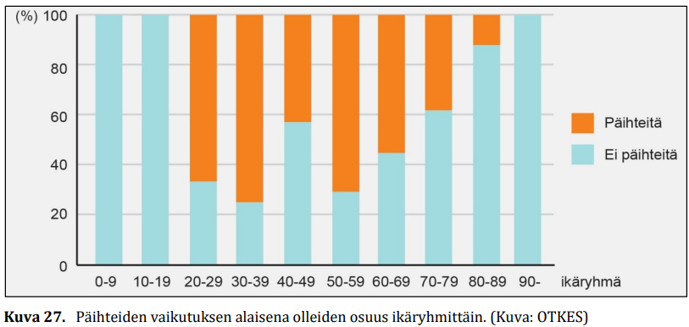
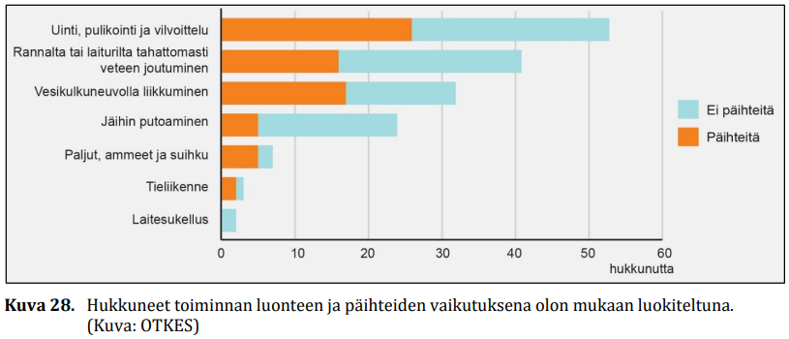
Intoxicants and age group & nature of activity
Intoxicants
No intoxicants
age group
Figure 27. Proportion of intoxicated people by age group. (Image: SIAF)
Swimming and splashing around or cooling down in the water
Falling into the water from the shore or a jetty/pier
Travelling by watercraft
Falling through the ice
Hot tubs, bath tubs and showers
Road traffic
Scuba diving
No intoxicants
Intoxicants
drowning victims
Figure 28. Drowning cases classified by the nature of activity and the use of intoxicants. (Image: SIAF)
Notes:
The highest proportion of people under the influence of alcohol was among those who had gone into the water to splash around, cool themselves or swim, as well as among those who had been travelling by watercraft for some purpose. Half of the people in these groups were at least moderately intoxicated.

Slide 10
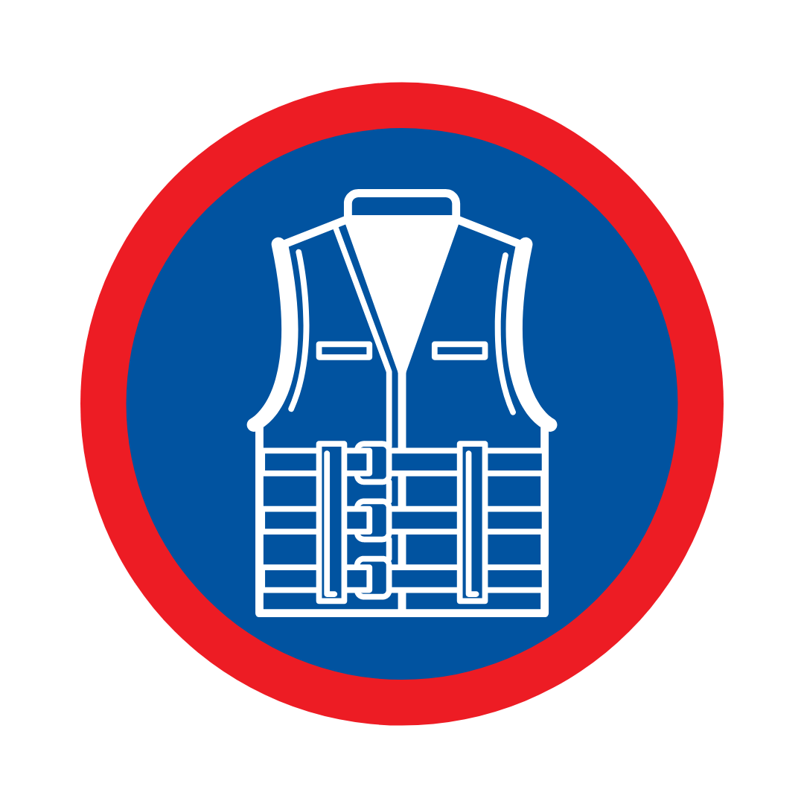
Factors in drowning accidents: Life jacket
Life jackets prevent drowning effectively
According to international studies, appropriate and correctly worn life jackets could prevent up to 70–80% of drownings in water traffic
www.viisaastivesilla.fi/pelastusliivipaiva
Life jacket
Notes:
Life jackets prevent drowning effectively. According to international studies, appropriate and correctly worn life jackets could prevent up to 70–80 per cent of drownings in water traffic.
A typical characteristic of boat-related drowning cases is falling from the boat. The boats in question are usually small rowing boats, often old ones with a tapered stern. Instability of the boat and a slippery, concave bottom increase the risk of falling when moving about in the boat during fishing or when fixing the motor, for example. Instability also increases the risk of capsizing, especially when there are multiple people aboard. (SIAF, 2021)
In the majority of the boat-related cases, the drowning victim did not have a life jacket with them or had not put it on. Of the 41 people who drowned in water traffic or at a marina, only six were wearing a life jacket or flotation suit, but there were problems with these as well. (SIAF, 2021)
People wear seat belts in cars, why do they not wear life jackets in boats?
Motor boats and sailing boats over 5 metres in length must have a life jacket or other personal flotation device of the correct size for each person on board. A life jacket significantly improves the chances of survival of a person ending up in the water and facilitates search and rescue.
The main reason for not wearing a life jacket when boating is the simple fact of not having one. Other reasons cited for not wearing a life jacket when boating include the discomfort of wearing one and perceiving the boating conditions as safe. This data is based the Finnish Transport and Communications Agency Traficom’s survey.
According to the survey, only a little over half of boaters always wear a life jacket when boating. One in ten never wear a life jacket. Men aged 50–64 are the least likely to wear a life jacket or other personal flotation device.
The most common reason for not wearing a life jacket is not having bought one (43%). According to respondents, life jackets are also perceived as uncomfortable to wear (17%). Another reason given by survey respondents for not wearing life jackets was that they were not considered necessary when boating on a small lake or pond.
A typical characteristic of boat-related drowning cases is falling from the boat. The boats in question are usually small rowing boats, often old ones with a tapered stern. Instability of the boat and a slippery, concave bottom increase the risk of falling when moving about in the boat during fishing or when fixing the motor, for example. Instability also increases the risk of capsizing, especially when there are multiple people aboard.
Most of those who drowned in water traffic were travelling by rowing boat, so the use of life jackets should be emphasised when travelling by rowing boat.

Slide 11
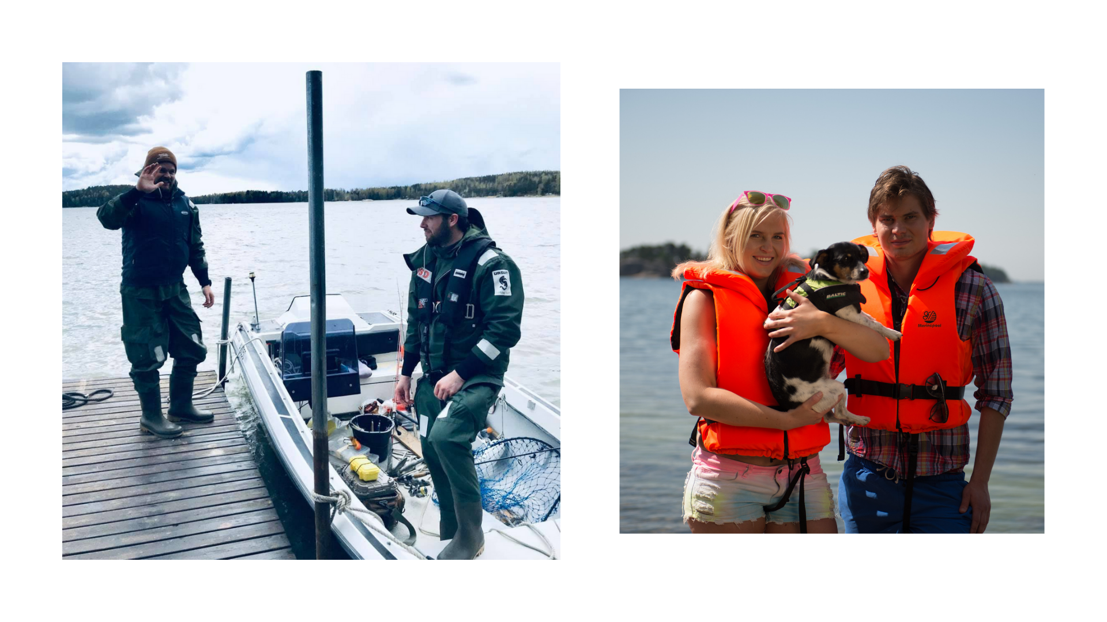
Home safety coaching & FSL 2022
Notes:
What kind of a personal flotation device is right for you?
Different types of PFD’s – what is the difference between a buoyancy aid and a life jacket?
When buying a new life jacket, insist on an open purchase and the opportunity to try it out in practice. Test if it fits well and feels comfortable. Keep in mind that you should also be able to fit an overcoat or other clothing under the jacket. Try sitting with the jacket on, because boating is all about sitting!
In Finland, all life jackets must have the features specified in the relevant directives. Buoyancy is indicated in newtons (N).
Life jacket: For children, those that can swim and those that cannot
A 100-newton life jacket is designed for use in sheltered waters. It can turn an unconscious person onto their back in 10 seconds. These jackets are only available in orange, red or yellow and come with a mandatory reflector and whistle. This is the kind of jacket a child should have.
Inflatable life jacket: For demanding conditions for adults
A 150-newton life jacket is designed for use in coastal waters. It can turn an unconscious person onto their back in 5 seconds. They are usually filled with air, and are also available with crotch straps.
A 275-newton jacket is designed for use in open sea conditions with waterproof and heavy clothing. It can turn an unconscious person into a safe floating position in 5 seconds. They are usually filled with air.
Buoyancy aid: For people who are able to swim and have help nearby / for water sports
50-newton buoyancy aid vests, jackets and suits are only intended for people who are able to swim, in sheltered waters and close to the shore where help is close at hand. Buoyancy aids are popular in water sports, for example, because they are easy to move around in.
They do not turn an unconscious person onto their back and usually lack a collar. Buoyancy aids are not made for children under 30 kg.
Proper use and maintenance
Personal flotation devices must be used, maintained and stored in accordance with the manufacturer’s instructions, and it is recommended that you read the instruction manual that comes with the device.
When wearing a life jacket, it is important that it is worn correctly. If the life jacket is poorly adjusted, the person may sink too low into the jacket and it will not work as intended. For example, the waist strap of an inflatable jacket must be sufficiently tight.
A life jacket will only save a person’s life if it is the right type for the purpose, it is on when the person falls into the water and it is worn correctly.
Is the life jacket usable?
When buying a jacket, check that it is approved and undamaged. The condition of the life jacket should be checked annually.
Approved life jackets and other PFD’s have the CE marking on the inside.
The seams are intact
The flotation material is intact and flexible
The fastening straps and buckles and other separate parts are intact
The surface material is intact
The maintenance of an inflatable life jacket includes a test inflation. You can inflate the jacket by blowing, but this may let moisture in. You can use a balloon pump, for example.

Slide 12

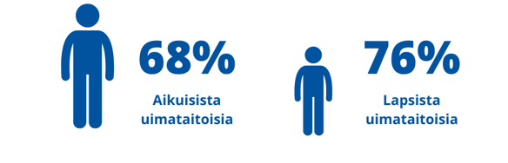
Factors in drowning accidents: Personal ability to function and swimming skills
Good swimming skills are a good preventive measure against death by drowning.
A person is able to swim if, after falling into deep water, they can swim 200 metres, 50 metres of which on their back.
53%
55%
Personal ability to function
of adults are able to swim
of children are able to swim
Notes:
Reduced ability to function plays a key role in drowning cases, as it increases the risk of falling into the water from the shore or a boat, for example. On the other hand, reduced ability to function can make it difficult to rescue oneself if one falls through the ice or from a boat, for example. Getting out from a hole in the ice or climbing onto a boat requires strength and good fitness.
Based on SIAF’s data, it appears that people who are perfectly healthy and able to function only rarely drown. Drowning victims often had a variety of previously known factors affecting their ability to function, which increased their risk of drowning and probably other accidents as well. However, it is possible to compensate for known risks by avoiding going into the water or spending time near the water alone. Furthermore, factors such as the good condition and easy accessibility of the beach and jetty of a summer cottage reduce the risk of falling into the water. Special attention must also be paid to stability when choosing a boat. (SIAF, 2021)
Many of the activities that led to drowning were ones in which the person had been engaged for decades, perhaps even surviving dangerous situations in the past. However, as the person’s ability to function has deteriorated, those activities have become risky without the person realising it. (SIAF, 2021)
Nearly two out of three people who drowned had a previously known or undiagnosed medical condition that limited their ability to function (2021, SIAF). Typically, these were heart diseases, but neurological conditions, musculoskeletal disorders and long-term alcohol abuse were also fairly common. The risk of problems caused by a cardiac disease increases when the temperature fluctuates or the person exerts themselves. (2021, SIAF)
Good swimming skills are an excellent preventive measure against death by drowning.
A person is able to swim if, after falling into deep water, they can swim 200 metres, 50 metres of which on their back.
Children 76% / adults 68%
In Finland, older age groups have poorer swimming skills than younger people. In 2021, the majority of drowning victims were older adults, among whom the proportion of unskilled swimmers is also higher than in the population on average. (SIAF, 2021)
No comprehensive data on the swimming skills of the drowning victims was available for the investigation at hand. However, it can be said that most of the cases, especially those involving boating or swimming, splashing around or cooling down in the water, were such that if the person was able to function, they could have benefited from proper swimming skills. However, a significant proportion of those who drowned were known to be able to swim, which means that the drowning was caused by a problem that occurred in the water rather than a lack of swimming ability. (SIAF, 2021)
Children and swimming skills:
Differences in children’s swimming skills between municipalities remain high.
In municipalities that do not offer any curricular swimming lessons, children’s swimming skills are clearly lower than in those that offer swimming in every grade.
According to teachers’ responses, the usual reason for not offering swimming lessons is that the municipality has not provided a budget for it.
In addition to swimming lessons at school, children’s swimming skills are also influenced by their proximity to a swimming pool and visits to the pool during their free time, in particular.
Swimming skills and good water safety skills give people the freedom to move safely in, on and around water in all seasons. At its best, swimming is an excellent form of exercise for beginners and active swimmers alike. It is inexpensive and suitable for all ages and can be practised all year round.

Slide 13
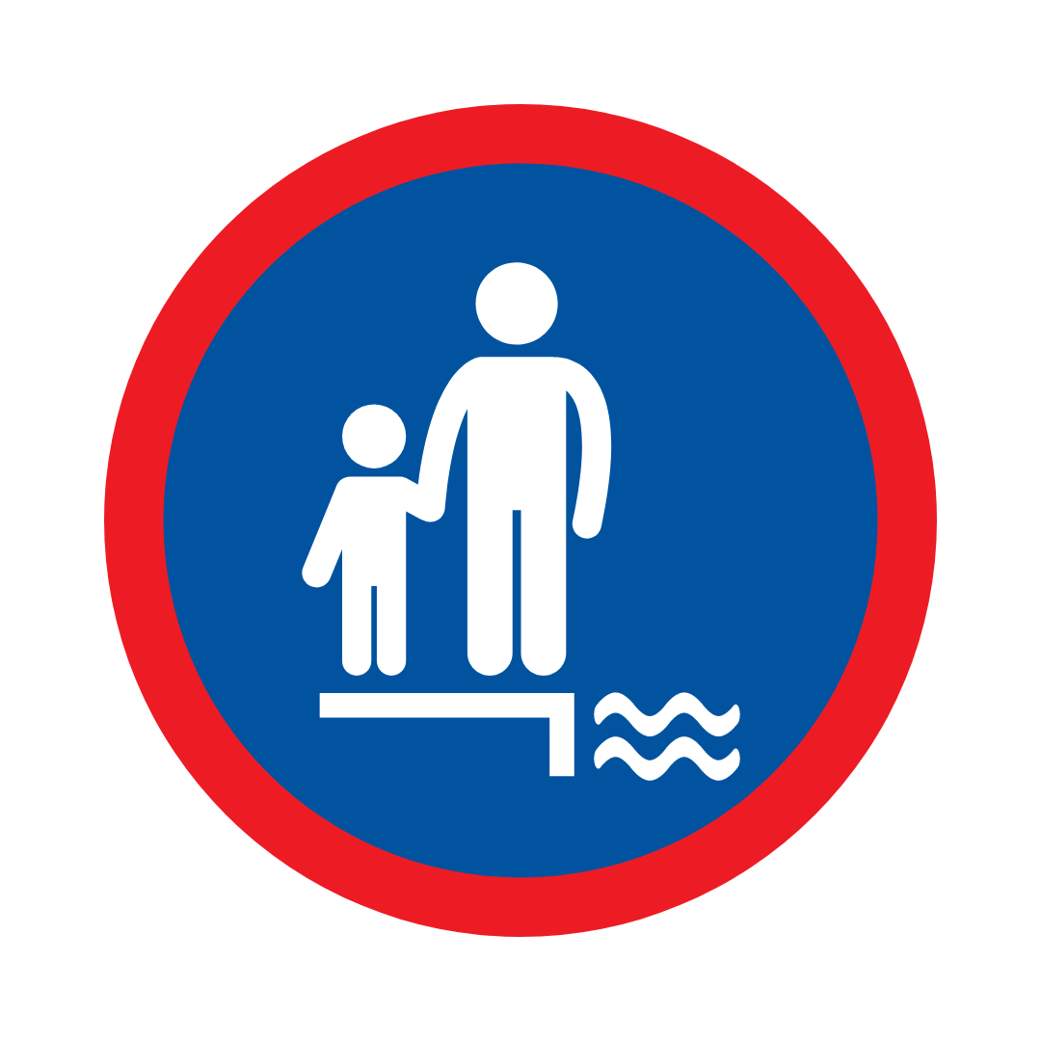
Factors in drowning accidents: Children
Drowning deaths among children and young people have declined since the early 2000s, but drowning remains one of the leading causes of accidental death among children under school age.
On average, four people under the age of 15 die by drowning each year, compared to six deaths among 15–24-year-olds.
Leaving children unsupervised near water
Notes:
Highlighting the role of parents in supervising children near water. Drowning is quiet; the child does not tell you that they are drowning. It can happen while you are focused on your mobile phone.
Drowning deaths among children and young people have declined since the early 2000s, but drowning remains one of the leading causes of accidental death among children under school age. Since 2012, an average of 10 people under the age of 25 have died each year as a result of drowning or in water traffic. On average, four people under the age of 15 die by drowning each year, compared to six deaths among 15–24-year-olds.

Slide 14
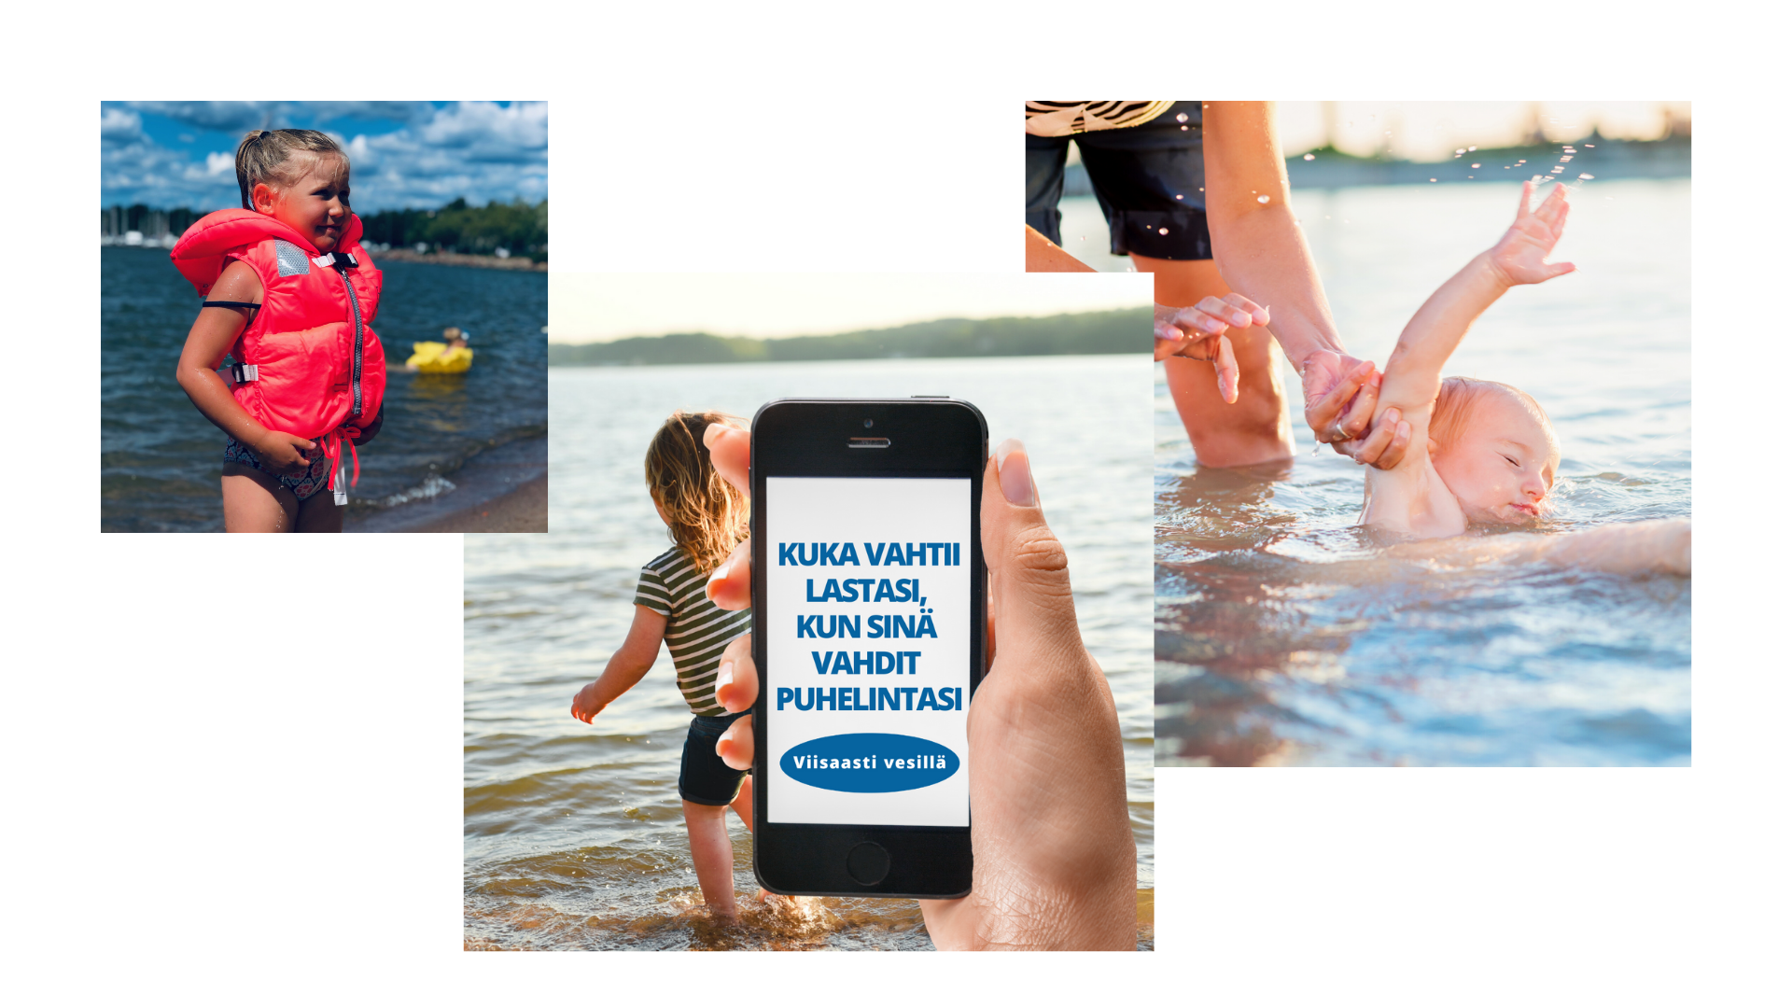
WHO IS LOOKING AFTER YOUR CHILD WHEN YOU ARE LOOKING AT YOUR PHONE
Notes:
Drowning happens quickly
parents responsible for their children – not lifeguards
within an arm’s length
There is surely no better summer pastime than being on the beach on a warm day. However, you must be vigilant at all times with young children so that they do not run into the water unnoticed.
With your child, learn and review the rules for how to act near or in the water.
Ensure that the child is wearing a life jacket in the correct manner.
Keep a constant watch over the child.
Remain within an arm’s length of the child.
When in the water, always keep the child between you and the shore.
You can put life jackets on children as soon as you arrive at the beach.
Supervise children, do not let them swim or play on the beach alone.
Supervise the child within an arm’s length and keep them between yourself and the beach.

Slide 15
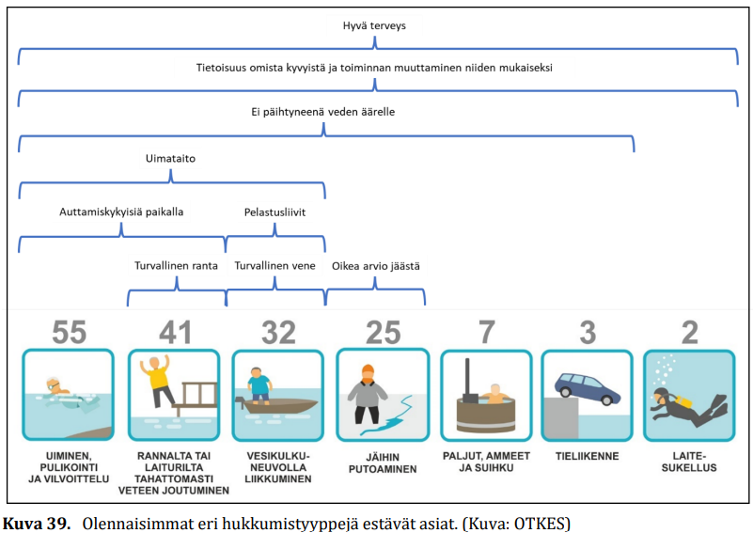
Good health
Awareness of your own abilities and adapting your actions accordingly
The main factors influencing the different types of accidents, i.e., what personal measures could be taken to prevent drowning.
Not going near water when intoxicated
Swimming skills
People able to help present
Life jacket
Safe beach
Safe boat
Correct estimate of ice
SWIMMING AND SPLASHING AROUND OR COOLING DOWN IN THE WATER
FALLING INTO THE WATER FROM THE SHORE OR A JETTY/PIER
TRAVELLING BY WATERCRAFT
FALLING THROUGH THE ICE
HOT TUBS, BATH TUBS AND SHOWERS
ROAD TRAFFIC
SCUBA DIVING
Figure 39. Key factors to prevent different types of drowning cases. (Image: SIAF)
Notes:
In the cases investigated by SIAF, the susceptibility to drowning had typically developed over the years. The susceptibility is related to personal circumstances, such as state of health, substance abuse and learned behaviours. Furthermore, the setting is often private, such as the beach of a summer cottage or the person’s home.

Slide 16

Spot and rescue a drowning person: Drowning does not look like drowning
Drowning may not look like what most people expect.
A drowning person may not splash or wave their arms for help and may not always be able to cry for help. This is why it is said that drowning is silent.
Drowning means suffocation by fluid in the airways.
Silent drowning
Notes:
The most important thing in this section is to change the perception of what drowning does not look like.
Drowning may not look like what most people expect. A drowning person may not splash or wave their arms for help, and may not always be able to cry for help. This is why it is said that drowning is silent. When a person is fighting for their life, it is impossible to cry for help because all the energy goes into keeping the airways above the surface.
People tend to think of a drowning situation as a violent, physical and noisy struggle for survival. But drowning is not like that, even though it is often portrayed that way on television.
Apart from rare exceptions, a drowning person is physiologically unable to cry for help. The respiratory system is designed for breathing, while speech is a secondary function. A person has to be able to breath to be able to speak.
A drowning person may not be waving for help. They instinctively spread their arms out to their sides and use them to push the water downwards. By pushing down on the water, the drowning person tries to push their body upwards so they can lift their mouth out of the water and breathe.

Slide 17
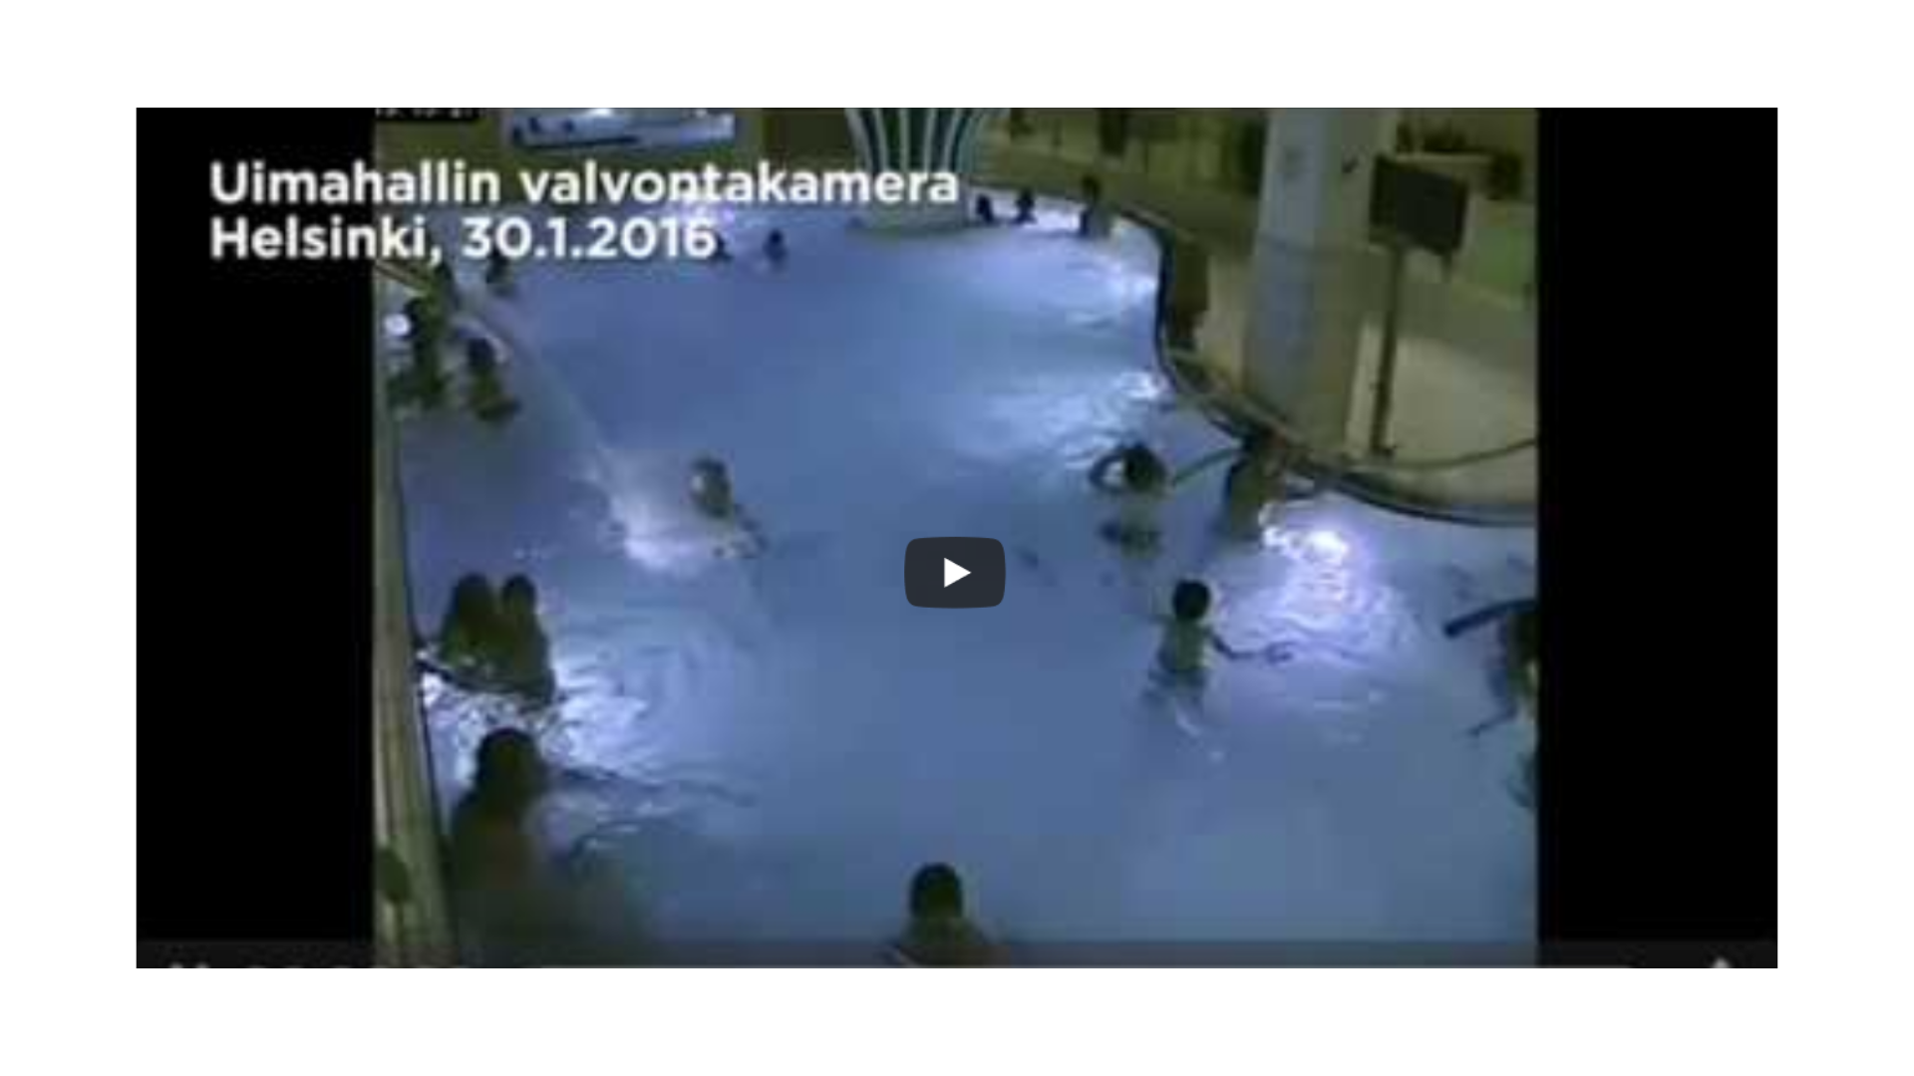
Notes:
Swimmers ignored a drowning 5-year-old – YouTube

Slide 18
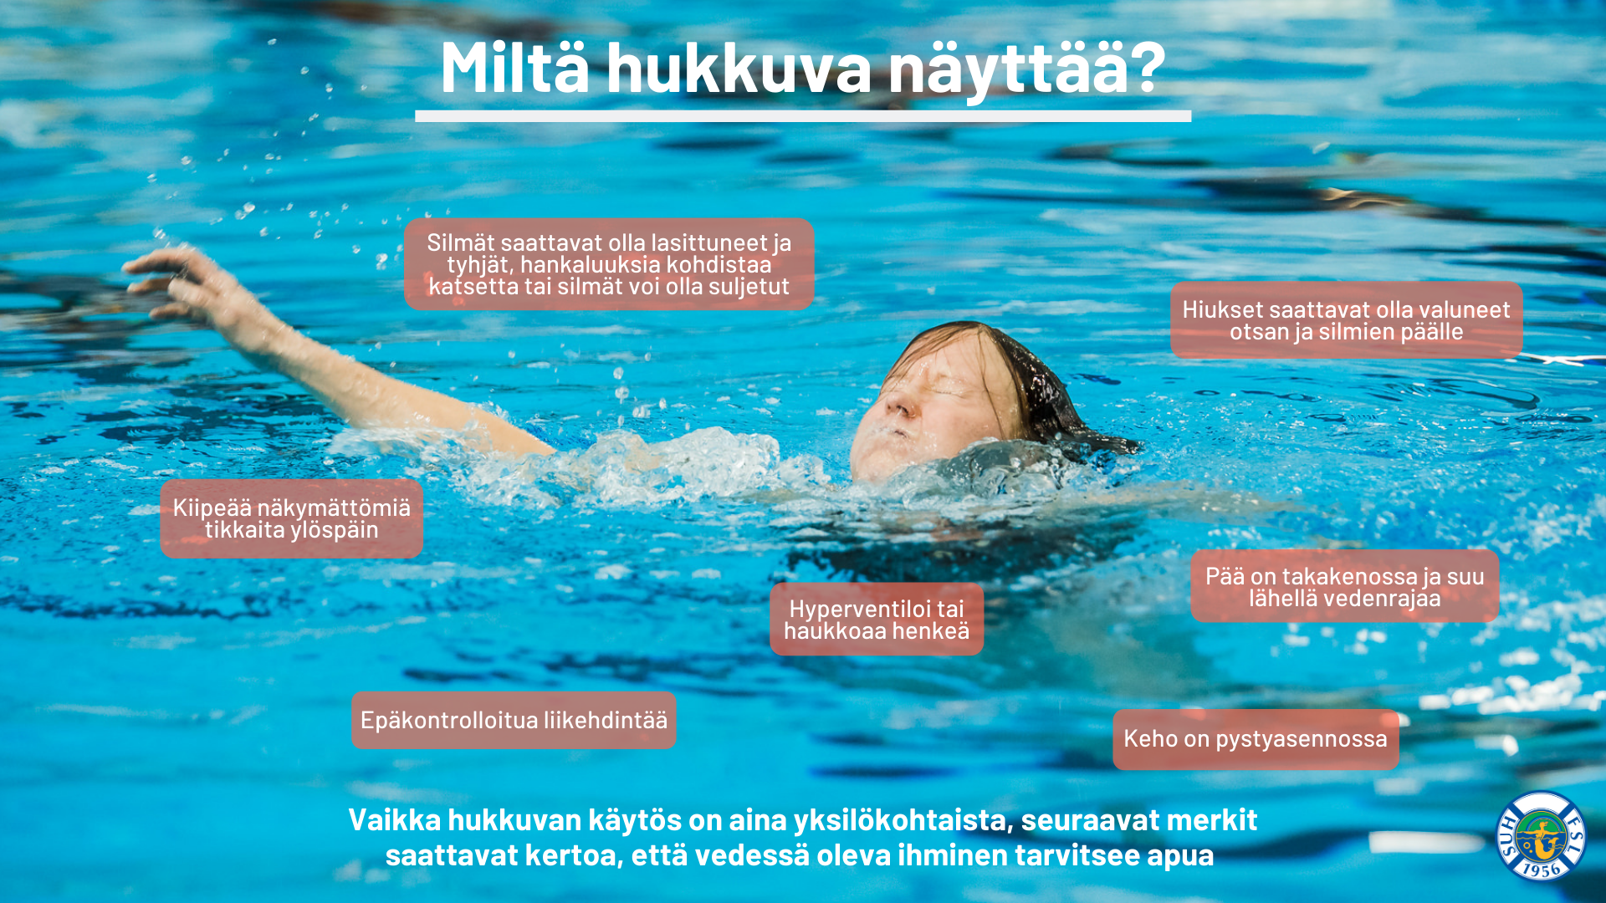
What does a drowning person look like?
Eyes may be glazed and empty, may have difficulty focusing the gaze or eyes may be closed
Hair may have fallen over the forehead and eyes
Climbing an invisible ladder
Head tilted back and mouth close to the surface of the water
Hyperventilating or gasping for breath
Uncontrolled movement
Body in an upright position
Although the behaviour of a drowning person is always individual, the following signs may indicate that a person in the water needs help
Notes:
What can drowning look like?
Although the behaviour of a drowning person is always individual, the following signs may indicate that a person in the water needs help.
A drowning person may have their head deep in the water, their mouth at the level of the water surface, some may have their head tilted back and their mouth open.
Eyes may be glazed and empty, may have difficulty focusing the gaze or eyes may be closed. Their hair may have fallen over the forehead and eyes.
A person in distress is in an upright position and not using their legs.
They are hyperventilating or gasping for breath.
A drowning person may try to swim in a certain direction, the movement is uncontrolled.
They may also try to push themselves out of the water and are barely above the surface.
A drowning person may look like they are climbing an invisible ladder.

Slide 19
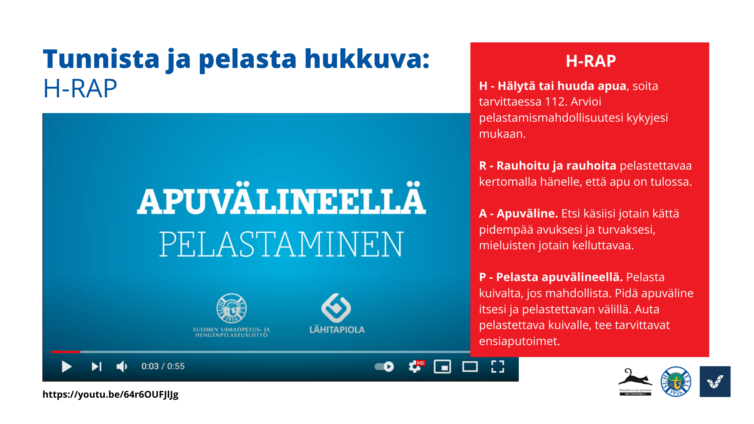
RESCUE STEPS
Call or shout for help, call 112 if necessary. Assess your chances of rescuing the person based on your abilities.
Stay calm and reassure the person being rescued by telling them that help is on the way.
Tool. Find some tool to help you and keep you safe, preferably something that can keep you afloat.
Save the person by using the tool. Save from dry land, if possible. Keep the tool between yourself and the person being rescued. Help the person onto dry land and perform first aid, if necessary.
Spot and rescue a drowning
person: Rescue steps
H
h
https://youtu.be/64r6OUFJlJg
Notes:
Steps for rescuing a person from water
Call for additional help if at all possible before you start the actual rescue. This will ensure that there is additional help.
Stay calm and reassure the person being rescued by telling them that help is on the way. This will give the person being rescued a sense of security and the strength to hang on for a while longer.
Find a tool to help you and keep you safe, preferably something that can keep a person afloat. If the circumstances are difficult, seek help from others on the scene or call 112.
Rescue: approach the person carefully but swiftly. Keep the tool between yourself and the person you are rescuing and reach it out to the person if they are close to the shore. You may also throw the tool to the person. Help the person to the shore, provide the necessary first aid and take them for further treatment if necessary.
Rescue with a tool – YouTube

Slide 20
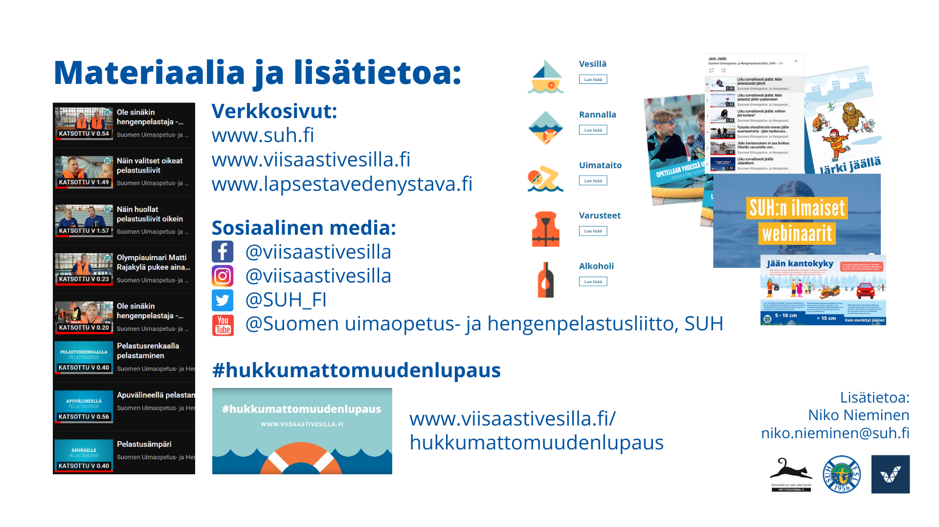
Materials and further information:
Websites:
www.suh.fi
www.viisaastivesilla.fi
www.lapsestavedenystava.fi
Social media:
@viisaastivesilla
@viisaastivesilla
@SUH_FI
@Suomen uimaopetus- ja hengenpelastusliitto, SUH
#hukkumattomuudenlupaus
Further information:
Niko Nieminen
niko.nieminen@suh.fi
www.viisaastivesilla.fi/
hukkumattomuudenlupaus
Notes:
Videos and webinars on YouTube
Online mini-courses of the #hukkumattomuudenlupaus campaign
Tips and current information via social media
More information on water and ice safety on websites, in particular viisaastivesilla.fi
For children and schools: www.vesiturvallisuus.fi
I have usually actually shown these websites, shared the screen and browsed a bit of the Viisaasti vesillä site and YouTube, etc.

