Slide 1

Prevention of home and leisure accidents – tasks

Slide 2
Tasks and exercises
Task
1-2 Accidents in general
3-5 Falls and fall risk assessment
6-7 Slips
8-9 Falls from a height
10-11 Physical activity habit assessment
12 Functional exercise
13-15 Home safety
16 Fire safety
17-18 Water safety
19-21 Bringing up the subject
22-23 Memory disorders and accidents
24 Safety Coach bag

Slide 3
Task 1. Discuss in groups/pairs
How many accidents occur in Finland each year?
Where do accidents occur most often?
What is the most common type of accident?
Could they be prevented? How? Any experiences?

Slide 4
Task 2. Use of accident indicators at events
In groups/pairs, look at the Safety Coaches’ guidelines on the use of accident indicators.
Select one or more indicators you want to examine.
Next, select the areas you want to include in the examination.
Discuss what you observe from the results.
Notes:
The instructions are available in the Safety Coach Rednet: https://rednet.punainenristi.fi/system/files/page/Turvallinen%20virtuaali%20koti%20ja%20tapaturmaindikaattorit.pdf

Slide 5
Task 3. Falling
Discussion in pairs or groups (2 min) Have you fallen at home? What was the situation? How could you have prevented it?
Discussion (5 min): discussing the participants’ experiences together.
Fall-related
    statistics and theory
    preventive measures (8 min).
If the group is large, you can take 2–3 discussion examples from each group to share.
Leave room for questions.

Slide 6
Task 4. Fall risk assessment
In groups or pairs, take a look at the electronic self-assessment questionnaire on the risk of falling.
The purpose of the questionnaire is to carry out a rough estimate of your risk of falling. Answer the following questions by selecting the option that best describes you.
Based on the answers, the person receives a rough estimate of their risk of falling.

Slide 7

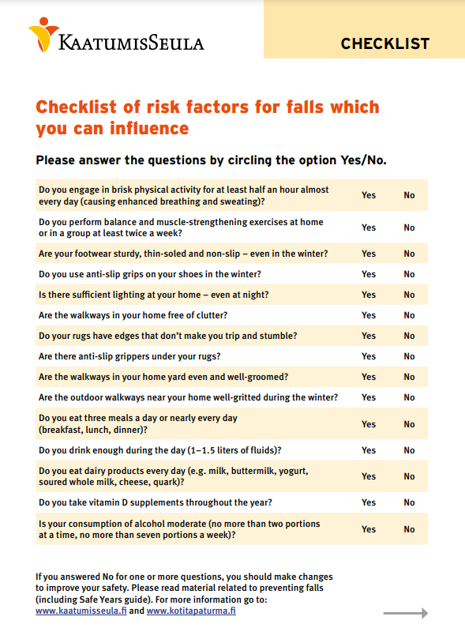
Task 5. Fall risk assessment
In groups or pairs, look at the checklist of risk factors for falls, either on the computer or on paper.
The list contains risk factors for falls that everyone can influence themselves and thus have an impact on their own risk of falling.
Discuss the answers together and suggest changes to reduce the risk of falling.

Slide 8
Task 6. Checking your winter footwear
Take off your shoes.
Check the suitability of the sole for winter conditions.
Make use of the Kengät kelin mukaan brochure and the following slide on criteria for safe winter footwear.

Slide 9
Criteria for safe winter footwear
The heel is low and wide, with a slanted and textured rear edge.
The sole is flexible and made of a soft and porous material.
The sole has a pronounced, criss-cross pattern at least 5–8 mm deep. The grooves in the sole pattern are open on the sides.
The heel is textured and made of soft material.
Notes:
The criteria for safe winter footwear can be discussed in task 4.

Slide 10
Task 7. Slip prevention
Find out about different products that make walking in winter safer:
Anti-slip protection
Studded shoes
Hip protectors
Walking sticks and poles
Make use of the materials on pysypystyssä.fi and in particular the infographic on the different footwear and anti-slip options.
It is a good idea to make use of the contents of the Safety Coach bag.

Slide 11
Task 8. Discussion in pairs, falls from a height
Why do falls from a height occur?
Could they be prevented? How? Any experiences?
The following slides describe the factors involved in a fall and give examples of cases that can be addressed in the discussion.
Notes:
After the discussion, the trainer can review the general factors associated with falls and go through the most typical examples (slides 2–4).

Slide 12
Task 9. Discussion in pairs, falls from a height
Why do you climb high?
How do you prepare for climbing?
How can you climb safely?
The following slides describe the factors involved in a fall and give examples of cases that can be addressed in the discussion.

Slide 13
Factors associated with falls
Falling off ladders and ladders tipping over when they are not firmly in place.
Work on roofs or other high places without a safety harness.
Falling from an aerial work platform, balcony, pier, sauna bench or other platform (railing too low).
Falling off a chair, stool or stepladder.
Falling down the stairs or off the bed.
Poor working position, such as having to reach.
In families with children, also stairs, shelves, windows, etc.

Slide 14
Examples of falls from a height 1
A person fell off a ladder while demolishing a barn alone.
A ladder that had been laid against the wall slipped to the side, causing the person to fall to the concrete floor.
A person was working on the roof without a safety harness. They probably lost their balance and fell to the ground from a height of 6 metres.
A person was repairing a tin roof and fell from an aerial work platform (safety railing 110 cm, poor working position).
A person lost their balance and fell from the balcony of their home (railing 105 cm).
A rider fell off their horse and suffered a hip injury.

Slide 15
Examples of falls from a height 2
A person with reduced mobility was walking alone on weak ice, the ice cracked, and the person fell through.
A person was alone in the sauna and fell from the benches, sustaining a serious injury.
A person is staying the night at a friend’s home and goes to the bathroom at night. The corridor is dark and the layout unknown; the person falls down the nearby stairs.
A person loses their balance in a boat and falls head first into shallow water.

Slide 16
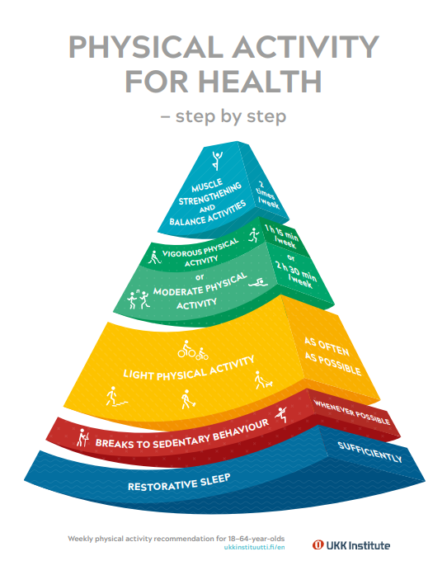
Task 10. Physical activity habit assessment
Together, assess the physical activity habits of an “imaginary person” and thereby familiarise yourselves with the tool and the physical activity recommendation
OR
Each participant assesses their own physical activity habits (if everyone has a smartphone)
Objective:
  To assess current physical activity habits
  To compare the habits to the physical activity recommendations

Slide 17
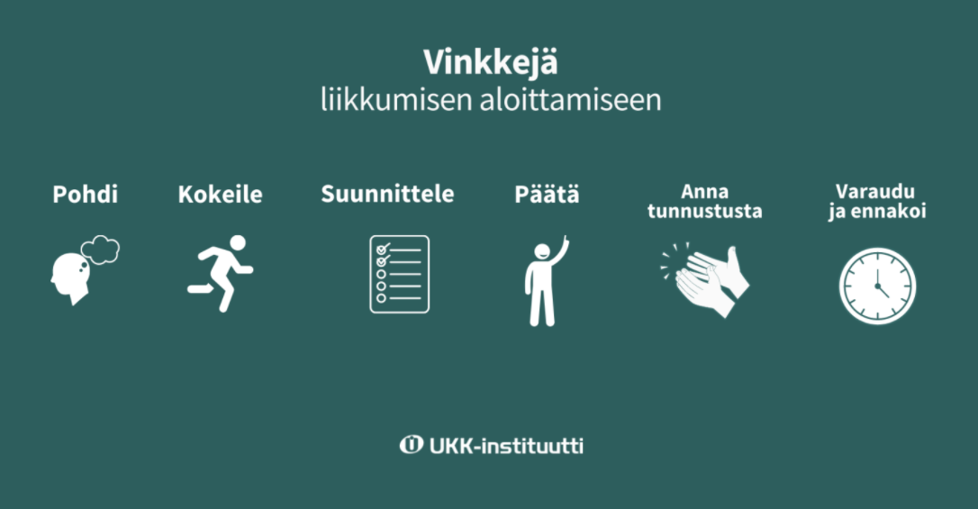
Task 11.
How do I start moving?
Tips
for starting physical activity
In groups/pairs, consider the question: what do you think about physical activity?
How can you incorporate physical activity into familiar everyday situations that are important to you?
Make use of UKK Institute’s tips on how to start moving
Prepare
and anticipate
Reflect
Try
Plan
Decide
Acknowledge
Notes:
https://ukkinstituutti.fi/liikkuminen/vinkkeja-liikkumiseen/miten-lahtea-liikkeelle/

Slide 18
Task 12. Functional exercise
Teach the group a short example of how to improve balance and/or muscle strength in everyday life, either with the following slides or by using the videos on strength and balance training (four videos on YouTube, Strength in Old Age)
https://www.youtube.com/playlist?list=PLSGkbeFujqqHZT7pHktH6-eEGxTbGs0J7
Notes:
The following slides provide some ideas for exercises

Slide 19


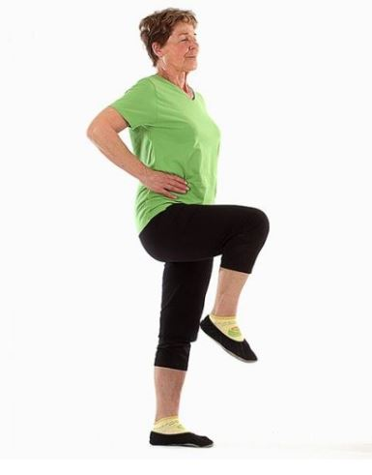
Balance exercise: ‘Rooster step’
Starting position
Stand with your feet slightly apart and hands on your hips.
Exercise description
Lift your right leg up with the knee bent and straighten the knee. Bend the knee and lower the leg. Repeat a few times and then switch legs.
Things to note
Keep your back straight and your supporting leg slightly bent.
Grounds for the exercise
The exercise strengthens the thigh muscles and improves balance.
Notes:
Note: for an extra challenge, you can, for example, stand on your toes, swing your arms or do the exercise with your eyes closed. http://paakallokelit.fi/?one_page_portfolio=kurkiseisonta
You can find more balance exercises here, for example: http://www.liukastumis.info/turvallisempikaatumistapa_tasapainoharjoitteita.html

Slide 20
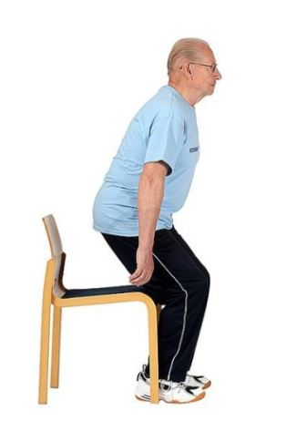
Balance exercise: ‘Jump-start’
Starting position
Sit up straight at the edge of the seat.
Exercise description
Lean your upper body forward and stand up. Sit back down very slowly. Repeat a few times.
Things to note
A sufficient forward lean makes it easier to both stand up and take your time when sitting back down.
Grounds for the exercise
The exercise strengthens your leg muscles and makes it easier to stand up.

Slide 21
Task 13. Home safety
In groups or pairs, have a look at the home safety checklist, which can be completed online.
Also take a look at the safety checklists for different age groups and those that can be downloaded or ordered from the material bank.
Discuss how you could use the checklists.
How often should the lists be updated?
Notes:
The safety checklists for different age groups are available in Finnish, Swedish and English.
The checklists for children’s safety are also available in Arabic and Somali, and the checklist for an older person’s safety is also available in Russian.

Slide 22
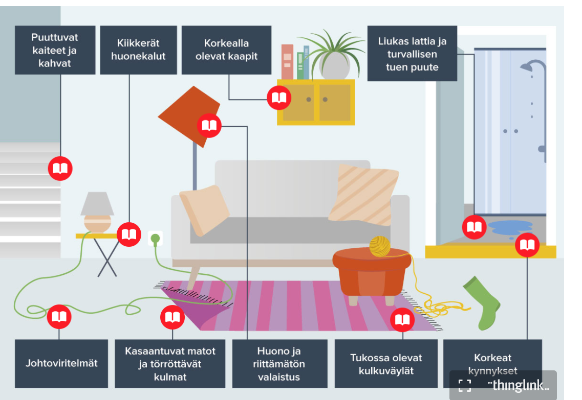
Task 14. Home safety
Lack of railings and handles
Unstable furniture
Cabinets too high
Slippery floor and lack of safe support
Take a look at the most common hazards at home with the help of this picture by the UKK Institute.
Think about how these things function in your own home.
If you had to choose one remedy, what would it be?
Cords lying underfoot
Bunched-up rugs and protruding corners
Poor and inadequate lighting
Obstructed pathways
High thresholds
Notes:
The icons on the picture open explanations of each point

Slide 23
Task 15. Sharp and hot objects
Discuss in groups/pairs what kinds of sharp objects you have at home.
What are they used for?
How often are they used?
Are they hazards?
Where do you store them?

Slide 24
Task 16. Fire safety
In groups/pairs, think about at least two of these questions
  Why should you not go into a stairwell or other space if there is smoke?
  Why is there so much talk about fires when more people die of falls?
  How have I handled fire safety in my own home?
  What could I do better?
  Am I able to exit my home via the emergency exit within 2–3 minutes of hearing the smoke alarm?
  Why should the smoke alarm be on the ceiling?

Slide 25
Task 17. Water safety: Discuss in pairs
Have you or a loved one had a near miss on the water?
What happened? Could it have been prevented? How?
How could water safety be improved?

Slide 26
Task 18. Discussion
Watch the videos and discuss:
Can you identify when a person is drowning?
Sport the drowning – Youtube video
Spot and rescue a drowning person
Notes:
Watch the video,
discuss together:
Can you spot the drowning person?

Slide 27
Task 19.
Distribute slips of paper with these headings on tables:
  Identifying risks
  Increasing knowledge
  Attitude change
  Changes in behaviour
  Safe products
Envelopes with individual words / pairs of words.
Ask the participants to put the words under the headings in order of importance (including the headings).
See where the answers are different/similar.
Discuss the topic.

Slide 28
Task 20. Broaching the subject
How do I broach the subject of safety with my family and friends?
Example: You go to visit a friend (aged 75+) and find that the rugs are slipping. How do you bring up the fact that your friend’s floors are dangerous?
Notes:
Can you do something to help them?

Slide 29
Task 21. Broaching the subject
You have asked a friend to help you repair the roof of your cottage. You suggest wearing a safety harness, but your friend says that there is no need.
How do you bring up the importance of wearing a safety harness?
How do you personally feel about safety advice?

Slide 30
Task 22. The many facets of memory disorders
Memory disorders affect the brain and, as they progress, bring a wide range of symptoms that also affect everyday safety and the risk of accidents.
What kinds of memory disorder symptoms do you know of?
What kinds of safety risks might a memory disorder pose at home?
How could the risks be mitigated?

Slide 31
Task 23. A person with a memory disorder getting lost or disappearing
Watch the video of Preventing people with memory loss from getting lost on YouTube.
What do you do when you find a person with memory loss who is lost?
  Encounter – What do you say? How can you be present in the situation?
  Follow-up – What do you do next?

Slide 32
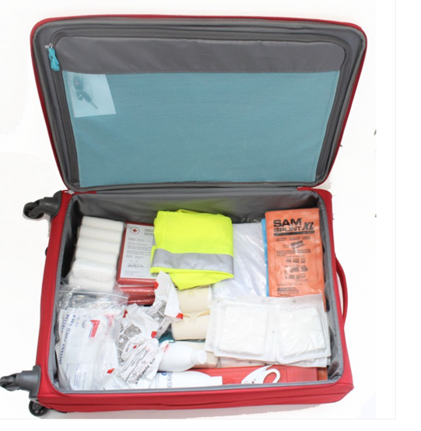
Task 24. Safety Coach bag
The bag contains essential everyday safety tools and examples of accident prevention materials that can be used to help you identify accident risks.
Get to know the contents of the Safety Coach bag

