Slide 1

Prevention of home and leisure accidents
– Slips and falls
The content is based on the content of the project for the prevention of home and leisure accidents

Slide 2

Accidental falls resulting in death in 1998–2020
Total
Men
Home safety coaching, Statistics Finland causes of death
Notes:
They account for about half of all accidental deaths at home and in leisure activities.
Men and women are nearly equally likely to die of falls, with a total of around 1,200 deaths per year.
Slight increase over the last two decades, although the trend has been more positive in recent years
The majority of falls occur among people aged 75 or older.
One in two people over the age of 80 falls every year, one in three over 65.
Among the very oldest people, women fall more often than men.
Among people of working age or younger, deaths from falls are not very common.
The situational picture changes when deaths are compared to the size of the population, with a downward trend for both men and women.
The number of deaths from falls starts to rise in the adult population from the age of 45 and peaks at the age of 64.
Total
Men
Women

Slide 3
Accidental falls resulting in death in 1998–2020
men
women
Home safety coaching, Statistics Finland causes of death
Notes:
The majority of falls occur among people aged 75 or older
Among the very oldest people, women have these accidents more often than men
Among people of working age or younger, deaths from falls are not very common
men
women

Slide 4
Factors associated with falls
Internal risk factors for falls
Old age
Female gender
Previous falls
Muscle weakness
Balance problems
Reduced mobility
Reduced ability to function
Reduced vision
Nutritional state
Reduced cognition
Low BMI
Inappropriate medication
Alcohol consumption
Pain
Depression
Dizziness
Other illnesses, incl. Parkinson’s, stroke, diabetes
External risk factors for falls
Poor lighting
Inappropriate shoes
Wet or slippery floor
Items on the floor
Unevenness of the walking surface
Lack of supports or mobility aids
Lack of resting places
FALLING
Situational and behavioural factors
Rushing, alertness, risk-taking, excessive caution, carelessness
Home safety coaching, Chart adapted from Kaatumisen ja kaatumisvammojen ehkäisyn fysioterapiasuositus (2017) Pajala, Satu: Iäkkäiden kaatumisten ehkäisy (2012)
Notes:
IMPORTANT MESSAGE: Falling is not normal and the cause should be investigated.
Risk factors are often divided into internal and external risk factors.
It is possible to influence most internal risk factors, all external risk factors and all situational and behavioural factors.
Most factors can be influenced by the individual, but factors such as age, genetic disorders, etc., are beyond the individual’s control.
The more problems the individual has with their ability to function, the more attention needs to be paid to identifying and addressing hazards at home.
Here you could do an exercise: Talk about different types of risk factors with the group.

Slide 5
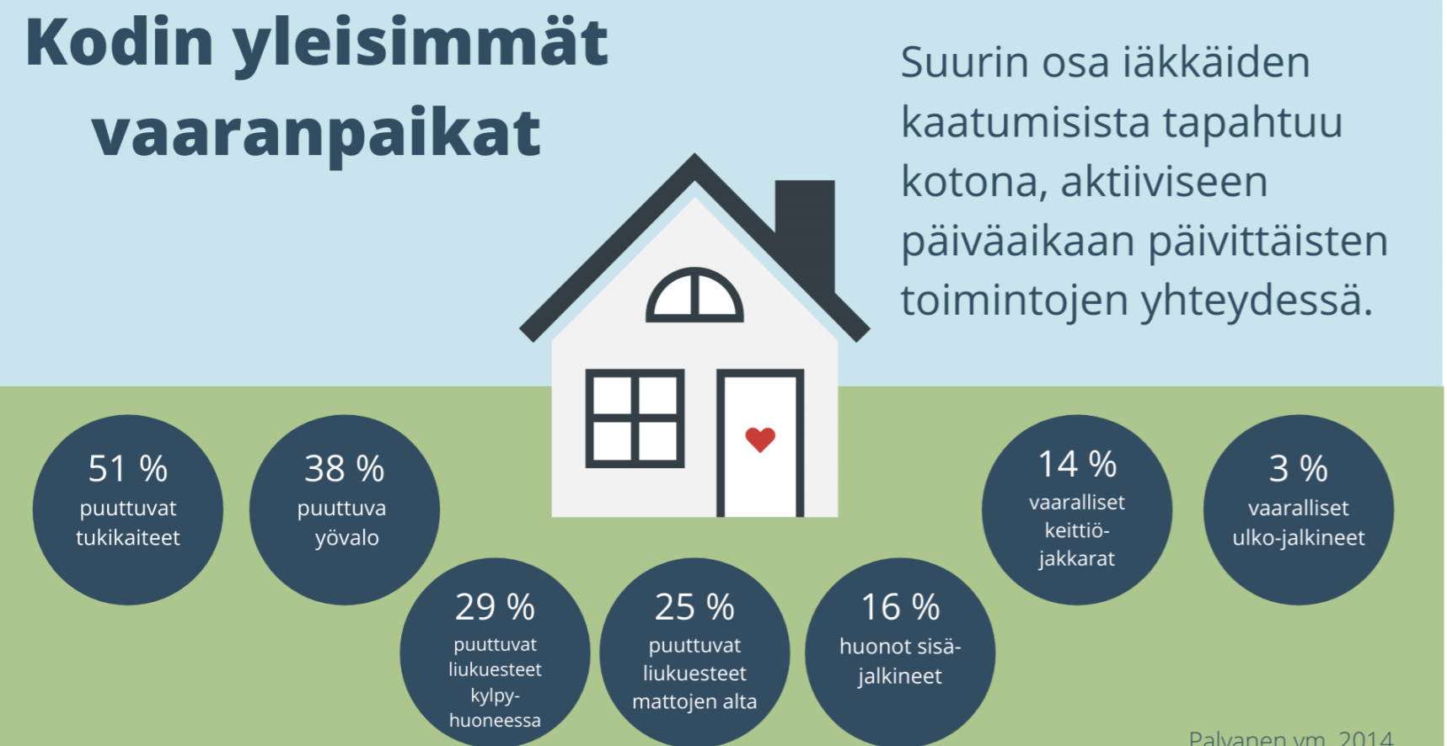


The most common hazards around the house
The majority of falls among older people occur at home, in the daytime during daily activities.
51%
38%
14%
3%
no handrails
no night light
unsafe step stools
unsafe outdoor footwear
29%
25%
16%
no anti-slip protection in the bathroom
no anti-slip underlays under rugs
poor indoor footwear
Home safety coaching
Notes:
Around 80% of falls occur at home or in the home’s yard.
According to a study, the lack of handrails and the lack of night lights are the most common risk factors identified.

Slide 6
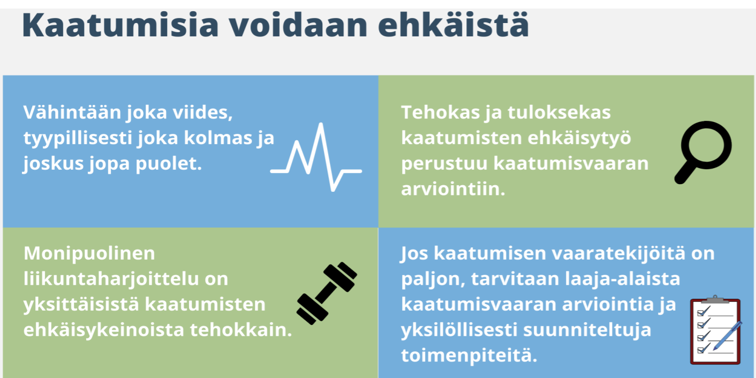



Falls can be prevented
At least one in five, typically one in three and sometimes even one in two.
Effective and successful fall prevention work is based on the assessment of the risk of falls.
Varied physical activity is the single most effective means of preventing falls.
If there are many risk factors for falls, a comprehensive fall risk assessment and individually tailored measures are needed.
Home safety coaching
Notes:
IMPORTANT MESSAGE: falls can be prevented!
A fall risk assessment can be carried out by anyone.
Later, we will learn about the KaatumisSeula material, which can be used in the fall risk assessment.

Slide 7
Be prepared: identify risks, prevent falls
Identify the factors associated with falling.
Consider measures that can
  partially or completely eliminate risk factors
  reduce their impact by increasing safety.
Notes:
What are the factors that increase the risk of falling for this particular person?
What can they do themselves to reduce the risk?
Close relatives know the older person’s habits and environment and can identify places that may be dangerous. It may be easier for an older person to talk about things such as their fear of falling to a loved one than to a doctor, for example.

Slide 8
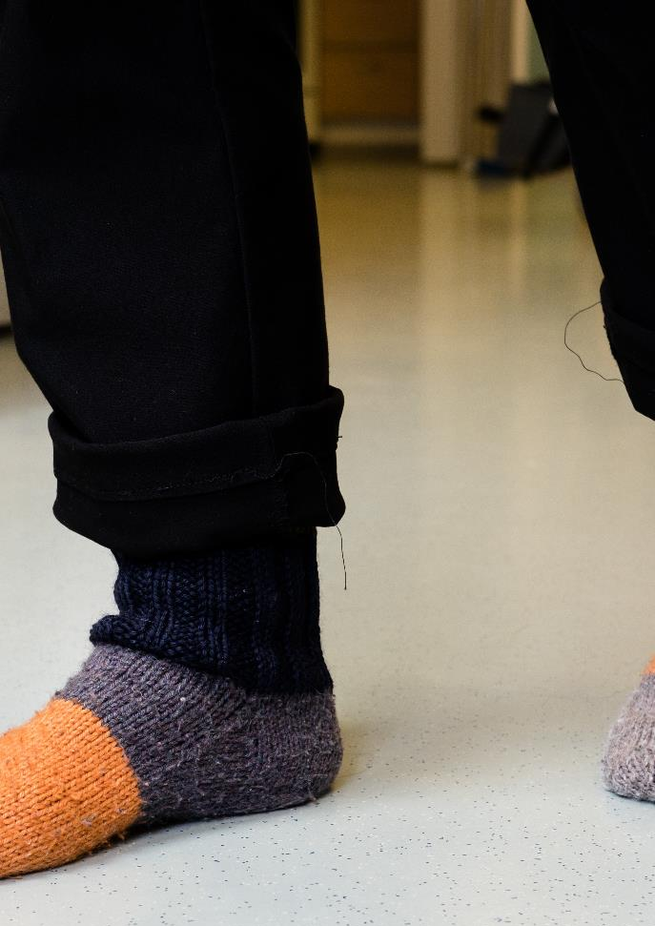
Falling accident prevention
Accessibility and tidiness: no extension cords or objects on the floors.
Anti-slip rug underlays, anti-slip mats on the bathroom floor or anti-slip floor treatment.
Clearly visible & distinguishable steps and anti-slip stickers on interior stairs.
Handrails on staircases.
Any thresholds should be removed or lowered and any loose cables fixed to the wall.
Notes:
Tip for the trainer: you can have the participants do this in groups. Ask the group to think about how to prevent falls at home.
For example, divide the participants into four groups and give each group one topic from the slide.
For example, lighting for group 1, pathways for group 2, etc.
The groups can write their answers on a flip chart or other paper and the discussion can be carried out in several ways, e.g. with each group presenting what they have come up with. Another way is to display the results on a wall and have the groups go around reading them and potentially complementing each other’s answers.
If there is a need for a refresher, more detailed slides are available in the additional materials for Safety Coaches.

Slide 9
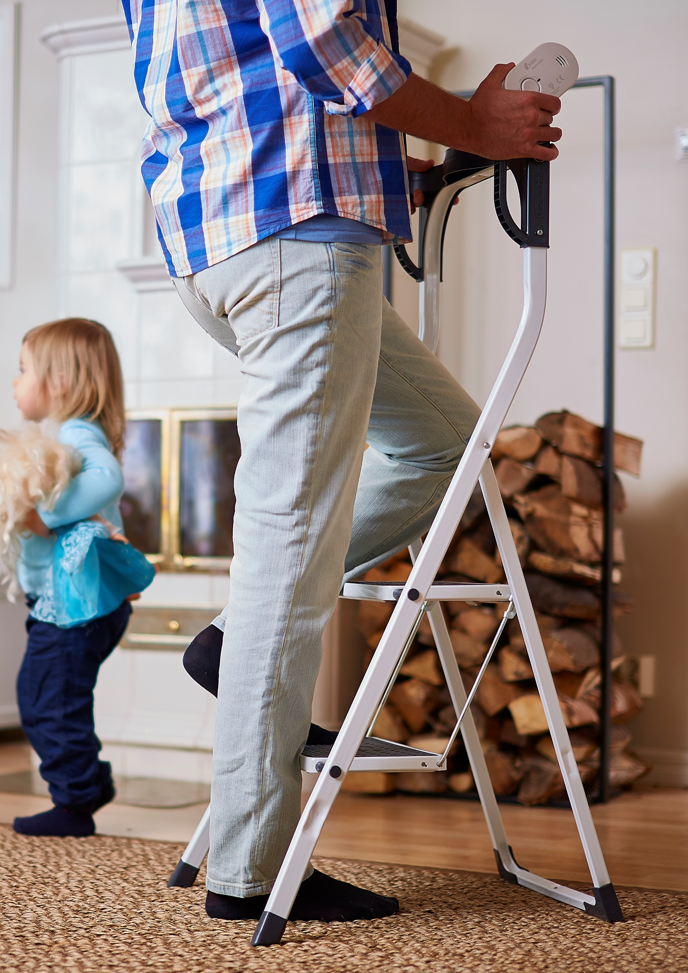
Falling accident prevention
A sturdy seat near the front door where you can take off and put on your shoes and other outdoor clothing.
Sufficient lighting, especially in the courtyard and staircase, and a night light where necessary.
A sturdy step ladder with handles – but also place the most frequently used items and foods within easy reach.
Bookshelves attached to the wall.
Notes:
FALLING FROM A HIGH PLACE
Falling from a height of more than 5 metres or 2–3 times your own height causes serious injuries
For a child or teenager, a fall of just 1–2 metres can cause serious injuries.
Fall injuries are also affected by which part of the body hits the surface first (feet, side, arm, head) and the surface material (e.g. asphalt, grass, snow).
For example, older people can benefit from a smoke alarm, the battery of which can be easily changed without climbing.

Slide 10
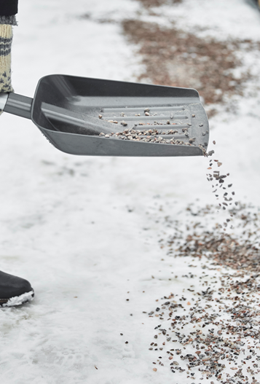
Slip prevention
Wear shoes that are suitable for the road conditions.
Pathways, courtyards: ensure that courtyards are cleared of snow, gritted and adequately lit.
Other aids: e.g. hip protectors and handrails provide support and safety.
When you set off, do not rush, allow sufficient time and move with caution.
Weather warnings for pedestrians are provided by the Finnish Meteorological Institute www.fmi.fi/en.
Notes:
Around 10% of falls.
Every winter month, around 20,000 Finns are injured as a result of slipping outdoors.
Typical injuries caused by slipping include bruises, sprains and arm and leg fractures.

Slide 11
Other aspects related to the prevention of falls
Medication can affect a person’s balance, which should be discussed with a doctor.
Regular vision checks are also recommended.
Disease and injury prevention and good rehabilitation.
Use of the necessary aids.
Shock absorption in the event of a fall, e.g., hip protectors, floor padding.
Varied and regular nutrition. Calcium, vitamin D and protein.
Moderate alcohol consumption.
Mental alertness and mental safety.
Awareness of functional ability, its limits and safety risks.
Notes:
Minimising the use of medical substances that cause a tendency to fall, e.g. sleeping pills, psychiatric medication, particularly benzodiazepines.
Ensuring the best possible vision.
Disease and injury prevention and good rehabilitation, e.g. rheumatism, hypertension, diabetes. Acute conditions (e.g. arrhythmias, infections, as well as long-term conditions such as joint problems, osteoporosis treatment)
Aids such as canes and rollators. Hip protectors, especially for people at high risk of fractures.
Nutrition: Vitamin D and protein deficiencies cause muscular weakness (myopathy). Protein: 1g/kg/day. For people over 75 years of age, a vitamin D supplement of 20 µg/day is recommended throughout the year.
Mental alertness and mental safety: outdoor activities, hobbies, friends, clubs, etc.
Awareness of functional ability, its limits and safety risks. For example, support from friends and family to change light bulbs, attention to alertness factors such as fatigue, rushing.

Slide 12
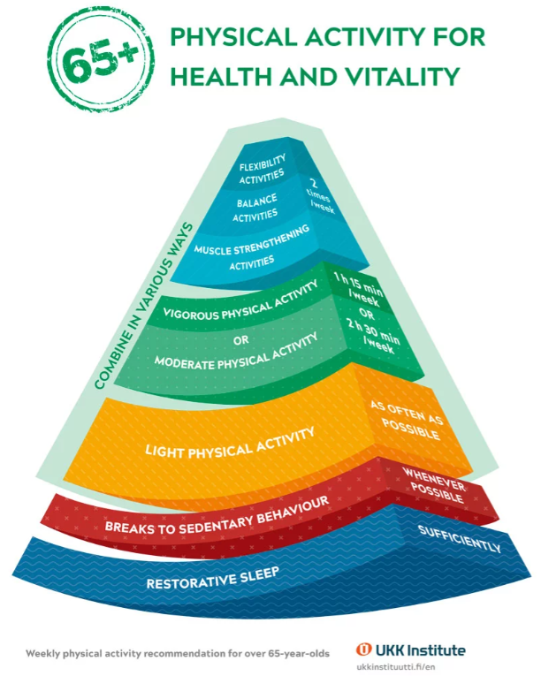
Exercise – the most effective way to prevent falls
A total of 2 hours 30 minutes of moderate physical activity or 1 hour 15 minutes of vigorous physical activity per week.
Muscle strength, balance and flexibility training is recommended 2–3 times per week.
Even a little exercise is good for your health and ability to function, as long as it is regular.
Notes:
The new physical activity recommendation for adults places greater emphasis on the importance of light physical activity, breaks in sedentary behaviour and adequate sleep.
Physical activity, such as walking, is moderate if you are slightly out of breath but can speak in complete sentences.
Physical activity, such as skiing or aquajogging, is vigorous if you are clearly out of breath and can only say a few words at a time.
Balance, muscle strength: many gymnastic exercises work on these qualities at the same time. For example, weight shift exercises, standing on one foot, etc., the gym. Choose your own way to exercise, such as gym, group exercise, yoga, dance or home gymnastics.
https://ukkinstituutti.fi/en/products-services/physical-activity-recommendations/weekly-physical-activity-recommendation-for-over-65-year-olds/
The single most effective way to prevent falls among older people living at home.

Slide 13
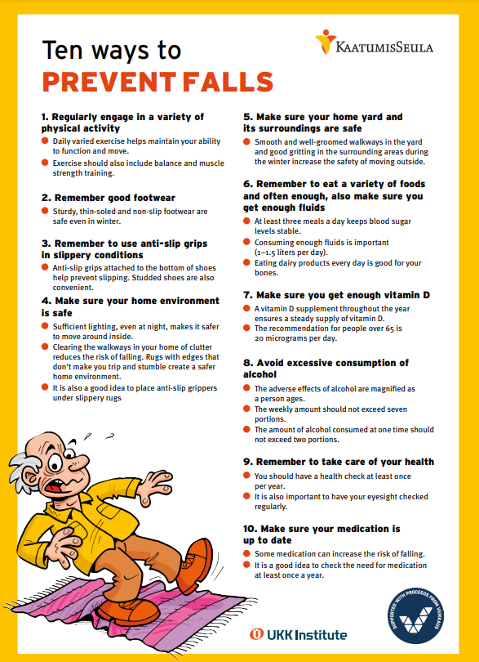
Fall risk assessment
The aim of the fall risk assessment indicators is to improve identification and prompt early intervention.
Fall accident prevention - Health Points
Fall risk assessment form developed in the KaatumisSeula® project
  Based on the older person’s own assessment.
  The online app can be accessed on a smartphone, tablet or computer and does not require downloading or logging in.
Notes:
https://ukkinstituutti.fi/en/products-services/other-health-promotion-materials/kaatumisseula-tools-to-prevent-falls/
Assessment of the fear of falling, the vicious circle of the fear of falling: http://www.ukkinstituutti.fi/ammattilaisille/testaaminen/kaatumispelkokysely
Mainly for professional use: The Finnish IKINÄ model and other fall risk assessment forms

Slide 14
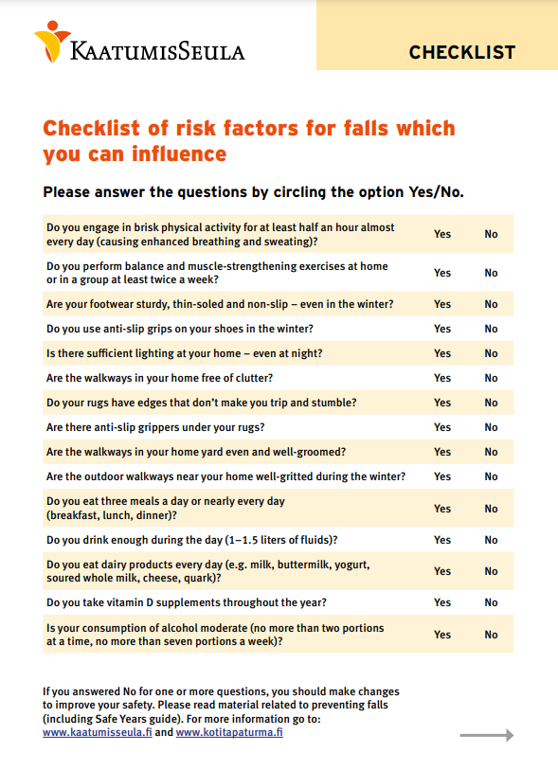
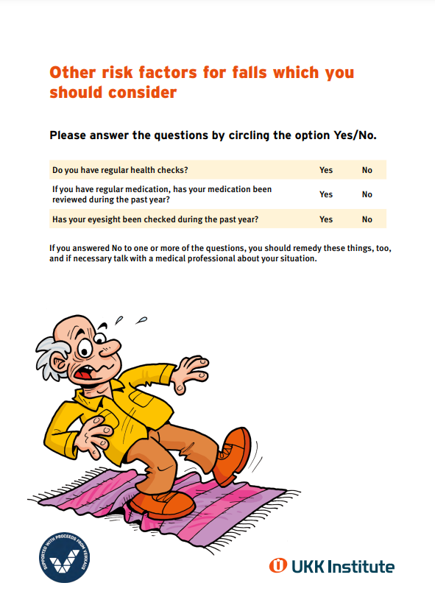
Fall risk assessment
Based on the answers, the person receives a rough estimate of their risk of falling.
If the risk of falling is elevated, the person filling in the form will receive feedback on recommended measures and tips on how to make use of the KaatumisSeula® tools.
Notes:
‘Ten ways to prevent falls’ brochure available
The website also provides more in-depth information on each point: https://ukkinstituutti.fi/liikkumisen-turvallisuus/kaatumisten-ehkaisy-iakkaille-ja-laheisille/kymmenen-keinoa-kaatumisten-ehkaisyyn/
→By clicking on the headings in the list, you can find out more about each prevention method.

Slide 15
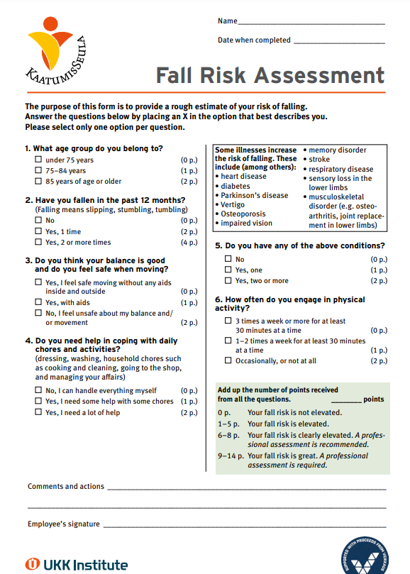
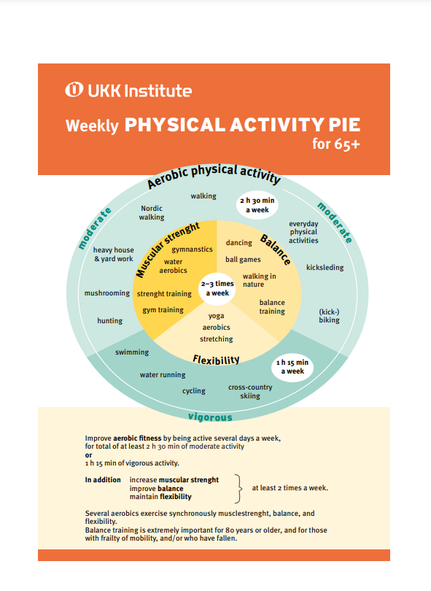
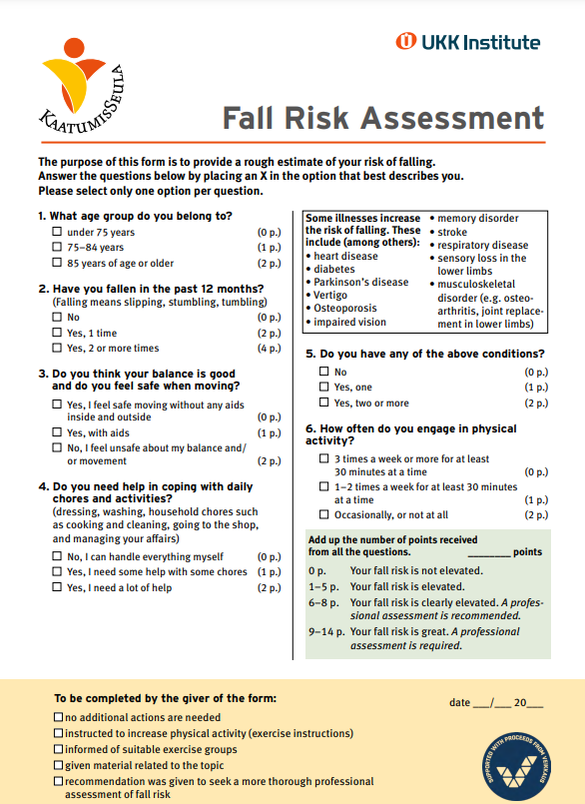
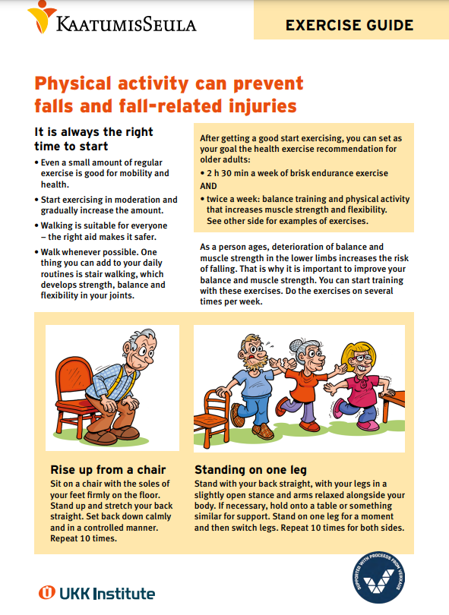
Tools for downloading and printing
KaatumisSeula Tools to Prevent Falls

