Slide 1

Prevention of home and leisure accidents – sharp and hot objects around the house
The content is based on the content of the project for
the prevention of home and leisure accidents

Slide 2
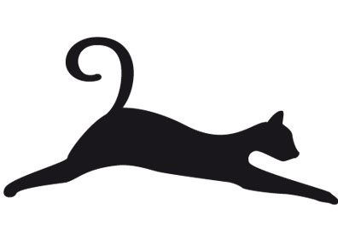
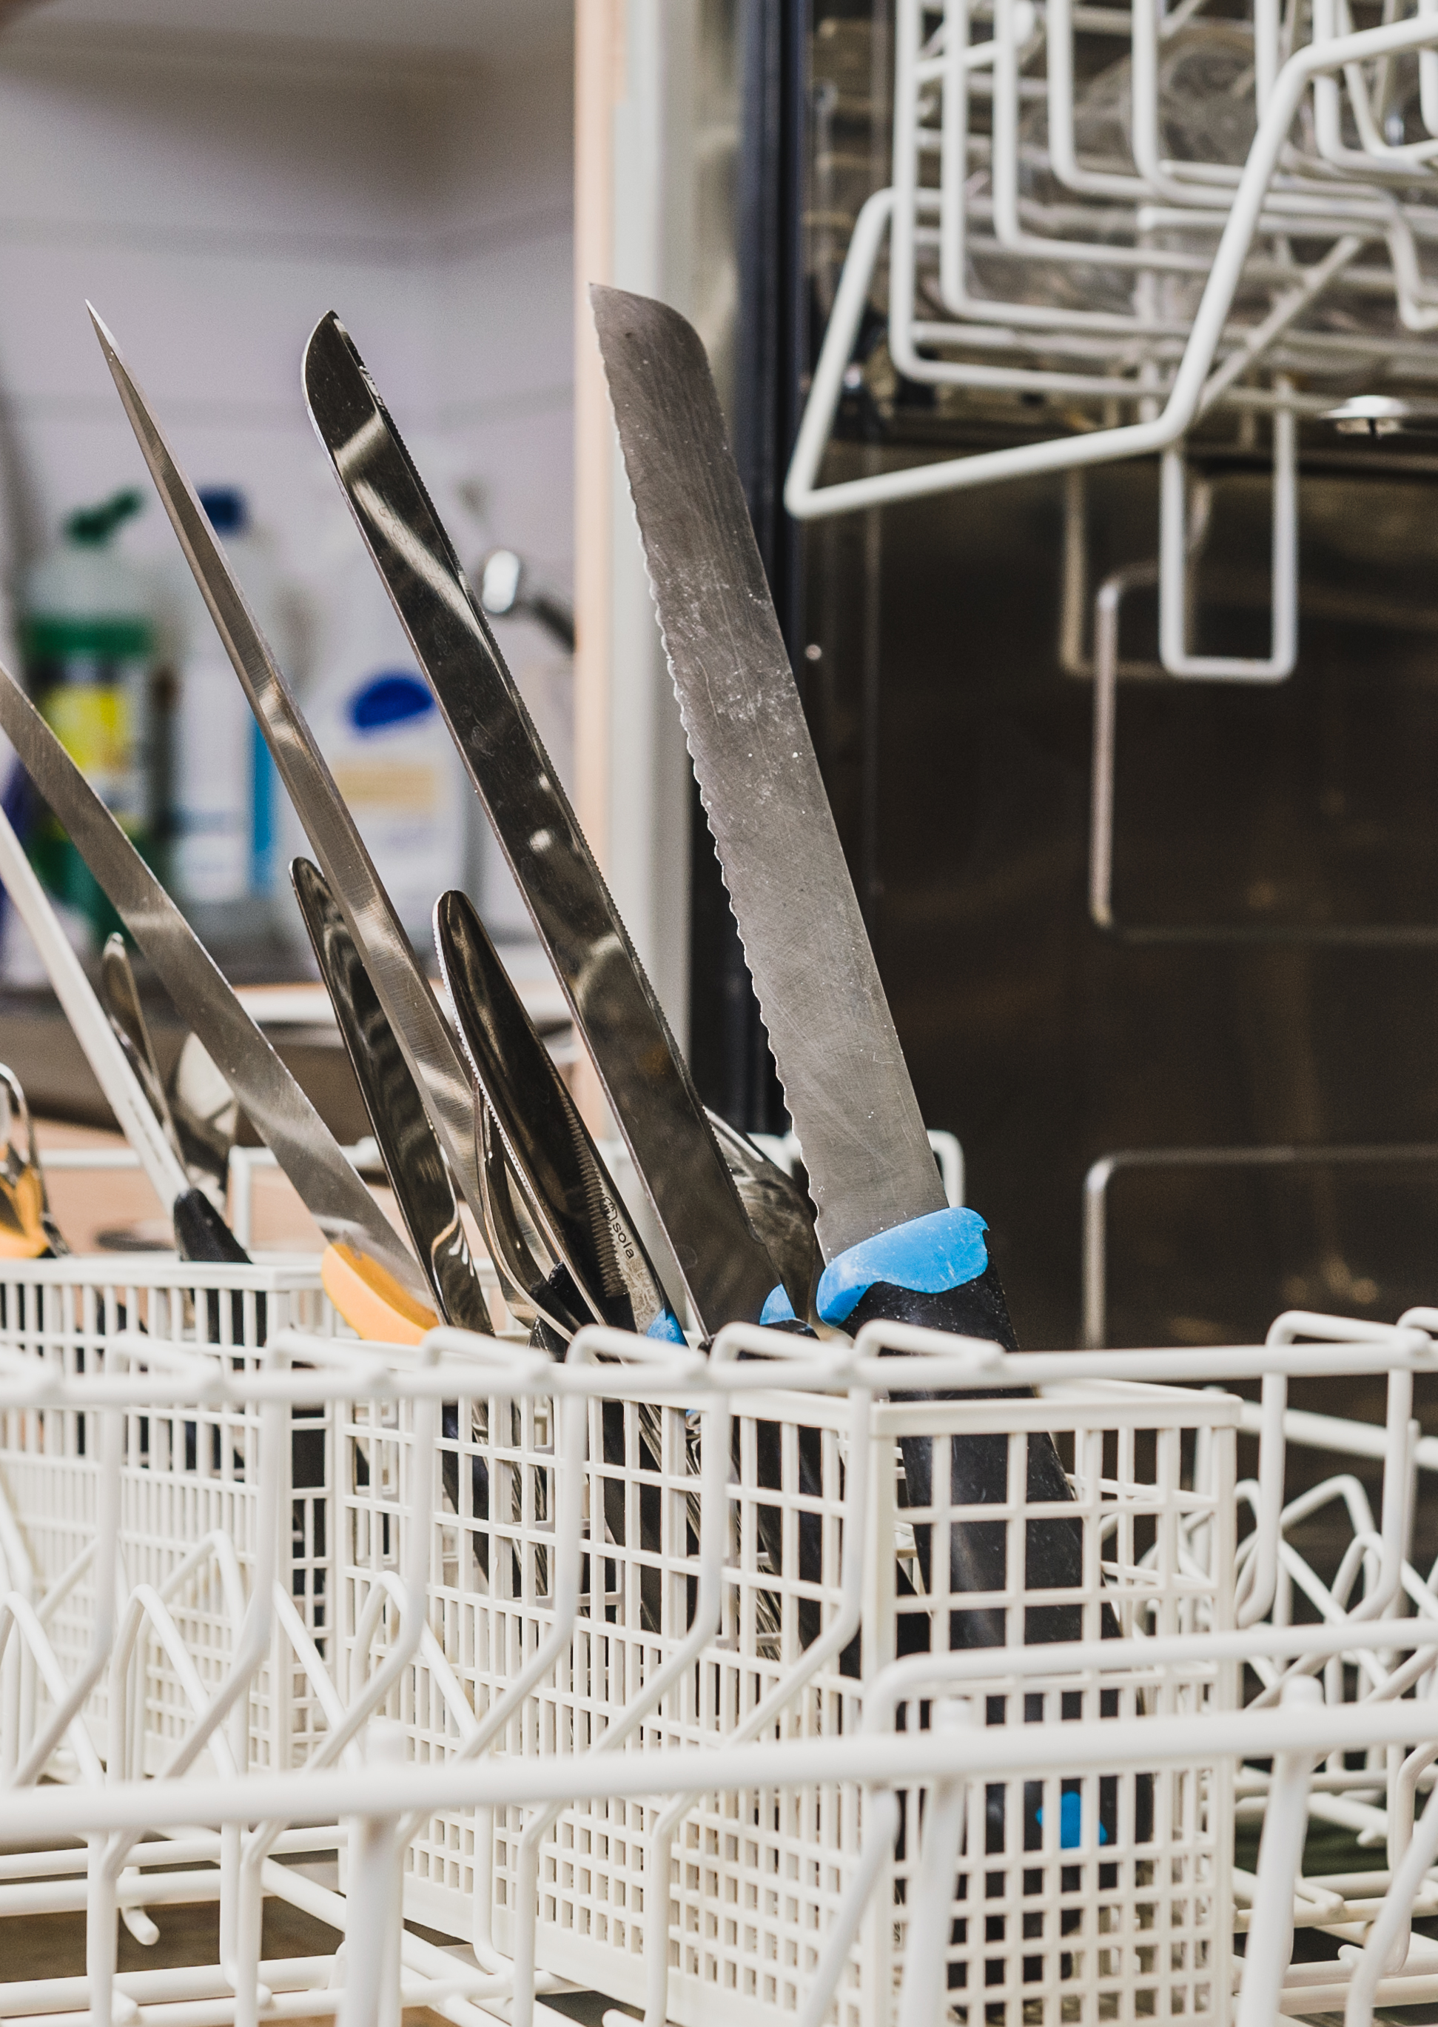
Sharp objects in housework and exposure to heat
Different types of wounds can be caused by the careless use of sharp objects.
Exposure to heat can result in burns.
A burn is tissue damage caused by heat or a corrosive chemical substance, in which damage is caused to the skin and possibly the tissues beneath it. If the skin is not cooled, the injury will spread to the deeper layers.
Tissue damage can be caused by a hot object, liquid or steam. Other causes include a corrosive substance, radiation and electricity.

Slide 3
Factors associated with wounds and burns
Sharp objects:
Various knives, scissors, axes, billhooks, saws, etc.
Sources of heat:
Cooker, steam, oven, barbecue, sauna heater, etc.
Rushing and carelessness during housework.
Insufficient familiarity with the tools.
Impractical facilities, lighting.
Special features of housework in families with children, for older people and for people with reduced functional ability.

Slide 4
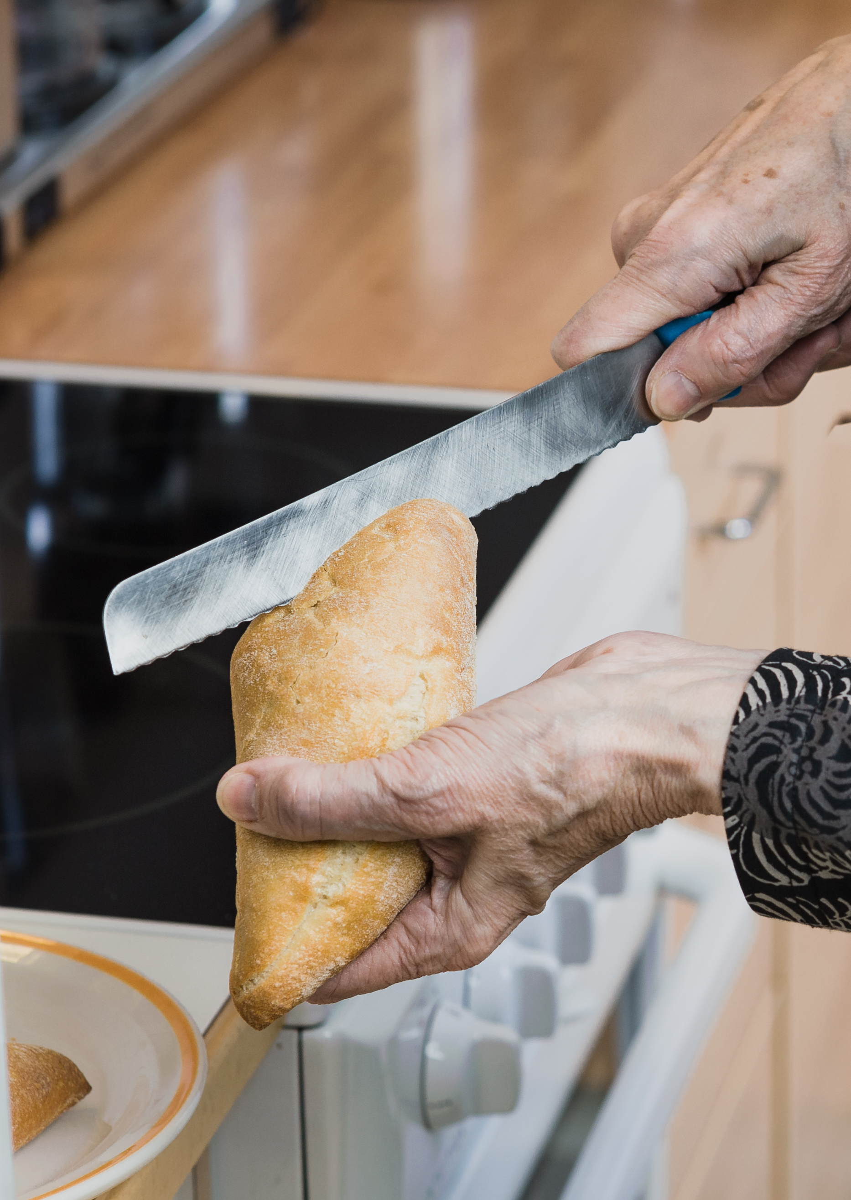
Prevent: identify risks, avoid wounds
Avoid the risks associated with sharp tools, use tools safely.
Familiarise yourself with the safe and correct use of new tools.
Store the tools safely.

Slide 5
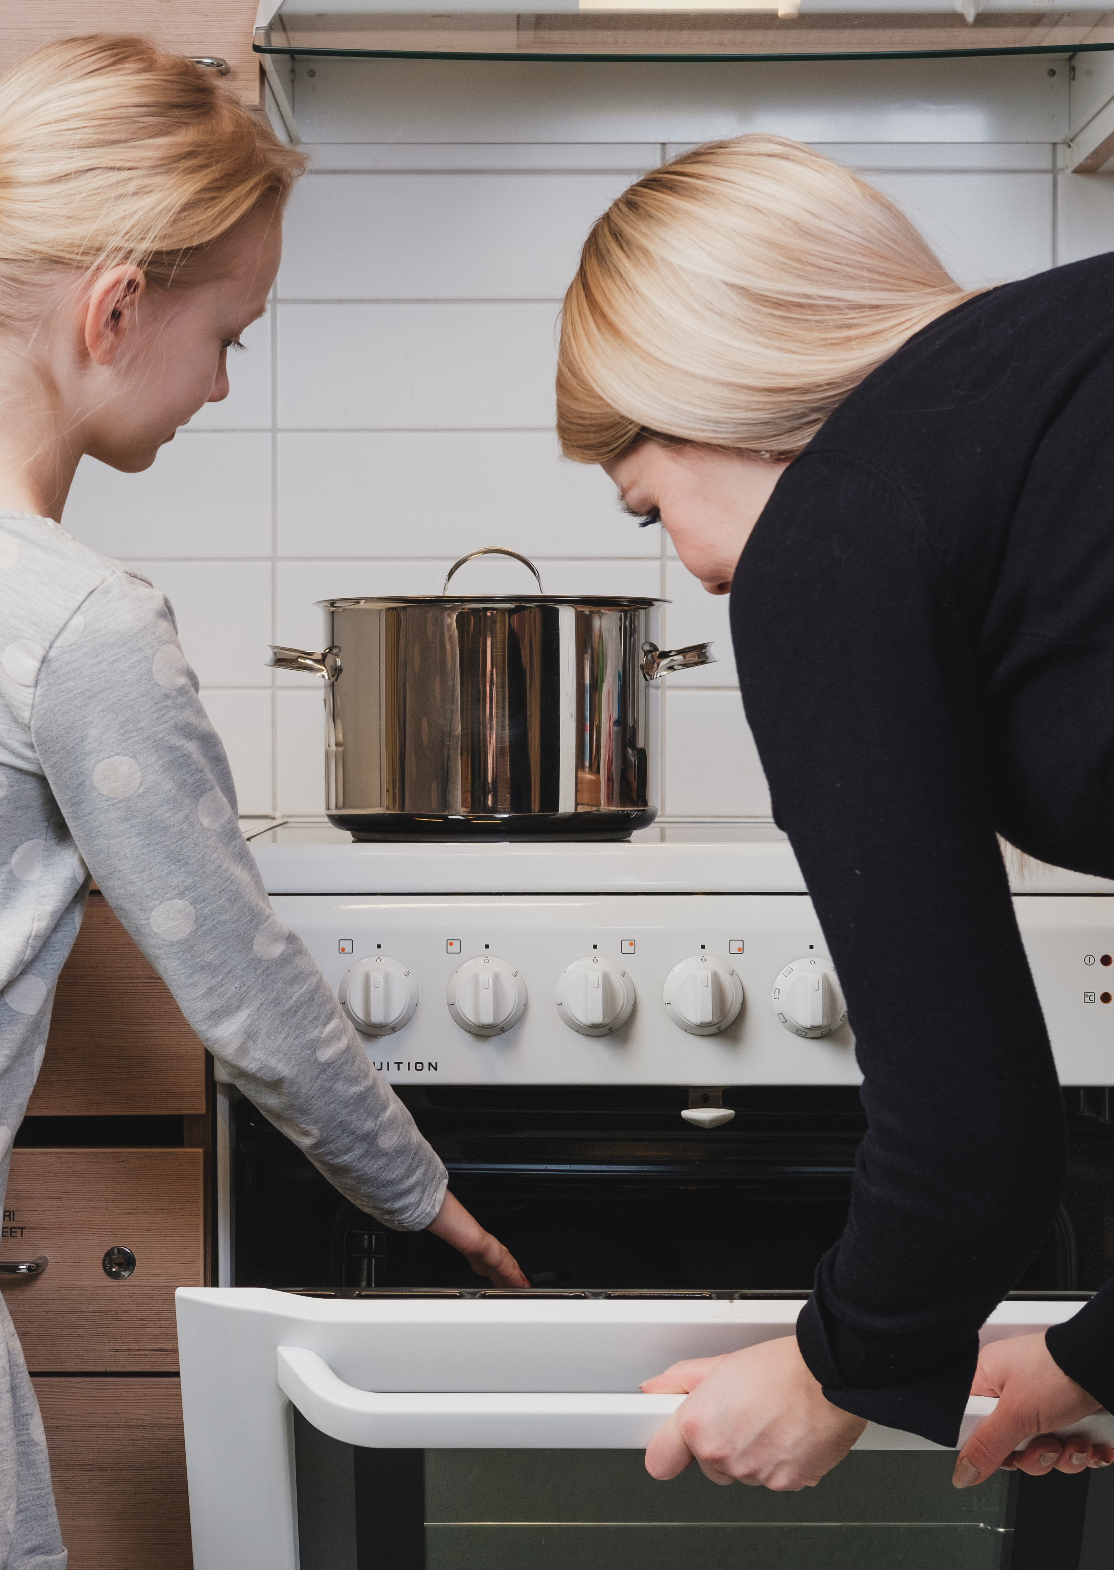
Measures to prevent burns
Prevent burns by avoiding contact with
  hot steam
  the sauna heater
  the iron
  the oven, barbecue.
Take special care when working with hot objects.
Take into account children and people with reduced functional ability.

Slide 6
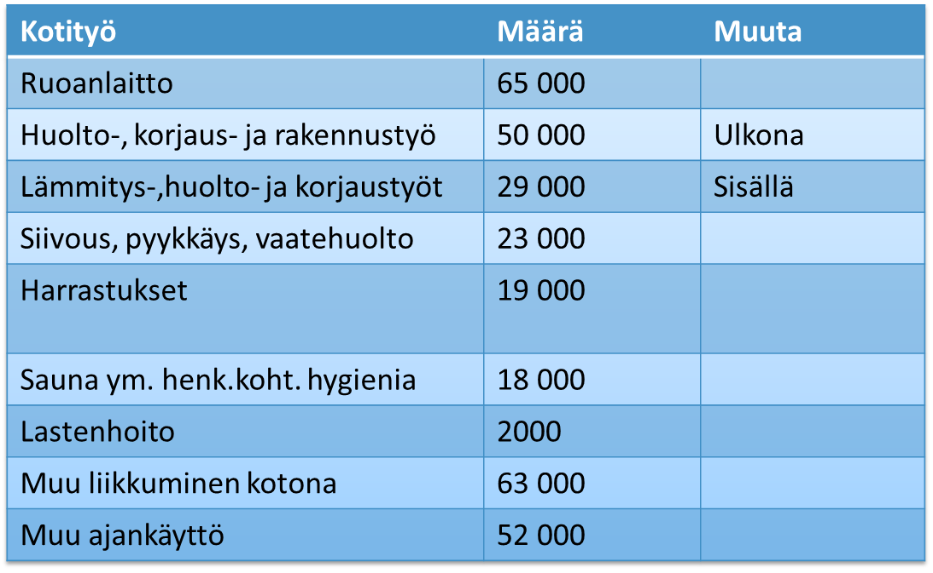
Accidents at home by activity at the time of the accident
Housework | Number of accidents | Other notes
Cooking | 65,000
Maintenance, repair and construction work | 50,000 | Outdoors
Heating, maintenance and repair work | 29,000 | Indoors
Cleaning, laundry, clothing maintenance | 23,000
Hobbies | 19,000
Sauna and other personal hygiene | 18,000
Childcare | 2,000
Other moving around at home | 63,000
Other forms of spending time | 52,000

Slide 7
First aid instructions
Burns
Wounds
How to stop bleeding

