Slide 1

Prevention of home and leisure accidents
– poisonings
The content is based on the content of home and leisure
accident prevention work

Slide 2
Poisoning deaths by gender in 1998–2020
Total
Home safety coaching, Statistics Finland causes of death
Notes:
Broadly speaking, there are two types of poisoning: alcohol and other substances (mainly pharmaceuticals and drugs)
The number of poisonings has decreased slightly from the turn of the millennium to the present.
The peak period was in 2006–2008. Alcohol poisonings spiked in 2005–2008, with alcohol poisonings twice as frequent as other poisonings.
Reasons: Restrictions on alcohol imports from EU countries were lifted on 1 January 2004
and Estonia joined the EU on 1 May 2004. In March 2004,
Parliament reduced the tax on spirits by 44%, beer by 32% and wine
by 10%.
After 2010, alcohol poisonings were about as common as other poisonings (pharmaceuticals/drugs)
The majority of drug-related deaths were accidental poisonings from multiple substances where the effect from drugs was dominant. Often the poisoning is deliberate.

Slide 3
Poisoning deaths by age group
men
Home safety coaching, Statistics Finland causes of death
Notes:
Most common in middle-aged men
Rare in children, no poisoning deaths in children under 15 years of age

Slide 4
Most common poisoning accidents
Among children, those under 3 years of age are the most vulnerable to poisoning accidents
Poisoning is most often caused by
  Medical substances, mushrooms, berries
  Carbon monoxide, gases
  Detergents, chemicals
  Alcohol, other intoxicants
In children aged 0–5, mostly medical substances, plants, detergents and chemicals
In children aged 6–16, mostly alcohol and medical substances
In adults, mostly medical substances, alcohol and chemicals
Notes:
On average, 25 people aged 15–24 die from poisoning each year, 80% of whom are aged 20–24.

Slide 5
Most dangerous household chemicals
Strongly acidic or alkaline detergents
e.g., drain cleaners (lye), oven cleaners
Automotive chemicals
e.g., windscreen washer fluids (methanol!), coolants
Painting products
e.g., solvents, alkaline cleaning agents
Lighter fluids

Slide 6
Poisoning
The severity and speed of appearance of poisoning symptoms depend on the substance and amount, as well as the method by which it entered the body.
Substances can enter the body through the mouth, airways, skin or eyes, or be injected.
Symptoms:
  Nausea, vomiting
  Skin symptoms
  Disorientation
  Headache, dizziness
  Shortness of breath, increased heartbeat
  Seizures, unconsciousness

Slide 7
First aid for poisoning
Poisoning method | First aid
Swallowed: medicine, mushrooms | Do not make the patient vomit in case of a non-irritant substance. Activated charcoal can be administered as instructed on the package.
Breathed in, eg. Carbon monoxide or a chemical | Move to fresh air outdoors, assume position that eases breathing.
Absorbed through skin or mucous membranes | Flush with plenty of water, always see a doctor if the eyes are affected.
Injected, adder bite | First aid to treat the symptoms, for example a hydrocortisone tablet.
Notes:
Breathing difficulties: emergency response centre, go to fresh air when suffering from breathing difficulties.
P.O.: Activated charcoal for non-irritants (good to keep at home, part of a home’s first aid kit). Activated charcoal does not adsorb alcohols or iron, and it should not be used for acid or alkali poisoning (e.g. by washing-up liquid).
Carbon makes examining the mucosa of the oesophagus and stomach more difficult. The patient can drink a small amount of water to dilute the acid or alkali, after which they will need to seek out medical treatment.
Mushrooms – symptoms are often delayed, occurring after 24 hours, for example. Symptoms may come in two stages: Digestive tract symptoms will start first. Later, maybe after a few days, neurological symptoms may start to occur. Amanita virosa is the most common mushroom causing a serious poisoning in Finland. In the most serious cases, the poisoning can lead to permanent liver or kidney damage and even death if left untreated.
Skin: flush with tepid water for at least 20 minutes. Always see a doctor if the eyes are affected.
Hydrocortisone tablets for adder bites: swelling of the head or neck – always call 112. Adder venom destroys red blood cells. The cortisone does not work on the venom itself; avoid moving the limb.

Slide 8
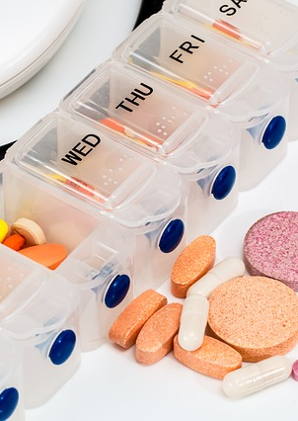
Poisoning accident prevention
Read the warning labels and instructions of products.
Store hazardous substances safely.
Keep household chemicals and medicines behind locked doors in their original packaging.
Choose products with a safety cap.
Keep cigarettes and cigarette butts out of the reach of children.

Slide 9
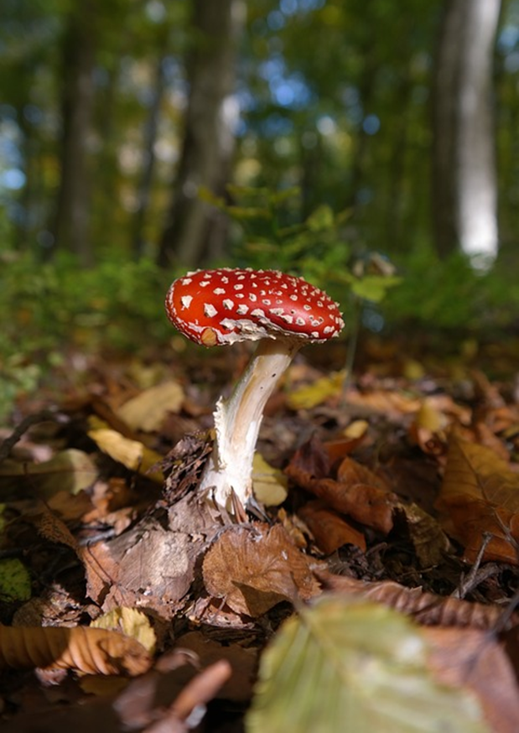
Identification of toxic substances
Learn to identify mushrooms and poisonous plants.
Do not eat mushrooms that you cannot identify.
Keep poisonous houseplants out of the reach of children.
Teach children not to put everything in their mouths.

Slide 10
Poisoning accident prevention
Prepare for a poisoning accident
  In case of poisoning, keep activated charcoal in your medicine cabinet (e.g., Carbomix® 50 g bottle)
  Learn sufficient first aid skills
Do not mix medicines with alcohol
Contact the Poison Information Centre immediately for details on the danger of poisoning and follow-up measures!

Slide 11
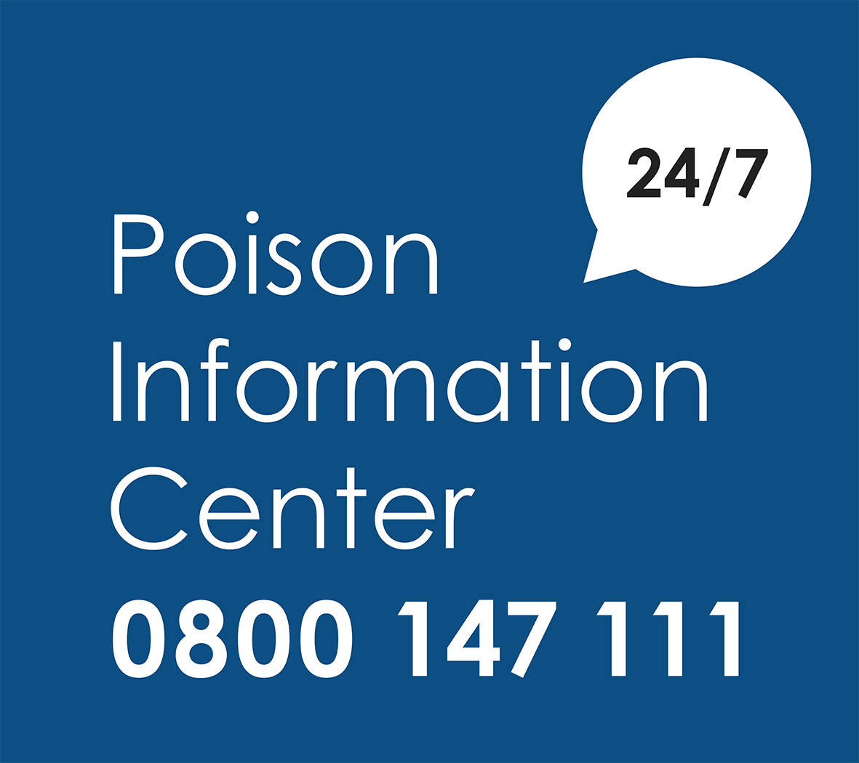
Poison Information Centre
The Poison Information Centre is available by telephone 24/7 to answer questions about the prevention and treatment of acute poisonings.
Open 24/7​
0800 147 111 (toll free)
​09 471 977 (normal-price call)
  First aid instructions
  Substance list
Notes:
https://www.hus.fi/en/hospitals-and-other-units/poison-information-center
https://www.hus.fi/sairaanhoito/sairaanhoitopalvelut/myrkytystietokeskus/Ensiapuohjeet/Sivut/default.aspx
Substance list:
https://www.hus.fi/sairaanhoito/sairaanhoitopalvelut/myrkytystietokeskus/aineluettelo/Sivut/default.aspx
https://www.hus.fi/en/search/poison-information-center

