Slide 1

Prevention of home and leisure accidents – memory disorders and accidents
The content is based on the content of home and leisure accident prevention work

Slide 2
General information about progressive memory disorders
Memory loss is not part of normal ageing → always investigate the causes!
The number of people with a memory disorder in Finland is estimated at 200,000 and is projected to grow strongly in the coming decades.
Age is a major risk factor for developing a progressive memory disorder, but there are also around 7,000 people who developed the condition at working age (under 65).
Memory disorders are neurological diseases that can affect anyone.

Slide 3
Memory disorders affect the brain
Memory disorders do not just affect memory. As the disease progresses, there may be changes in the following:
  Perception, reasoning and problem-solving skills
  Perception of time and place
  Mobility and walking
  Behaviour
Memory disorders can involve a lack of awareness of the symptoms, meaning that the person does not notice their own symptoms.
The symptoms are individual and depend on the type of memory disorder.
As a rule, memory disorders progress slowly, but the course of the disease varies from person to person.

Slide 4
When memory deteriorates
It is important to anticipate hazards and take into account the same risks as for older people in general.
Safety devices, such as GPS safety phones, facilitate independent walks and provide a sense of security not only for the person themselves but also for their loved ones.
It is important to consider in good time who is responsible for safety when the person with a memory disorder is no longer able to manage it themselves.
Discussing safety issues with loved ones well in advance will facilitate decision-making at a later stage.
People living alone must also be considered. Who will take care of them?

Slide 5
Memory and fire safety

Slide 6
Memory disorders and fire safety
Fire safety requires a new kind of attention, in particular to the following:
  Memory loss can lead to forgetfulness, e.g., the cooker might be left on.
  The person may also forget what they were doing before; e.g., the phone rings while they are ironing, and they leave the iron on.
  The use of open fires, such as fireplaces and candles, must be considered according to the person’s ability, and the necessary safety equipment must be provided.
Video on fire safety and memory disorders

Slide 7
Who is responsible?
Checking smoke alarms
Maintaining electrical equipment
Cleaning up dust from behind household appliances
Buying new small electrical appliances with an automatic shut-off feature and practising how to use them
Keeping the sauna clean

Slide 8
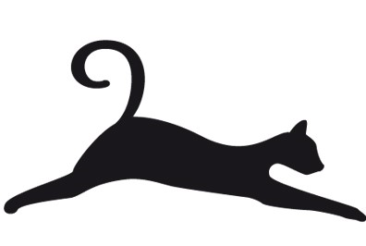
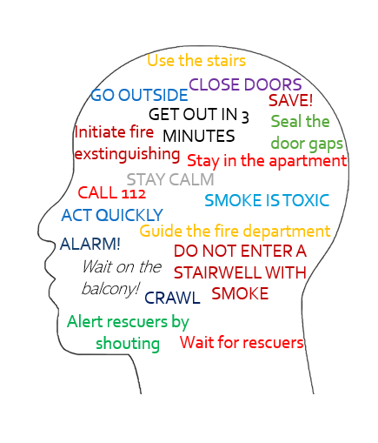
Evacuation
Evacuating the building during a fire involves many steps, and remembering them requires a lot from anyone in a new situation.

Slide 9
Falling and memory disorders

Slide 10
Memory disorders increase the risk of falls
As a memory disorder progresses, the person’s body and behaviour change, increasing the risk of falling.
  Changes in mobility are common because the decline in initiative leads to a decrease in the amount of physical activity in many people with a memory disorder. Physical activity requires encouragement and support from loved ones.
  Changes in reaction and reasoning skills predispose people to falls and may increase risk-taking.
  Alertness varies → the risk of falling varies.
  Moving about at night often increases with a memory disorder, increasing the risk of falls.

Slide 11
Memory disorders and falling
Prevention is the key to avoiding falls:
  Identify hazards
  Ensure sufficient physical activity
  Acquire mobility aids and support handles. Learn how to use them!
There is a post on the blog of Varsinais-Suomen Muistiyhdistys about the falls of people with memory disorders and how to prevent them https://www.muistiturku.fi/fi/blogi/vinkkeja-kaatumisen-ehkaisyyn-tapaturmapaiva

