Slide 1

Prevention of home and leisure accidents
– lifestyle

Slide 2
Lifestyle factors in accident prevention
In addition to keeping your home environment safe, you can prevent accidents by taking care of your health and ability to function:
  regular exercise
  avoiding rushing
  sufficient sleep
  varied nutrition
  abstinence from intoxicants

Slide 3
Prevention of home and leisure accidents
– lifestyle: Intoxicants and haste

Slide 4
Intoxicants and accident risks
Decrease in capability
Central nervous system depression
Loss of coordination
Increased impulsiveness
Deterioration of judgement
Increased risk-taking
Distorted perception of one’s own skills

Slide 5
Intoxication often involved in accidents
Total
Notes:
There was a spike in the contribution of intoxication to accidents around 2006
Reasons: Restrictions on alcohol imports from EU countries were lifted on 1 January 2004
and Estonia joined the EU on 1 May 2004. In March 2004,
Parliament reduced the tax on spirits by 44%, beer by 32% and wine
by 10%.
At the beginning of the period, about one third of accidents occurred while intoxicated, but by the end of the period this had fallen to only slightly more than one in five
The decrease is clear in men

Slide 6
Percentage of deaths from accidents while intoxicated vs. total alcohol consumption
Notes:
The percentage of deaths from accidents while intoxicated roughly mirrors total alcohol consumption

Slide 7
Intoxicants and accidents
Most accidents occur under the influence of intoxicants among young people, middle-aged people and men.
In older adults, the amount of alcohol consumed does not need to be high to increase the risk of accidents.
Intoxicants, and alcohol in particular, play a significant role in fire and sauna deaths. In addition to this, alcohol is often involved in road and water traffic accidents, freezing and asphyxiation.
Just over 7% of fall accidents occur under the influence of alcohol.
Notes:
As the body ages, its functioning and composition change, which also reduces its tolerance to alcohol. In addition to this, various medical conditions and medications can intensify the negative effects of alcohol and increase the risk of falls and accidents.
Two out of three drowning victims have been found to have a blood alcohol level of 0.5 per mille or more.

Slide 8
Accidents caused by intoxicants can be prevented
By reducing overall alcohol consumption, especially binge drinking.
By sharing information on the risks of the polysubstance use of medicines and intoxicants.
By refraining from using intoxicants when near water or travelling on water.
By actively discussing intoxicant use and identifying high-risk use.
Through low-threshold substance abuse services and treatment referral.

Slide 9
Rushing and accident risks
Loss of concentration
Slower reactivity
Increased risk-taking
Increased carelessness, negligence
Rushing is an underlying cause especially in home accidents, well over half (62 per cent) of which were partly or entirely caused by rushing.
Notes:
A little over a quarter of sports injuries and about 40 per cent of other leisure time accidents were also caused by rushing (source National Victimisation Survey 2017)

Slide 10
Prevention of home and leisure accidents
– lifestyle: Exercise

Slide 11
Changes brought about by age
Changes are gradual and individual.
Research data on the effects of ageing:
  muscle mass has decreased by 10% by the age of 50 and by as much as 40% by the age of 70.
  height decreases, by 2 cm per 10 years for people aged 60 and over.
  weight increases more easily with age.
  bone mass may start to decrease as early as at 40 years of age.
Muscle strength decreases faster in the lower limbs than in the upper limbs.
The risk of accidents increases due to reduced balance, increased risk of falls and slower reaction times.
Notes:
During menopause, the production of the female hormone oestrogen decreases, which also affects the muscles and causes a loss of muscle mass.

Slide 12
Exercise promotes the ability to function, prevents disease and improves quality of life
Research shows that the single most effective intervention for preventing falls is physical exercise.
It is never too late to start exercising, but it is always too early to stop.
For older people, even small effects can make all the difference when it comes to their ability to function and quality of life.
The UKK Institute’s physical activity recommendation sets out the weekly amount of physical activity needed to promote health and gives examples of forms of physical activity.
You can use the free app on the UKK Institute website to assess whether you are getting enough weekly physical activity.
Notes:
Good muscle strength and balance help prevent falls and slips.

Slide 13
Exercise can:
Reduce and slow down the changes brought on by ageing
Promote health and physical ability to function
Improve body composition
Slow the loss of muscle mass and strength
Maintain and even improve muscle strength and endurance
Maintain bone mass and strength
Maintain mobility, balance, flexibility and joint health
Increase oxygen uptake
Improve sleep quality and patterns
Improve appetite and nutritional status
Improve mental well-being
Notes:
A high level of physical activity reduces body fat, particularly abdominal and visceral fat.
Exercise maintains bone mass and strength→ important for preventing osteoporosis and fractures.

Slide 14

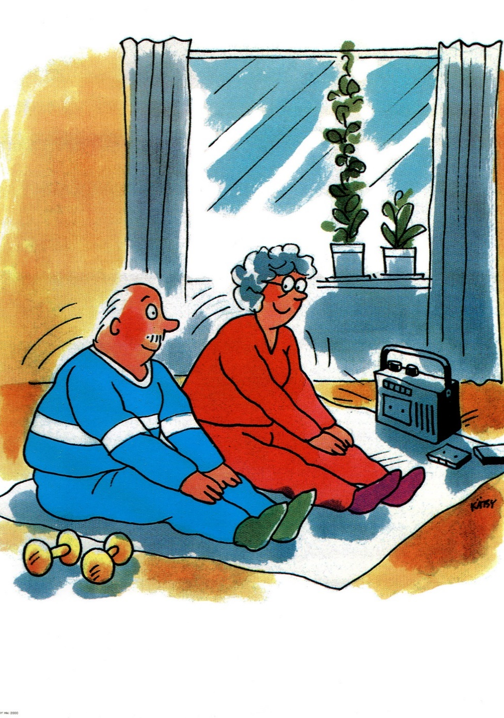
Choose your own style of physical activity, every step is worthwhile
Light physical activity as often as possible, e.g., household chores, outdoor activities, walking to the grocery shop, yard work and other normal activities.
Good and safe activities for older people include
  walking
  Nordic walking
  cross-country skiing
  gymnastics
  dancing
  swimming, water exercise
  various group gymnastics for older people.

Slide 15
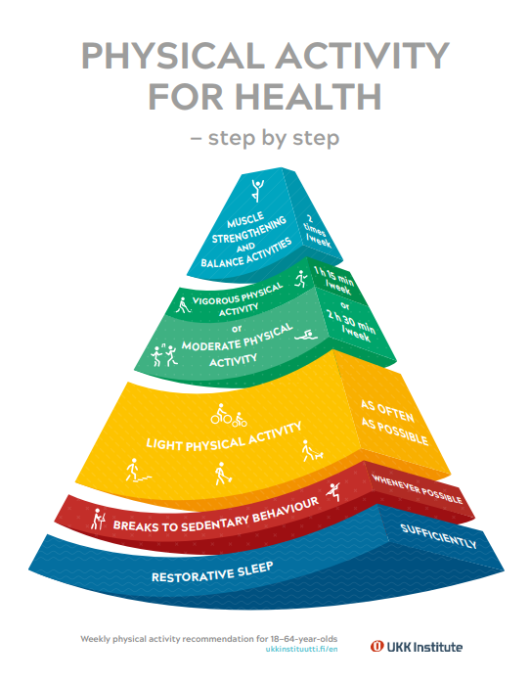
Physical activity recommendations
The new physical activity recommendations (2019) place greater emphasis on the importance of light physical activity, breaks in sedentary behaviour and adequate sleep.
A total of 2 hours 30 minutes of moderate physical activity or 1 hour 15 minutes of vigorous physical activity per week.
Muscle strength, balance and flexibility training is recommended 2–3 times per week.
Even a little exercise is good for your health and ability to function, as long as it is regular.
https://ukkinstituutti.fi/en/products-services/physical-activity-recommendations/weekly-physical-activity-recommendation-for-18-64-year-olds/
Notes:
Physical activity, such as walking, is moderate if you are slightly out of breath but can speak in complete sentences.
Physical activity, such as skiing or aquajogging, is vigorous if you are clearly out of breath and can only say a few words at a time.
Balance, muscle strength: many gymnastic exercises work on these qualities at the same time.
https://ukkinstituutti.fi/en/products-services/physical-activity-recommendations/weekly-physical-activity-recommendation-for-over-65-year-olds/, video (https://www.youtube.com/watch?v=748HgjzxjL4&t=28s)

Slide 16
Prevention of home and leisure accidents
– lifestyle: Nutrition

Slide 17
Nutrition becomes more important with age
Too little energy intake or an unbalanced diet can have negative effects, such as reduced mobility, making you more susceptible to accidents.
The importance of varied nutrition and adequate fluid intake becomes more pronounced in old age.
Ageing also increases the risk of osteoporosis, which can be prevented by adequate calcium and vitamin D intake and physical activity that puts pressure on your bones.

Slide 18
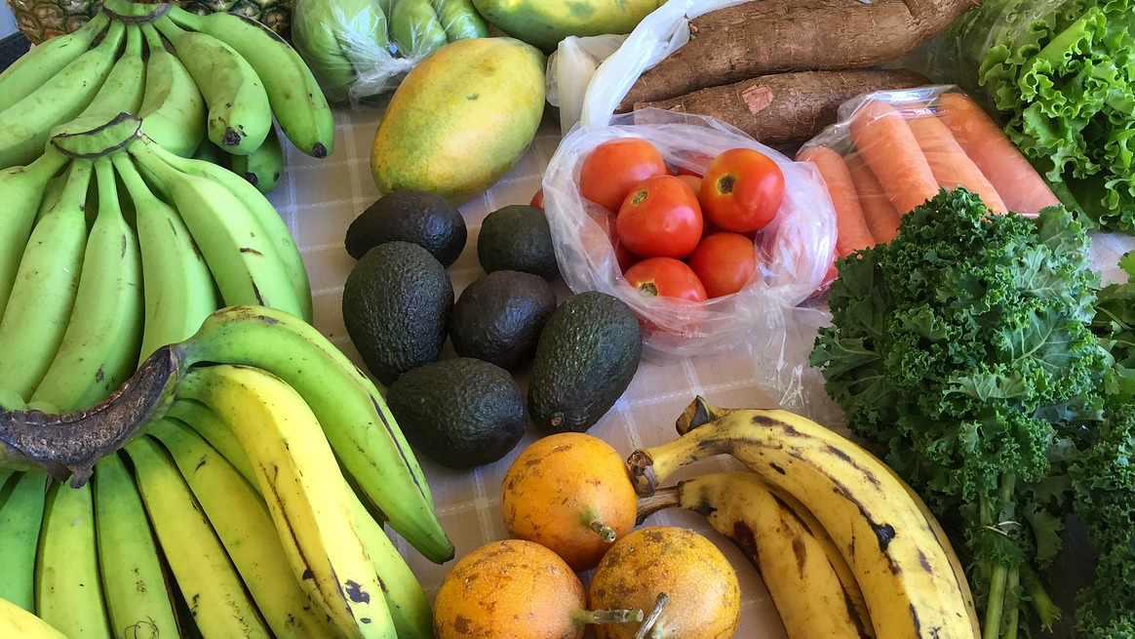
Nutrition recommendation for older people
The amount of energy in the diet is proportionate to energy consumption.
The diet is varied, colourful and sufficiently rich in protein.
Moderate salt intake and good-quality fats are important for arterial health.
There is enough physical activity to increase energy consumption and maintain muscle strength.
Any weight loss is carried out slowly.
Notes:
Terveyttä ruoasta – Hyvän ruokavalion aineksia [Health from food – Ingredients for a good diet] video (National Nutrition Council)

Slide 19
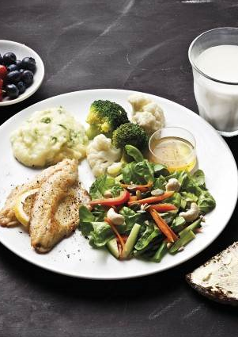
Nutrition recommendation for older people
Ensuring adequate energy, protein and nutrient intake during illness.
Taking 20 micrograms of a vitamin D supplement per day all year round.
Taking care of your oral health.
The THL website provides research-based information on topics such as
  Nutrition for different age groups
  Food services
  Voimaa vanhuuteen ruoasta (Strength in old age from food, Age Institute brochure)
Notes:
On the THL website, you can find research-based information on the correlation between diet and health, recommendations and nutrition in Finland.
About nutrition
Nutrition for different age groups
Food services
Voimaa vanhuuteen ruoasta (Strength in old age from food, Age Institute brochure)

