Slide 1

Home safety coaching
– You only have one life

Slide 2

Accident Prevention Network
A network of authorities and organisations, coordinated by the FRC.
The aim is to reduce the number of accidents at home and during leisure time.
Programme for the Prevention of Home and Leisure Injuries 2021–2030.
OBJECTIVES
A good level of safety in all environments.
The number of serious and fatal home and leisure accidents will be reduced by 25% by 2030.
VISION
No one has to die or be seriously injured as a result of an accident.
Notes:
What is the work based on?
Network cooperation to reduce accidents has been going on since the 1990s.
The network is made up of public authorities and organisations and now has 20 members. Work is planned and carried out together.
The Red Cross has been coordinating the network since 2015.
The activities are based on the Programme for the Prevention of Home and Leisure Injuries 2021–2031 and are guided by current accident statistics.
“The vision of the programme is that no one should have to die or be injured as a result of an accident”

Slide 3
Home and leisure accidents
According to THL, an accident is a sudden, unexpected event, such as a fall, caused by external factors and resulting in an injury.
One million accidents every year, 90% of which occur at home and during leisure time.
The total cost of home and leisure accidents in 2017 was 780–1,157 million euros.
Notes:
Accidental deaths are the fourth most common cause of death in Finland.
Finland has the fifth highest accident mortality rate in the EU.
Of all accidental deaths, 89% occur at home and during leisure time, 10% in road traffic and 1% at work.
The costs are direct and indirect and do not appear in the statistics.

Slide 4
Home and leisure accidents
Workplace accidents
Notes:
Of all accidental deaths, 90% occur at home and during leisure time, 10% in road traffic and 1% at work.

Slide 5
Home and leisure accidents 1998–2020
Men
Notes:
Accidental deaths have decreased over the last two decades
The decrease is more pronounced in men
There has been a 21% decrease from the peak years

Slide 6
Home and leisure accidents
Falls account for more than half of accidental deaths. Men and women are nearly equally likely to die of falls, with a total of around 1,200 deaths per year.
The second most common cause is poisoning (around 450–500 per year).
Around 150–200 drowning cases per year.
Fire deaths have fallen markedly over the last two decades, to around 40–50 in recent years.
Asphyxiation causes 70–90 death per year.
Men are up to five times more likely to die as a result of an accident than women.
Notes:
Falling accidents: The majority of falls occur among people aged 75 or older
Poisonings: Most common in middle-aged people, rare in children. Good progress: no poisoning deaths in children under 15 years of age.
Drowning deaths occur mainly among middle-aged and older people.
Fire deaths are predominantly a problem for middle-aged and older people.
Asphyxiations: Middle-aged and slightly older men are the largest group. The number of deaths from asphyxiation has fallen for both men and women over the last 20 years.
Around 40–60 sauna deaths per year. The number of sauna deaths has risen over the last 20 years. Decrease in the percentage of people who died in a sauna while intoxicated (80% -> 60%), what is the reason?

Slide 7
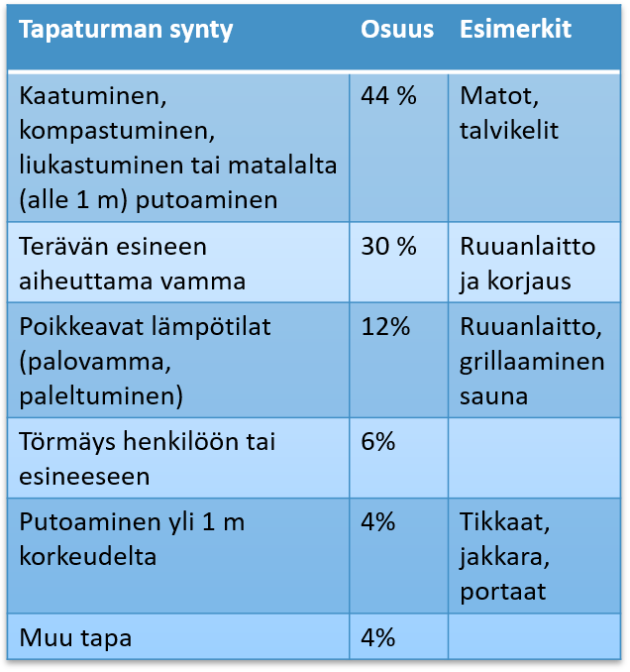
Most typical home accidents
Origin of the accident | Percentage | Examples
Falling over, tripping, slipping or falling from a low height (less than 1 m) | 44% | Rugs, winter conditions
Injury caused by a sharp object | 30% | Cooking and repairs
Abnormal temperatures (burn, frostbite) | 12% | Cooking, barbecuing, sauna
Collision with a person or object | 6%
Falling from a height of more than 1 m | 4% | Ladders, stools, stairs
Other | 4%
According to the National Victimisation Survey (2017), almost three in four accidents were home and leisure accidents (39% home, 27% sports and 14% other leisure accidents).
The most common types of injuries caused by accidents at home were bruises, contusions or lacerations (around half); sprains, strains or dislocations (18%) and burns (12%). Fractures occurred in 8% of accidents and head injuries in 3%.
Notes:
The National Victimisation Survey (2017) provides a fuller picture of the accident situation in addition to the more serious accidents. The results were obtained by conducting a survey by post or online (6,924 respondents, excluding those living in institutions).

Slide 8
Accidents by age group
Among children, the most common cause of accidental death after road traffic accidents is drowning or asphyxiation.
Among young people, poisoning is the second most common cause of accidental death after traffic accidents.
Among working-age people, poisoning (alcohol, drugs, pharmaceuticals) is the main cause of accidental death.
Among older people, the majority of accidents are caused by falls. The consequences of falls are more severe in older adults than in younger age groups.
Notes:
Children:
The younger the child, the greater the proportion of accidents that occur at home.
Among people aged under 25, different types of falls (including sports injuries) are the most common accidents resulting in a need for hospitalisation each year.
Accidents and suicide are still the main cause of death in Finland in the under-25 age group, although accidental deaths among children and young people have decreased significantly in recent decades.
The positive trend in child accident mortality is due to developments such as changes in legislation, the development and adoption of new and better safety equipment (such as car seats), increased awareness of risks and preventive measures through work carried out by operators such as child health clinics, the expansion of the activities of the Poison Information Centre and improvements in the treatment of accident patients.
Working-age people:
Fourth most common cause of death among working-age people. Falls are the main cause of hospitalisations. Intoxicants are involved in almost 70% of accidents among working-age people.
Older people:
The population is ageing rapidly and more and more older people are living at home in increasingly frail conditions.
The mortality rate of older people from different types of falls as a proportion of the population is on a slight downward trend. However, hospital admissions in relation to the size of the population have remained almost constant.

Slide 9
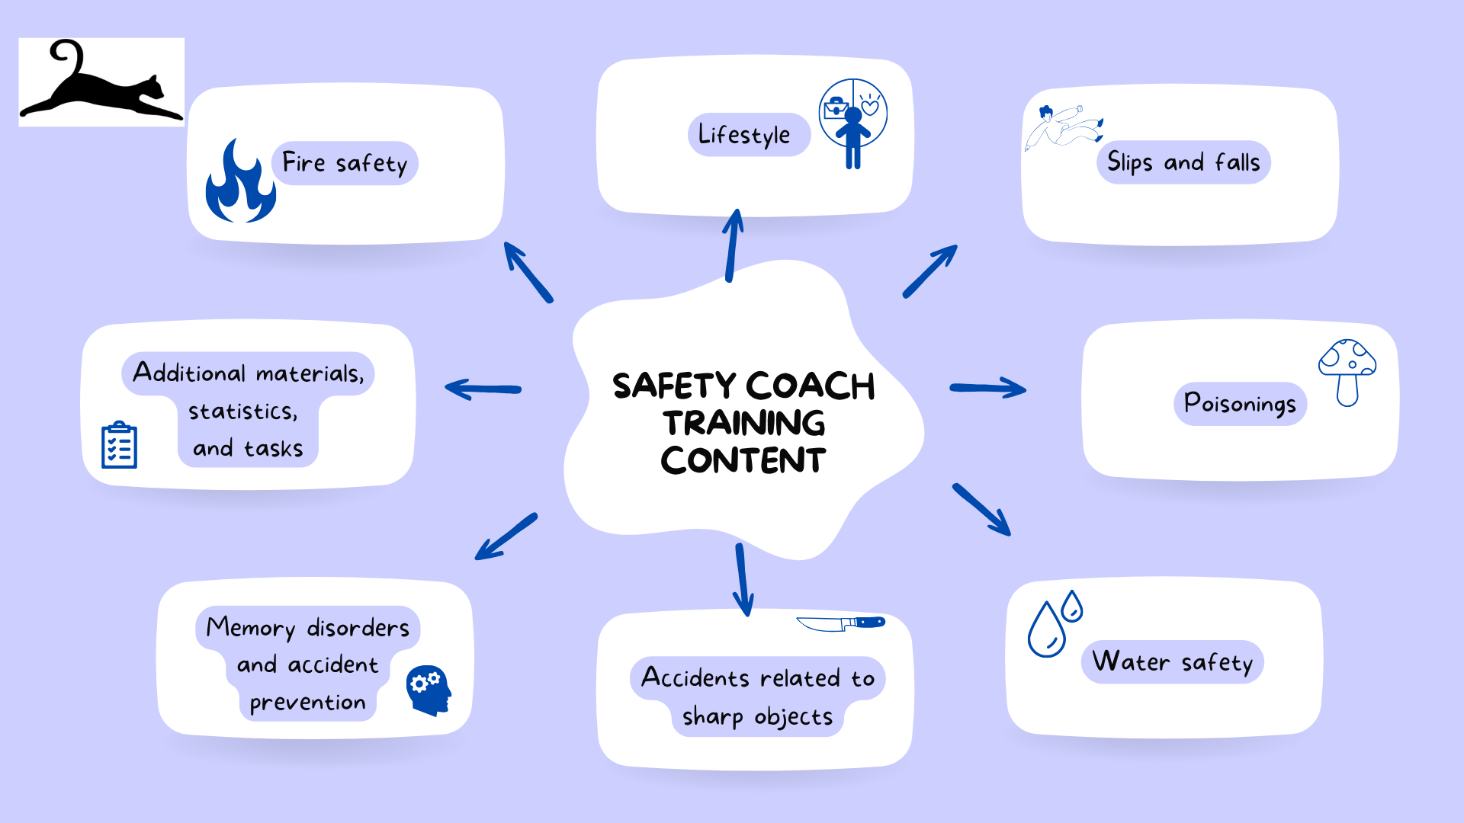
Home safety coaching

Slide 10
Main basis for the content of the training
National Victimisation Survey 2017.
Ministry of Social Affairs and Health’s Programme for the Prevention of Home and Leisure Injuries 2021–2030
THL’s accident statistics
National Action Plan for Safety Promotion among Children and Youth − Target and Action Plan 2018−2025: Part I
Various surveys, small-scale studies on the work of the Accident Prevention Network
Kotitapaturma.fi website
Sample survey 2020
Notes:
Safely at All Ages – a target programme for strengthening safety skills and anticipation

Slide 11
The Accident Prevention Network includes:
Finnish Association for Substance Abuse Prevention (EHYT)
Finance Finland
Finnish Road Safety Council
Finnish Transport and Communications Agency (Traficom)
National Defence Training Association of Finland
Alzheimer Society of Finland
National Police Board of Finland
Defence Command Finland
Ministry of the Interior / Department for Rescue Services
Ministry of Social Affairs and Health (STM)
The Finnish National Rescue Association
The Finnish Red Cross
The Traumatic Brain Injury Association of Finland
Finnish Swimming Teaching and Lifesaving Federation
Finnish Workers’ Compensation Center
National Institute for Health and Welfare (THL)
Finnish Safety and Chemicals Agency (Tukes)
The Centre for Occupational Safety
Finnish Institute for Occupational Health

Slide 12




















