Slide 1

Prevention of home and leisure accidents – further information and sources

Slide 2
Accident prevention
Communications based on data: making the environment and people’s behaviour safer.
Attitude change: the power to improve safety lies with people themselves, their loved ones and other parties involved in their daily lives.
Awareness:
  the possibility of an accident is real
  the risks concern the person themselves or those with whom they are involved
  consequences, e.g., fall injuries
  preventive measures and ways to reduce the consequences of an accident

Slide 3
Calling for help in the event of an accident
Call 112.
Make the call yourself if you can.
Give the exact address and town.
Explain what has happened.
  Sudden attack of illness or accident.
  What the person needing help is doing right now.
Answer the questions asked.
  The emergency response centre may ask you to give the phone to the person needing help if they are able to speak.
Follow the instructions given.
End the call after being told to do so.
Notes:
It is important that the emergency call is made by the person concerned or a person at the scene of the accident. They have information that the dispatcher needs to decide what kind of assistance to send. Calls through intermediaries can delay the arrival of assistance.
The questions will not delay the assistance. In an emergency, the dispatcher will alert the emergency responders during the call.
The dispatcher is able to give instructions. It is important to follow the instructions given.

Slide 4

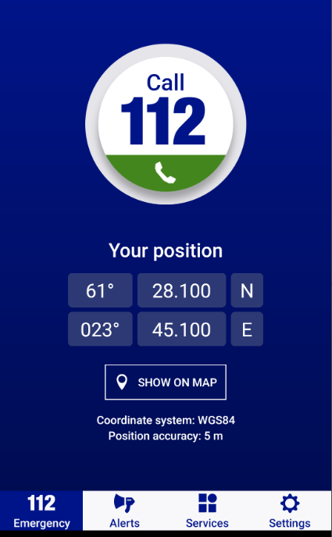
112 mobile app
If the person does not have a smartphone, it would be a good idea to have a 112 sticker on the phone.
You can download the free 112 Suomi app together from the phone’s app store.
With the 112 app, the emergency response centre can see your location and direct help to you, even if you do not know your location or address.
You should also download the FRC’s mobile first aid instructions onto the phone.

Slide 5
Injuries caused by slips and falls
Injury site on the body:
  Head or cervical vertebrae
  Pelvis
  Chest
  Femur
  Upper limb
Injuries occur in the course of domestic chores.
Often influenced by high-risk behaviour.
A reduced ability to function contributes to the occurrence of an accident

Slide 6
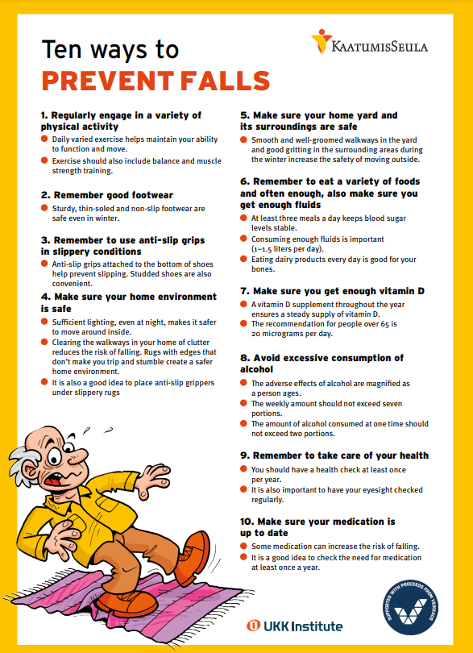
Measures to prevent falls
Regular and varied physical activity
Appropriate footwear
Anti-slip devices, “shoes to match the weather”
Safety of the home
Safety of the surrounding environment of the home
Varied nutrition
Sufficient vitamin D intake
Reducing excessive alcohol consumption
Taking care of your health
Keeping your medication up to date
Notes:
Ten ways to prevent falls (in Finnish): https://ukkinstituutti.fi/liikkumisen-turvallisuus/kaatumisten-ehkaisy-iakkaille-ja-laheisille/kymmenen-keinoa-kaatumisten-ehkaisyyn/

Slide 7
Falling accident prevention
Falling accident prevention, UKK Institute
Implementation of Evidence-Based Fall Prevention for Communities
KaatumisSeula Tools to Prevent Falls
Injuries among older people – Accidental falls
Information in Finnish:
Health Village’s Ikätalo (age hub) (Help with everyday life, home and living, ability to function, etc.)
Seminar recordings 4 April 2019
Video lecture on the ABC of fall prevention
Iäkkäiden kaatumisten ehkäisy. Pajala, S (2016).
Guide of the Regional Fall Prevention Network (RFPNetwork)
Notes:
https://www.who.int/news-room/questions-and-answers/item/healthy-ageing-and-functional-ability
https://www.falltips.org/about-fall-tips/

Slide 8
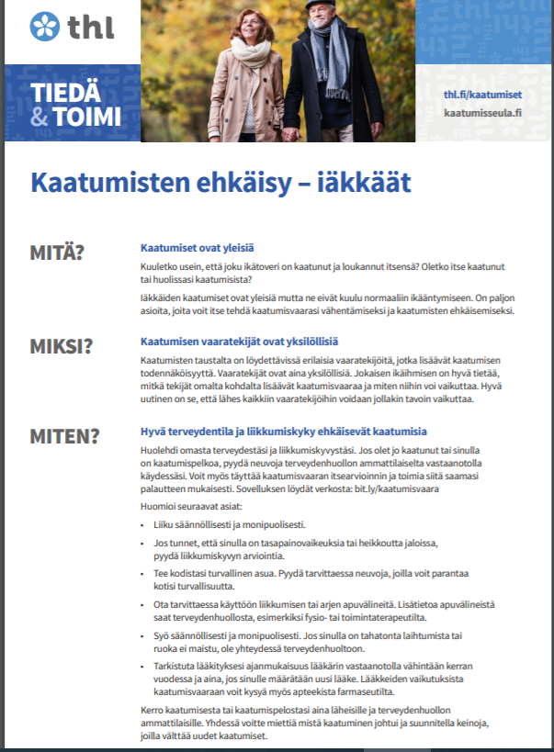
Tiedä ja toimi cards
Download and view the cards on the THL website
Fall prevention – older people
Fall prevention – informal carers
Notes:
https://www.julkari.fi/bitstream/handle/10024/140684/THL_TT_Kaatumisen_ehkaisy_Omaishoitajat__A4_2s%20WEB.pdf?sequence=5&isAllowed=y

Slide 9
Balance and muscle strength exercises
Physical activity, UKK Institute
How do you start moving? – tips for reflecting on your physical activity
Muscle strength and motion control exercises
Muscle strength and balance exercises
Muscle strength exercises, Terveyskirjasto
Muscle strength exercises – instructions for middle-aged and older people
Exercise instructions, equipment, forms of exercise, The Finnish Association for the Welfare of Old People
Database of group and recreational activities
Home exercise programme, Age Institute
‘Kävely kevyemmäksi’ home exercise programme
Strength and balance training (4 videos on YouTube, Strength in Old Age)

Slide 10
Physical activity recommendations, videos
Physical activity recommendation for people over 65 years old
Video, physical activity recommendation for people over 65 years old. Saija Karinkanta, UKK Institute (10 min)
Physical activity recommendation for adults (18–64-year-olds)
Video, physical activity recommendation for 18–64-year-olds. Minna Aittasalo, UKK Institute (15 min)
Physical activity recommendations for children and adolescents
Physical activity recommendation for adults with functional limitations
Strength in Old Age – Effective Model for Healthy Exercise

Slide 11
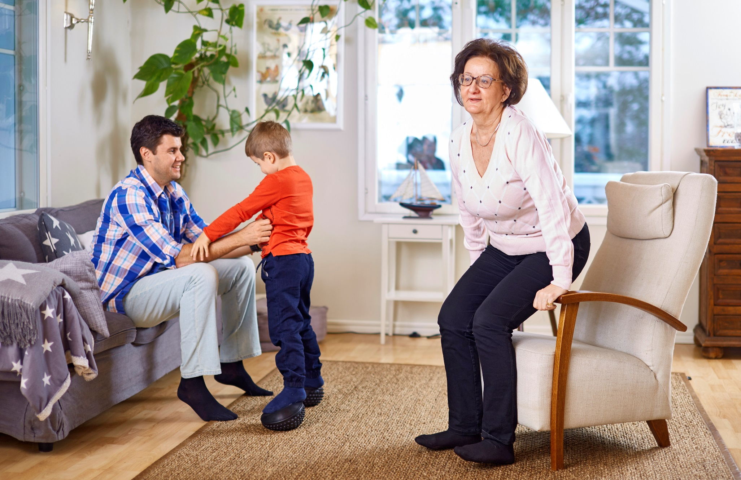
Strenght in Old Age
Notes:
Ikäinstituutti videos in english
https://www.youtube.com/playlist?list=PLSGkbeFujqqHM7ou2Sxg-PxxbzKPOXGZ9

Slide 12
Assistive everyday technology
Instruction videos for assistive everyday technology tools
All repair advice videos
    Smoke alarm installation, stove alarm, can openers, communicators, etc. to help with everyday life
Finnish Association for the Welfare of Older People
SeniorSurf
VALLI Gerontechnology Centre, guides and research data
Ministry of the Interior 2019. Update of the Action Plan — A Safe and Secure Life for the Elderly
Safe Years guide (in Finnish, Swedish, English and easy Finnish)

Slide 13
Checklists to ensure home safety
Use the checklist. Check each point to see if your home is safe. If you notice any shortcomings, correct them immediately.
Repeat the check every year or whenever your living circumstances change significantly. Take into account any changes in the residents’ ability to function.
Please note that several operators have checklists to ensure the safety of your home, including
Kotitapaturma website’s home safety checklist – safety checklists for different ages (Finnish, Swedish, English) that can be completed online, or downloaded or ordered from the material bank
  The checklists for children’s safety are also available in Arabic and Somali, and the checklist for an older person’s safety is also available in Russian.
  SPEK home safety checklists
  KAT – Safety at Home Test

Slide 14
Digital applications, campaign videos
FMI Weather app
RescueBusters game for youth safety education
Fire safety game for children
Animation: Tukevasti kiinni arjessa
Video: Hopulle loppu
‘Pysy pystyssä’ (Do not fall) campaign videos and Accident Prevention Day campaign videos

Slide 15
Use of accident indicators at events, Sotkanet
Sotkanet – The indicators allow the situation of a region or municipality to be monitored and compared with other regions using pre-selected indicators.
THL – Addicent indicators
Instructions for Safety Coaches on searching for indicators
Notes:
The instructions are available in the Safety Coach Rednet: https://rednet.punainenristi.fi/system/files/page/Turvallinen%20virtuaali%20koti%20ja%20tapaturmaindikaattorit.pdf

Slide 16
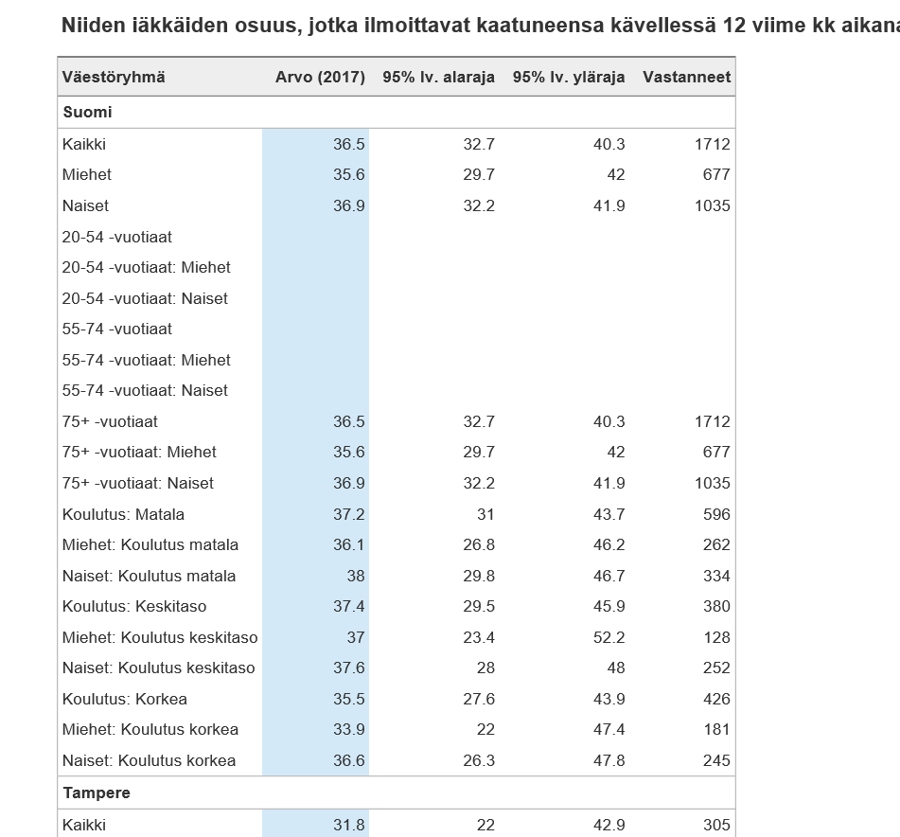
Terveytemme portal, e.g., the impact of different backgrounds on falls
Notes:
http://www.terveytemme.fi/
Comparative data on municipalities in TEAviisari

Slide 17
Nutrition
Lifestyle and nutrition:
On the THL website, you can find research-based information on the correlation between diet and health, recommendations and nutrition
Terveyttä ruoasta – Hyvän ruokavalion aineksia
[Health from food – Ingredients for a good diet] video (National Nutrition Council)
About nutrition
Nutrition for different age groups (in Finnish)
Food services (in Finnish)
Voimaa vanhuuteen ruoasta (Strength in old age from food, Age Institute brochure)
Consumers’ Union of Finland, syohyvaa.fi
Notes:
https://www.youtube.com/watch?v=hqJ5FoUY3W8

Slide 18
Intoxicants and rushing management
Things to do and listen: https://www.luontosivusto.fi/kevat/tekemisen-iloa/
Good mood forest walks – MIELI Mental Health Finland
Oivamieli website
Intoxicants and accidents - kotitapaturma.fi
Alcohol, drugs and addiction, THL.
Alcohol, THL
Päihteet lisäävät tapaturmavaaraa, Lääkärilehti publication.
Diverse information on intoxicants: AddictionLink
EHYT Finnish Association for Substance Abuse Prevention

Slide 19
Water safety (in Finnish)
Finnish Swimming Teaching and Lifesaving Federation
Viisaasti vesillä
Hukkumattomuudenlupaus (Promise not to drown)
Online materials for distance learning
Pelastu ja pelasta (Save yourself and others)
Videos for use in teaching:
Life jacket
Identify a person drowning
Rules for saving a person who is drowning
Safety of young children at the beach
Ice safety webinar
Move safely on ice videos

Slide 20
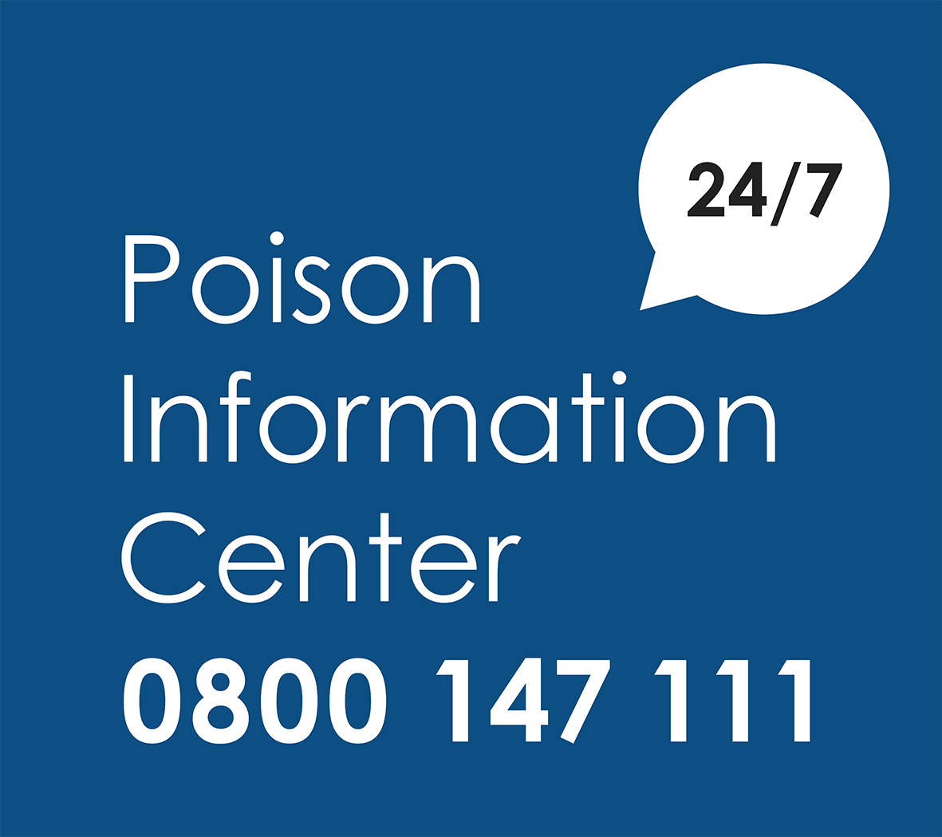
Poisoning accidents
Poison Information Centre
Korpilahti, Ulla, et al. Lasten ja nuorten tapaturmakuolleisuus on Suomessa yleisempää kuin Euroopassa keskimäärin [Child and youth injury mortality rate in Finland is higher than average in Europe]. Duodecim, 2019.
Finnish Red Cross, first aid instructions for poisoning
Video in Finnish: First aid in instances of suspected poisoning, Poison Information Centre
THL, poisonings
Poisonings, kotitapaturma.fi

Slide 21
Fire safety
Home safety, SPEK
Additional information about safety for special groups, i.e. older people, people with memory disorders
Fire safety in different languages, videos of the Tampere Region Rescue Department
Guide for fire safety at home

Slide 22
Memory disorders and accidents
Web pages on everyday safety by Varsinais-Suomen Muistiyhdistys ry
Web pages on a memory-friendly environment and safety by the Alzheimer Society of Finland
Videos in Finnish:
Lecture recording on safety at home 90 min
Fire safety and memory disorders 6 min
Preventing a person with a memory disorder from getting lost 3 min
Guidance and supplementary material (in Finnish)
Safe years for the families of people with memory problems (Varsinais-Suomen Muistiyhdistys)
Guide to a memory-friendly home (Salon Muistiyhdistys)
Safety at home checklist
Guide to safety bracelets and GPS trackers

Slide 23
Main basis for the content of the training
Ministry of Social Affairs and Health’s Programme for the Prevention of Home and Leisure Injuries 2021–2030
THL’s accident statistics
www.kotitapaturma.fi website
National Victimisation Survey 2017.
National Action Plan for Safety Promotion among Children and Youth − Target and Action Plan 2018−2025: Part I
Various surveys, small-scale studies on the work of the Accident Prevention Network
Sample survey 2020
Notes:
Safely at All Ages – a target programme for strengthening safety skills and anticipation

Slide 24
Other sources used in the coaching
Korpilahti and Kolehmainen (2016). Kansallisen lasten ja nuorten tapaturmien ehkäisyn ohjelman väliarviointi. THL.
Kotitapaturma website
Pysy Pystyssä website
Koti- ja vapaa-ajan tapaturmien ehkäisyn tavoiteohjelma 2014–2020 [Target programme for the prevention of home and leisure accident injuries 2014–2020]. (2013) , Ministry of Social Affairs and Health (STM). Publications 2013:16.
Good grip for walking, Finnish Road Safety Council
Lönnroos, Eija & Karinkanta, Saija & Häkkinen, Hanna & Havulinna, Satu (2018). Tiedosta ja toimi: iäkkäiden kaatumisia voidaan vähentää. Lääkärilehti 11/2018 No 47.
Finnish Association of Physiotherapists (2017). Kaatumisten ja kaatumisvammojen ehkäisyn fysioterapiasuositus. https://www.terveysportti.fi/dtk/sfs/avaa?p_artikkeli=sfs00003
Suomalaiset tapaturmien uhreina 2009 – Kansallisen uhritutkimuksen tuloksia [Victims of accidents in Finland 2009. Results from the national victimisation survey]. (2010). Haikonen et al. THL. Publication 13/2010.

Slide 25
Other sources used in the coaching
Suomalaiset tapaturmien uhreina 2017. Kansallisen uhritutkimuksen tuloksia [Victims of accidental injuries in Finland 2017. Results from the national victimisation survey]. (2017). Haikonen et al. THL. Publication 45/2017.
Terveyttä edistävä ruokavalio. Evira.
Fall risk assessment, National Institute for Health and Welfare (THL)
Accident prevention web pages, National Institute for Health and Welfare (THL)
Physical activity and its safety, UKK Institute
Physical Activity Recommendations in Finland. UKK Institute.
Safe Years – Information for older people and their loved ones on preventing accidents. Pajala, S. (2016 + 2020) THL.
Työikäisten vakavat tapaturmat. (2016) Safety Investigation Authority. Investigation report 8/2016.
Strength and balance training for older people. Strength in Old Age. Age Institute.

