Slide 1

Prevention of home and leisure accidents –
Fire accidents
The content is based on the content of home and leisure
accident prevention work

Slide 2

Number of residential fires in Finland
Every day, there are fires in eight Finnish homes.
The most common causes include leaving the cooker unattended, using electrical appliances contrary to the instructions, leaving appliances unattended, using damaged appliances, handling open fires and smoking.
Carelessness or intoxication often make fires more likely.
Information: Emergency Services Academy Finland
Notes:
In 2021, rescue services were called to
5,213 building fires. Around 2,923 of them were residential fires.
Leaving the cooker unattended – approximately three fires each day.
Building fires by building type
2016 2017 2018 2019 2020 2021
Residential building 2971 2921 2837 2798 2700 2923
Detached house 1399 1254 1289 1294 1106
Attached house 306 265 289 292 282
Block of flats 1266 1402 1259 1212 1194

Slide 3
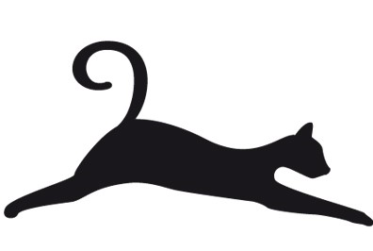
Fire deaths 2006–2021
The annual number of fire deaths seems to have stabilised at between 40 and 50.
Information: Emergency Services Academy Finland and SPEK
Notes:
Fire death statistics from the Finnish Rescue Services’ Pocket Statistics published by Emergency Services Academy Finland.
Over the last ten years, the average number of fire deaths has fallen from around 100 to less than 60.
Older people make up 1/5 of the population, 2/5 of fire deaths→increased risk of fire death.
Alcohol involved in at least half of the cases
People who need special support for housing are a risk group
The single largest age group of deaths is middle-aged men
People over 65 years of age are overrepresented in fire deaths
Men
Women
Total

Slide 4
Fire deaths
Cigarettes remain the most common cause of fatal fires.
One in three fatal fires involved the absence of a working smoke alarm.
In fatal fires, the fire most often starts in the living room. (Living room 14, bedroom 8, kitchen 7)

Slide 5
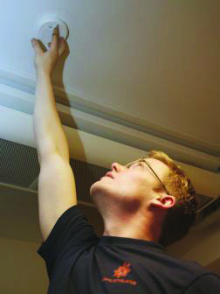
Smoke alarm
Every floor of the home must have a functional smoke alarm for every 60 square metres of floor space.
Attach the smoke alarm to the ceiling.
Replace the smoke alarm battery once a year.
Test the smoke alarm regularly by pressing the test button.
Usually, the occupant is responsible for the operation of the smoke alarms.
The smoke alarm must be replaced after 10 years at the latest.
Notes:
The wisest thing to do is to install a smoke alarm on the ceiling of each bedroom and on exit routes.
Under the Act on Disability Services and Assistance, people with hearing loss have the right to receive a smoke alarm system at home free of charge. It includes a flashing light on the wall and a vibrating pillow under the pillow to wake the person at night to the alarm. It requires a medical specialist’s statement, which must be submitted to the disability services adviser.
The smoke alarm can be equipped with an extension cord and a battery box, which eliminates the need for climbing to change the battery.
According to surveys, almost all Finnish homes have smoke alarms.
However, according to the Rescue Services’ Pronto database, 40% of the dwellings where a fire occurred had working smoke alarms.
The distribution of smoke alarms during Fire Safety Week was well received in 2019. This will be continued.

Slide 6
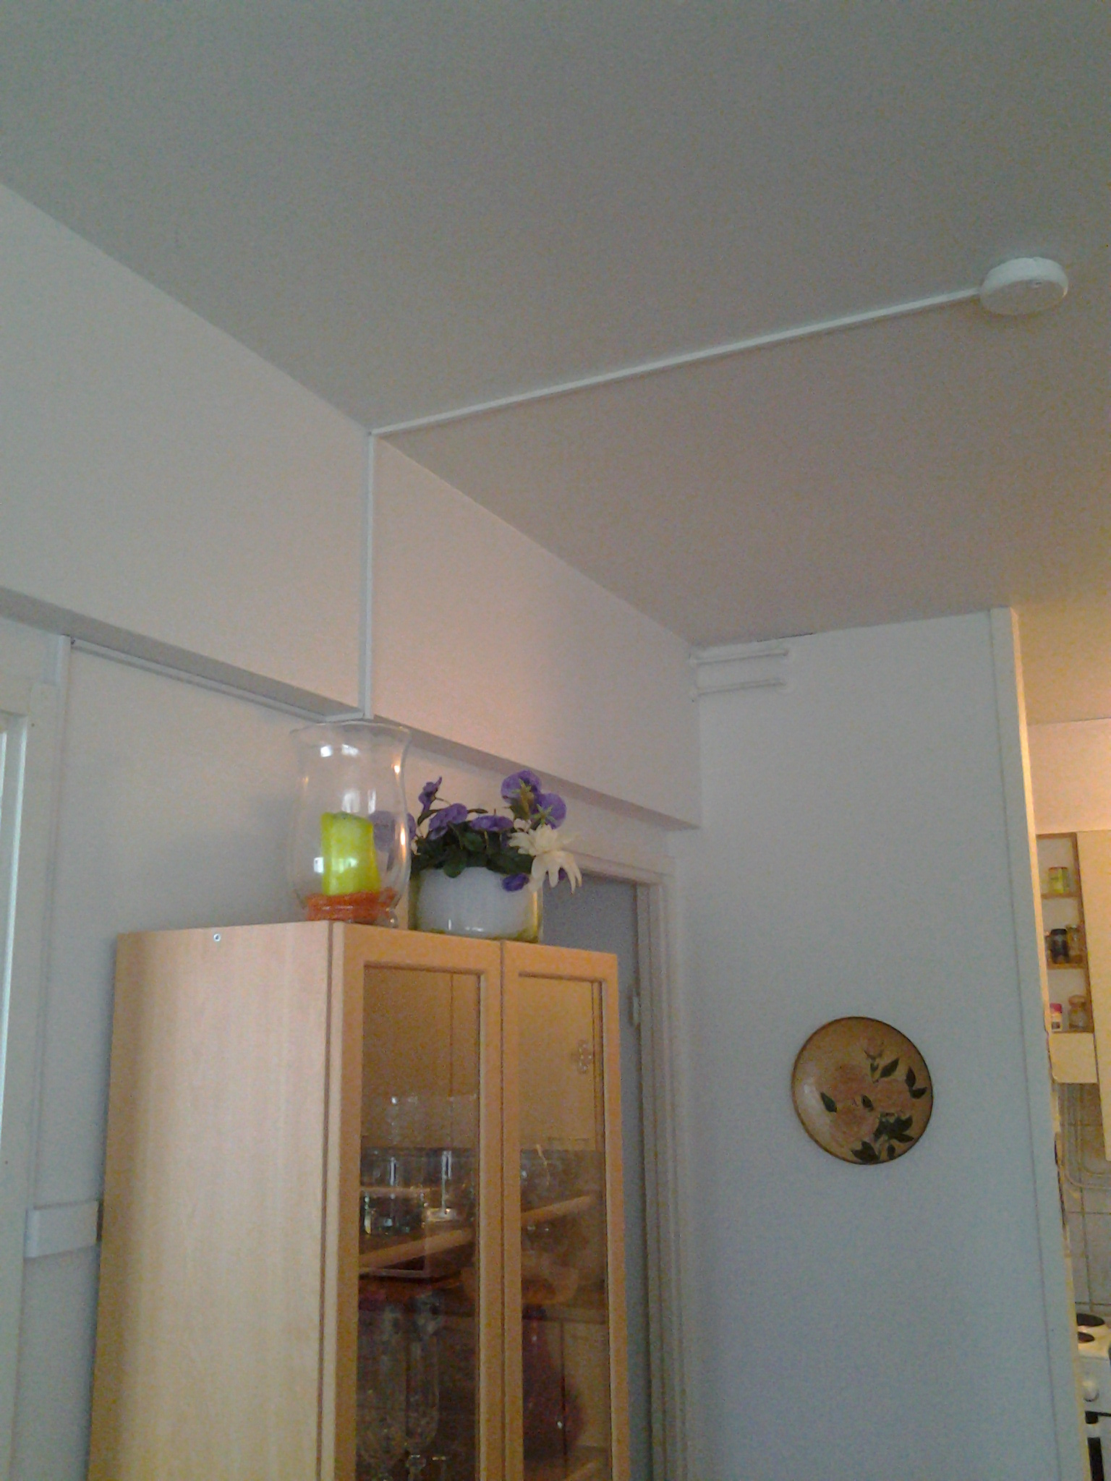
Responsibility for smoke alarms
Battery-powered smoke alarms are the responsibility of the resident.
In blocks of flats and terraced houses, the maintenance of smoke alarms connected to the power grid is the responsibility of the housing company.
The ongoing change in regulations aims to make housing companies always responsible for ensuring that there are enough working smoke alarms in their dwellings.
In detached houses, smoke alarms are the responsibility of the owner.
Notes:
The wisest thing to do is to install a smoke alarm on the ceiling of each bedroom and on exit routes.
Under the Act on Disability Services and Assistance, people with hearing loss have the right to receive a smoke alarm system at home free of charge. It includes a flashing light on the wall and a vibrating pillow under the pillow to wake the person at night to the alarm. It requires a medical specialist’s statement, which must be submitted to the disability services adviser.
The smoke alarm can be equipped with an extension cord and a battery box, which eliminates the need for climbing to change the battery.
According to surveys, almost all Finnish homes have smoke alarms.
However, according to the Rescue Services’ Pronto database, 40% of the dwellings where a fire occurred had working smoke alarms.
The distribution of smoke alarms during Fire Safety Week was well received in 2019. This will be continued.

Slide 7
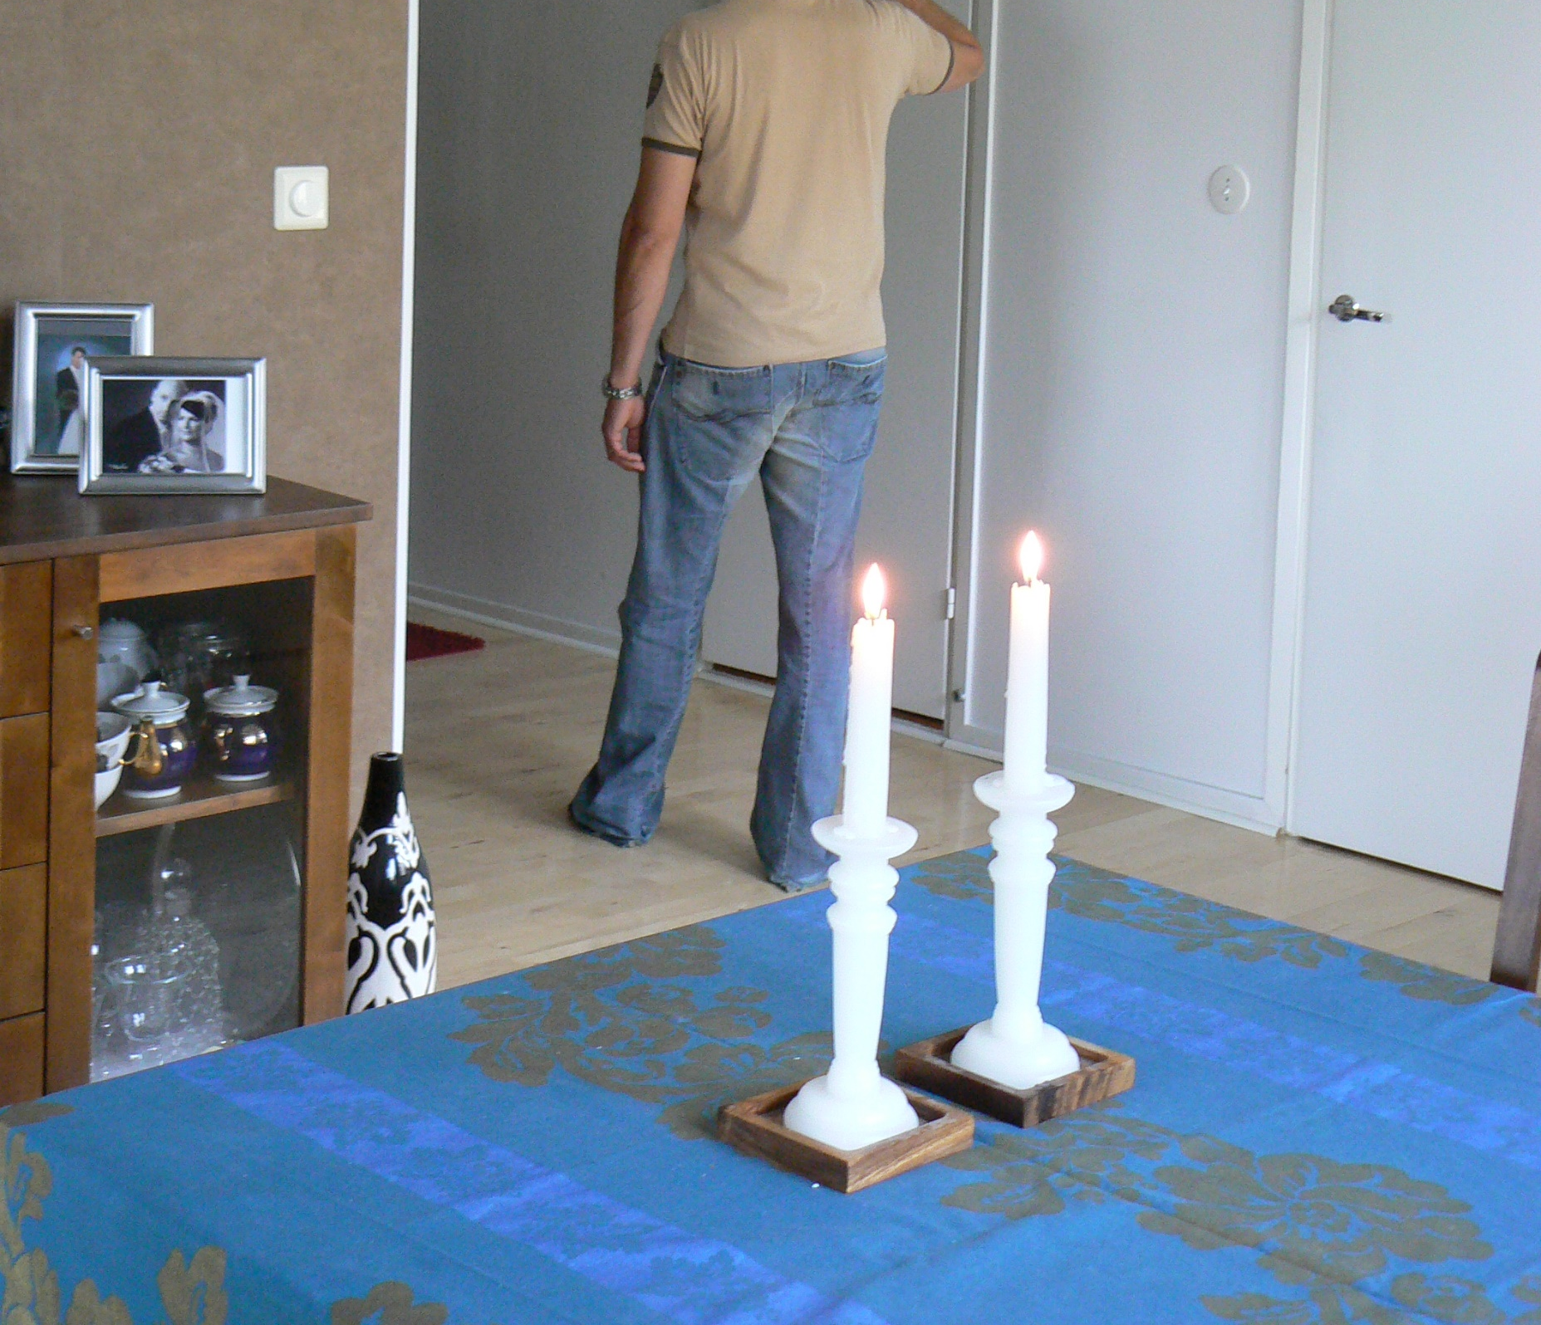
Open fires and smoking
Never leave burning candles unattended.
Use LED candles instead, they are safer.
Outdoor candles may not be used indoors or on balconies or decks.
Put out cigarette butts carefully.
Smoking in bed or on the sofa is also potentially life-threatening.
Notes:
Candleholders must be made of non-flammable materials.
Leave a distance of at least five centimetres between candles and tealights.
Cigarette butts must not be thrown in the bin.
Do not leave lighters or matches where children can find them.

Slide 8
Energy crisis extra – supplementary heating
Fireplaces
Fireplaces that have not been used for a long time must be swept.
  Fireplaces in year-round use must be swept annually.
Gas appliances
Gas appliances must be suitable for the intended use. Some heaters are designed as supplementary heaters for indoor use and others for outdoor use only.
It is important to properly maintain a gas appliance kept in storage. The maintenance includes checking that the appliance is clean, the installation has no leaks, and the hose is in good condition.

Slide 9
Energy crisis extra – carbon monoxide detector
The use of a fireplace or gas appliance may pose a risk of carbon monoxide gas building up.
How to place a carbon monoxide detector
Place the detector in the room where the fireplace or gas heater is located.
Make sure that the alarm sound of the carbon monoxide detector can be heard in the rooms where people spend time.
If you place the detector on the ceiling, place it at least 300 mm away from the walls.
In the case of a combination smoke alarm and carbon monoxide detector, install the device on the ceiling.
Note that a wall-mounted detector must be at least 150 mm from the ceiling, as the corner of the wall and ceiling can form a pocket of still air.

Slide 10
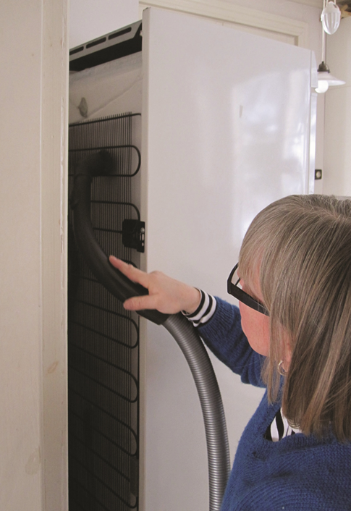
Electrical appliances
Following the instructions for use is fire safety
Unplug electrical appliances when not in use.
Do not connect multiple extension cords into long chains.
Keep extension cords free of dust.
Replace or repair faulty equipment. Faulty electrical appliances can start a fire.
Do not place anything on lamps or electric radiators.
Vacuum behind refrigeration appliances at least once a year.
Notes:
The wisest thing to do is to install a smoke alarm on the ceiling of each bedroom and on exit routes.
Do not leave electrical appliances on when you are not at home. For example, you must not leave the washing machine or dishwasher on when you leave.
Replace or repair faulty equipment. Only an electrician can repair a broken electrical appliance.
When removing the plug from the socket, pull on the plug, not the cord.
Do not use broken electrical wires or sockets.

Slide 11
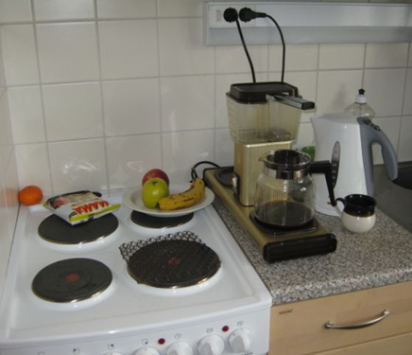
Cooker
^{Cleanliness is fire safety}
Around a third of fires in homes are caused by improper use of the cooker.
Do not leave the cooker on unattended.
Keep the area around the cooker free of anything flammable: paper, cardboard boxes, plastic containers, potholders, etc.
Make use of cooker safety technology:
  External power switch or timer
  Cooker alarm
  Cooker guard
  Cooker hood with a fire suppression system
Notes:
Turn the cooker off when not in use.
Set the oven or hob temperature according to the dish you are preparing.
The wisest thing to do is to install a smoke alarm on the ceiling of each bedroom and on exit routes.

Slide 12
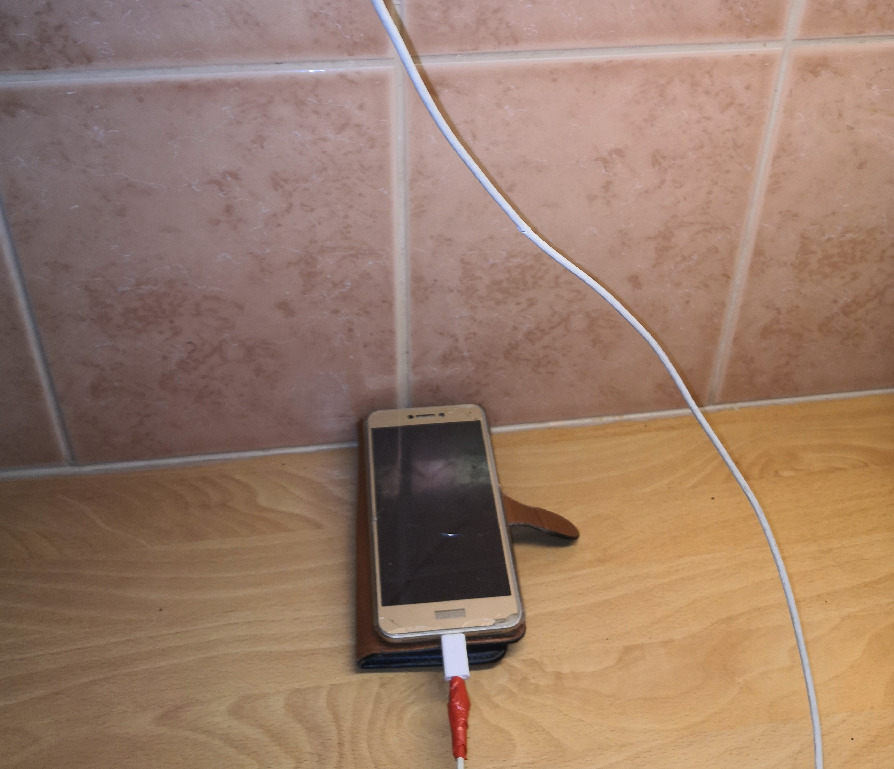
Rechargeable devices
Devices should not be left unattended when charging.
  This applies to mobile phones too!
Battery fires are difficult to put out.
  “If a battery-powered device catches fire, it should be submerged in water and taken outdoors in a bucket.”

Slide 13
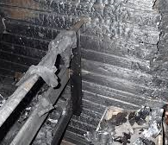
Sauna
Do not dry laundry or store items in the sauna.
Do not put anything on the sauna heater.
If you have an electric sauna that you are not using for its intended purpose, disconnect the heater by removing the fuses, for example.
Notes:
The sauna is not a storage room, but IF YOU STILL USE AN ELECTRIC SAUNA FOR STORAGE, REMOVE THE HEATER’S FUSES OR DISCONNECT THE POWER AT THE CIRCUIT BREAKER.

Slide 14
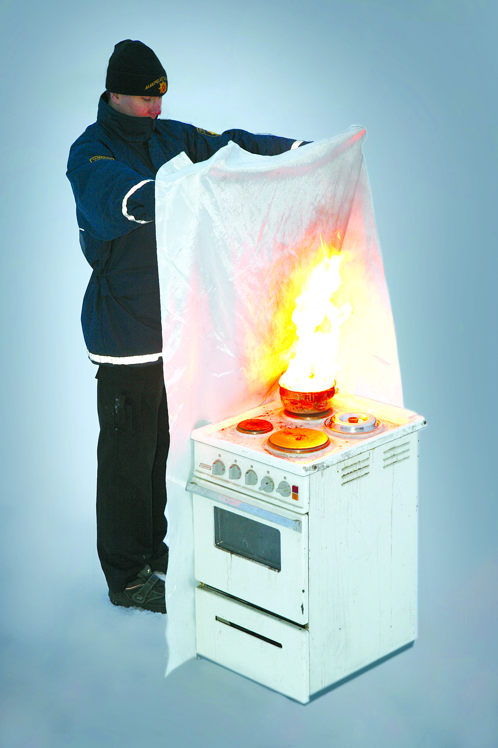
Extinguishing equipment at home
Fire blanket
The fire blanket must be sufficiently large, for example 120X180 cm, and hung on the kitchen wall.
Other extinguishing equipment
The best handheld fire extinguisher for homes is a 6-litre liquid extinguisher.
A rug made of natural fibres can be used as a fire blanket.
A cooking pot lid can be used to extinguish a fire on the hob.
Notes:
A fire blanket is used to extinguish small fires, such as a coffee maker, a cooking pot or a television. A fire blanket can also be used to extinguish a fire on a person.
Replace a damaged fire blanket with a new one.
Fire blankets start at €6.90 and are available in grocery stores.
Remember to check and maintain your extinguishing equipment: a handheld extinguisher should be checked at least every two years. A fire extinguisher must be serviced after even the slightest use. More information: http://www.kodinturvaopas.fi/paloturvallisuus/sammutusvalineet-ja-alkusammutus/
Instructions for using a fire blanket:
Hold the fire blanket at the corners. Keep the fire blanket between you and the fire, also protect your hands.
Lay the blanket gently over the burning object.
Make sure that the burning object is not exposed to the air. Used for extinguishing fires such as a coffee maker, a cooking pot or a television. A fire blanket can also be used to extinguish a fire on a person.

Slide 15
If there is a fire in the dwelling where you are
Warn and save others.
Try to extinguish. Do not put yourself at risk.
Leave the burning area.
Limit the fire by closing the door, windows and ventilation.
Call 112 from a safe place.
Guide the firefighters to the scene.

Slide 16
When there is a fire in another flat in a block of flats
If there is no smoke in the stairwell, use the stairwell to escape.
  Close the door to your flat, do not use the lift.
If there is smoke in the stairwell, stay inside the flat and keep the stairwell door closed.
If there is smoke in your flat, go onto the balcony or position yourself by an open window. Call for help and wait for the rescue services to help you to safety.
Do not go onto the balcony if the fire is in the flat below you.
Notes:
The door leading to the stairwell can be sealed with a wet towel, for example.

Slide 17
More information
https://www.spek.fi/en/safety/
https://www.spek.fi/en/safety/housing-safety-for-special-groups/
https://paloturvallisuusviikko.fi/en/
Juha Hassila
Safety Communications Specialist
juha.hassila@spek.fi
Notes:
The door leading to the stairwell can be sealed with a wet towel, for example.

