Slide 1

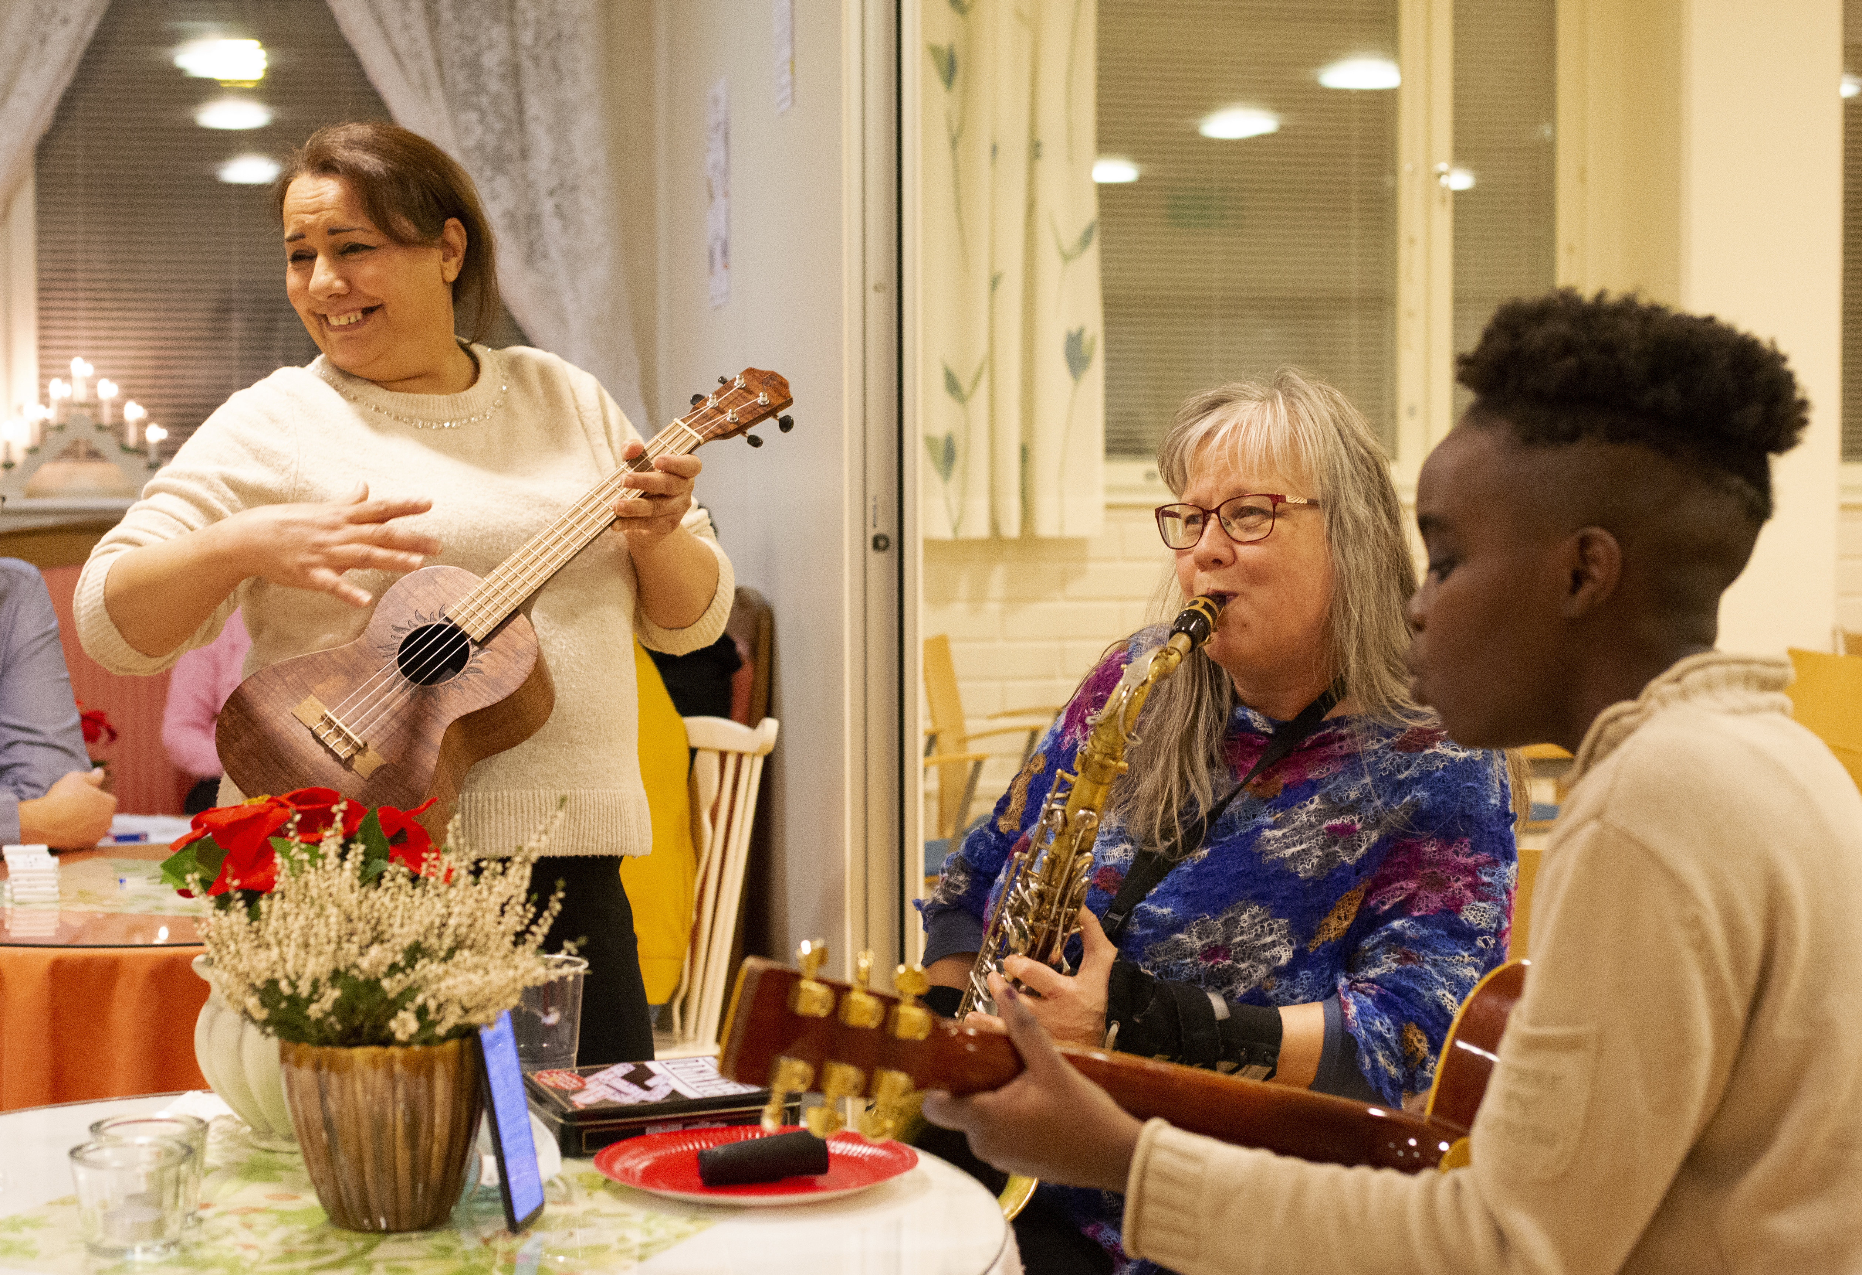
Cheerful gatherings at the meeting café
Photo: Pauliina Vilpakka
The Finnish Red Cross
Red Cross meeting cafés are places where everyone is welcome. In the cafés, people can spend time in good company over a cup of coffee. There will be coffee, tea and some snacks on offer.
At the meeting café, you can learn Finnish by chatting and interacting with others in a relaxed atmosphere. The café can also organise different types of activities and visits, depending on what the participants wish to do.
Date and location: xx Month xxxx
Contact person: xxxx, telephone number, e-mail
Welcome!
Organiser: The XX branch of the Finnish Red Cross

Slide 2
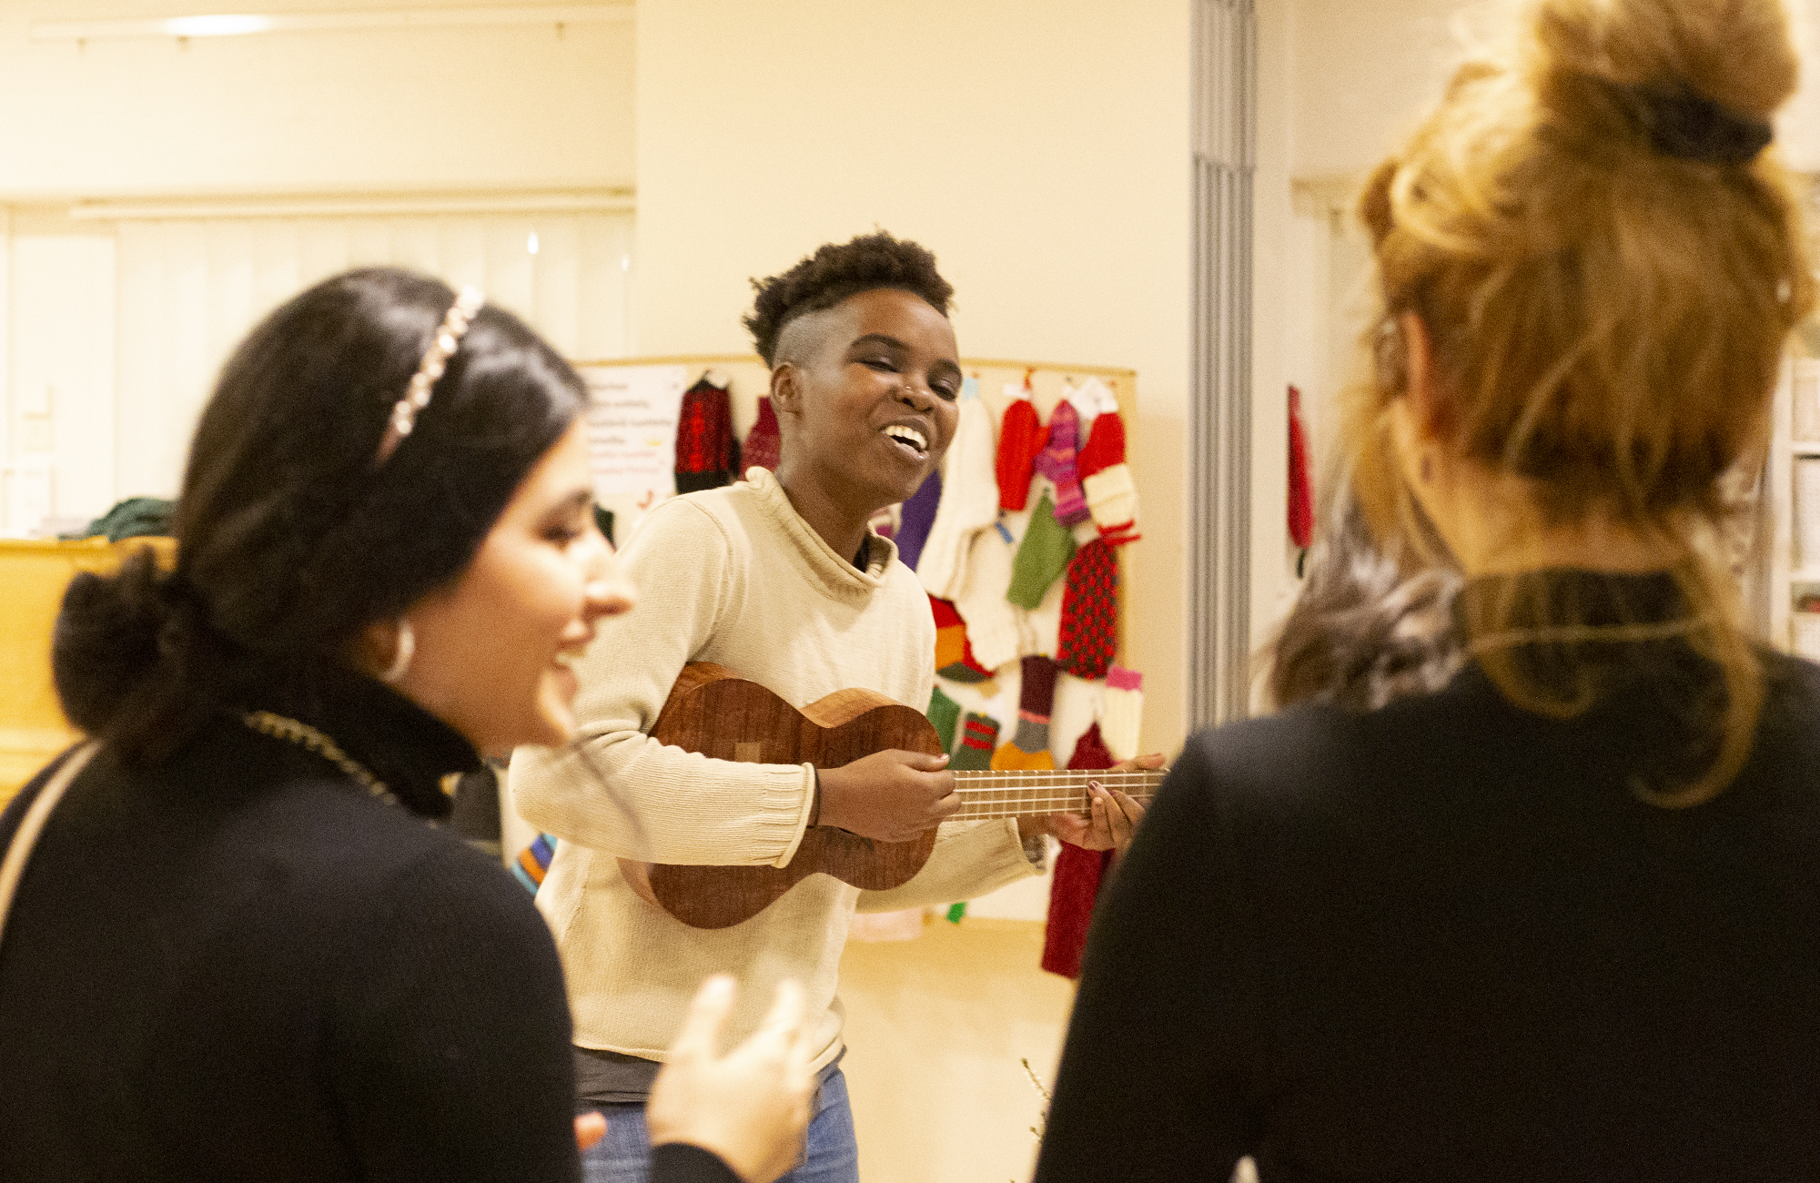
Become a volunteer at a meeting café!
Photo: Pauliina Vilpakka
The Finnish Red Cross
Red Cross meeting cafés are places where everyone is welcome. At the cafés, people can spend time in good company over a cup of coffee, playing games and engaging in a variety of activities together. There will be coffee, tea and some snacks on offer.
The most important qualities for a meeting café volunteer are a kind heart and the will to spend time with people from a variety of backgrounds. As a volunteer, you will make new friends and get to know people from all over the world.
Join us – we could use your help!
Contact information: XXXXX

