Slide 1

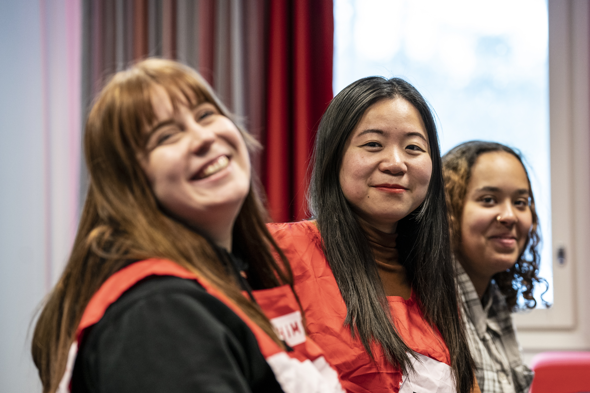
Join our important volunteer activities!
Photo: Kaisa Sirén
The Finnish Red Cross
The XXXmunicipality branch of the Red Cross is looking for new volunteers – could it be you? We hope to have people from many different backgrounds join us. You can join the activities even if you are not fluent in Finnish or Swedish. What matters is that you have an open mind and a desire to help others.
There are a variety of things you can do as a Red Cross volunteer: you can work in areas such as first aid and preparedness, food aid, activities for children and young people or support for people who have recently moved to Finland. As a volunteer, you can make new friends, gain diverse work experience and enjoy the joy of helping others.
Are you interested in joining our activities? Ask for more information!
Contact information: XXXXX

