Slide 1
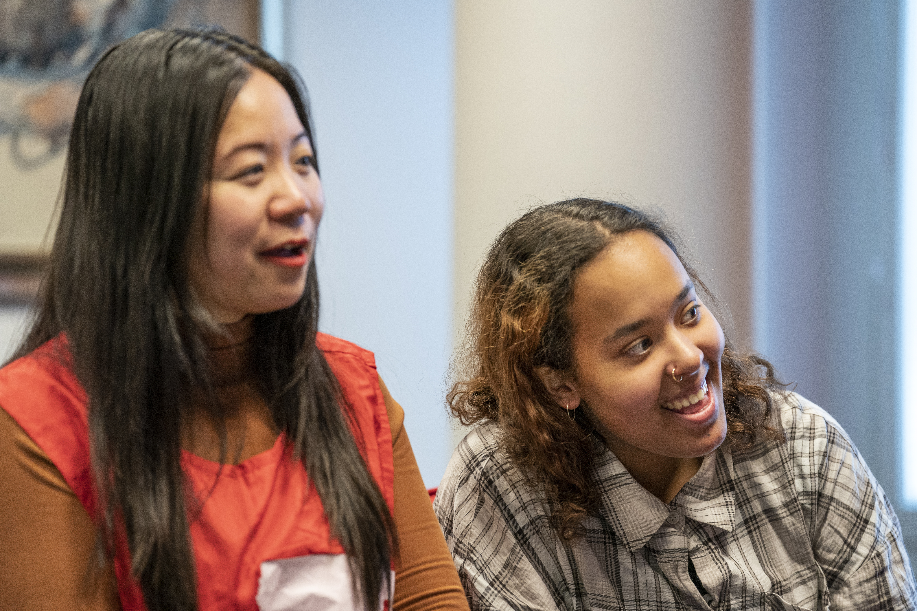

Come and find out more about Red Cross activities!
Photo: Kaisa Sirén
The Finnish Red Cross
Want to do good in great company? Did you know that the Red Cross also has activities in XXXmunicipality? You are very welcome to join our activities – we could use your help!
We are organising an introductory evening where you can learn about the activities organised by the XXX branch of the Red Cross. Come and hear about all the things you can do at the Red Cross. You can join the activities even if you are not fluent in Finnish or Swedish.
Date and location: xx Month xxxx
Contact person: xxxx, telephone number, e-mail
Welcome!
Organiser: The XX branch of the Finnish Red Cross

