Slide 1

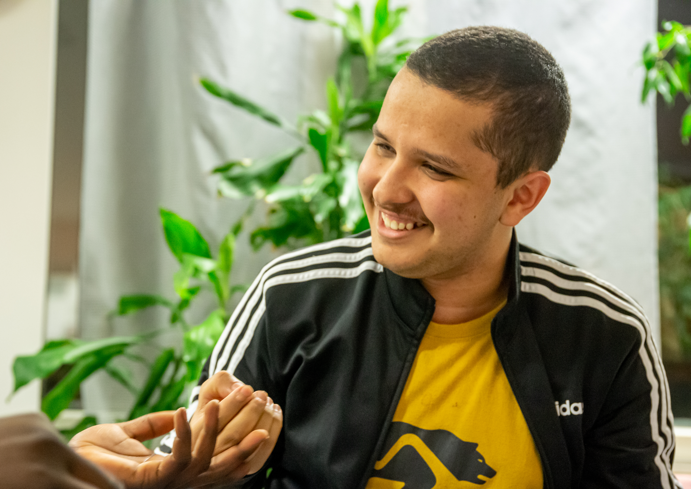
International club – fun activities and new friends
Photo: Susanna Chazalmartin
The Finnish Red Cross
Red Cross international clubs are spaces open to all, where people can do fun things together. Club members can go ice-skating in the winter and have a picnic or a pancake party in the summer, for example. Participants and volunteers will decide on the programme together.
The international club is a great place to meet new people and do fun activities. Join us!
Date and location: xx Month xxxx
Contact person: xxxx, telephone number, e-mail
Welcome!
Organiser: The XX branch of the Finnish Red Cross

Slide 2
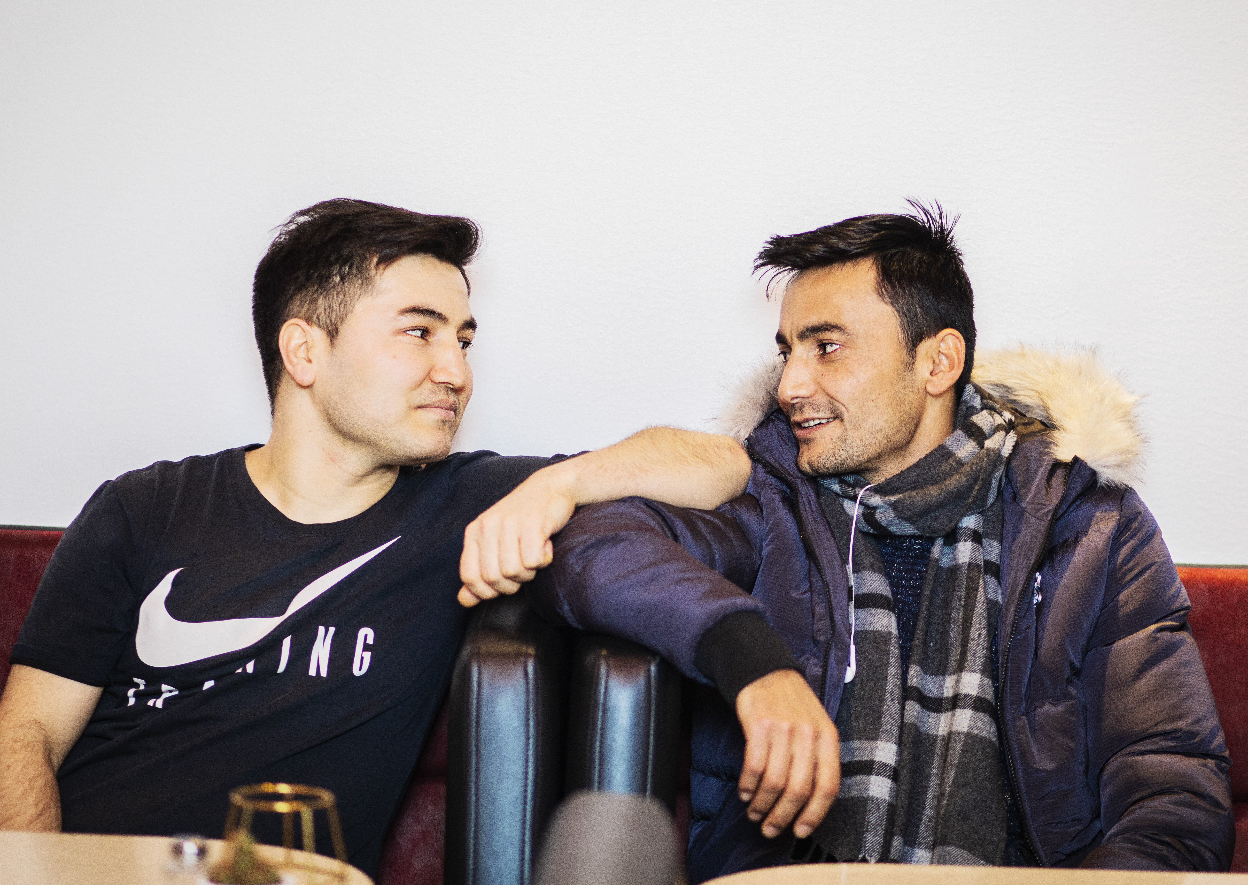
Become a volunteer at an international club!
Photo: Sabrina Bqain
The Finnish Red Cross
Red Cross international clubs are spaces open to all, where people can do fun things together. Club members can go ice-skating in the winter and have a picnic or a pancake party in the summer, for example. Participants and volunteers will decide on the programme together.
There are many different roles, big and small, in running an international club, and you can choose the one that suits you best. At the club, you can make new friends and have fun with a diverse group of people.
Sign up as a volunteer in Oma Punainen Risti or contact us!
Contact information: XXXXX

