Slide 1

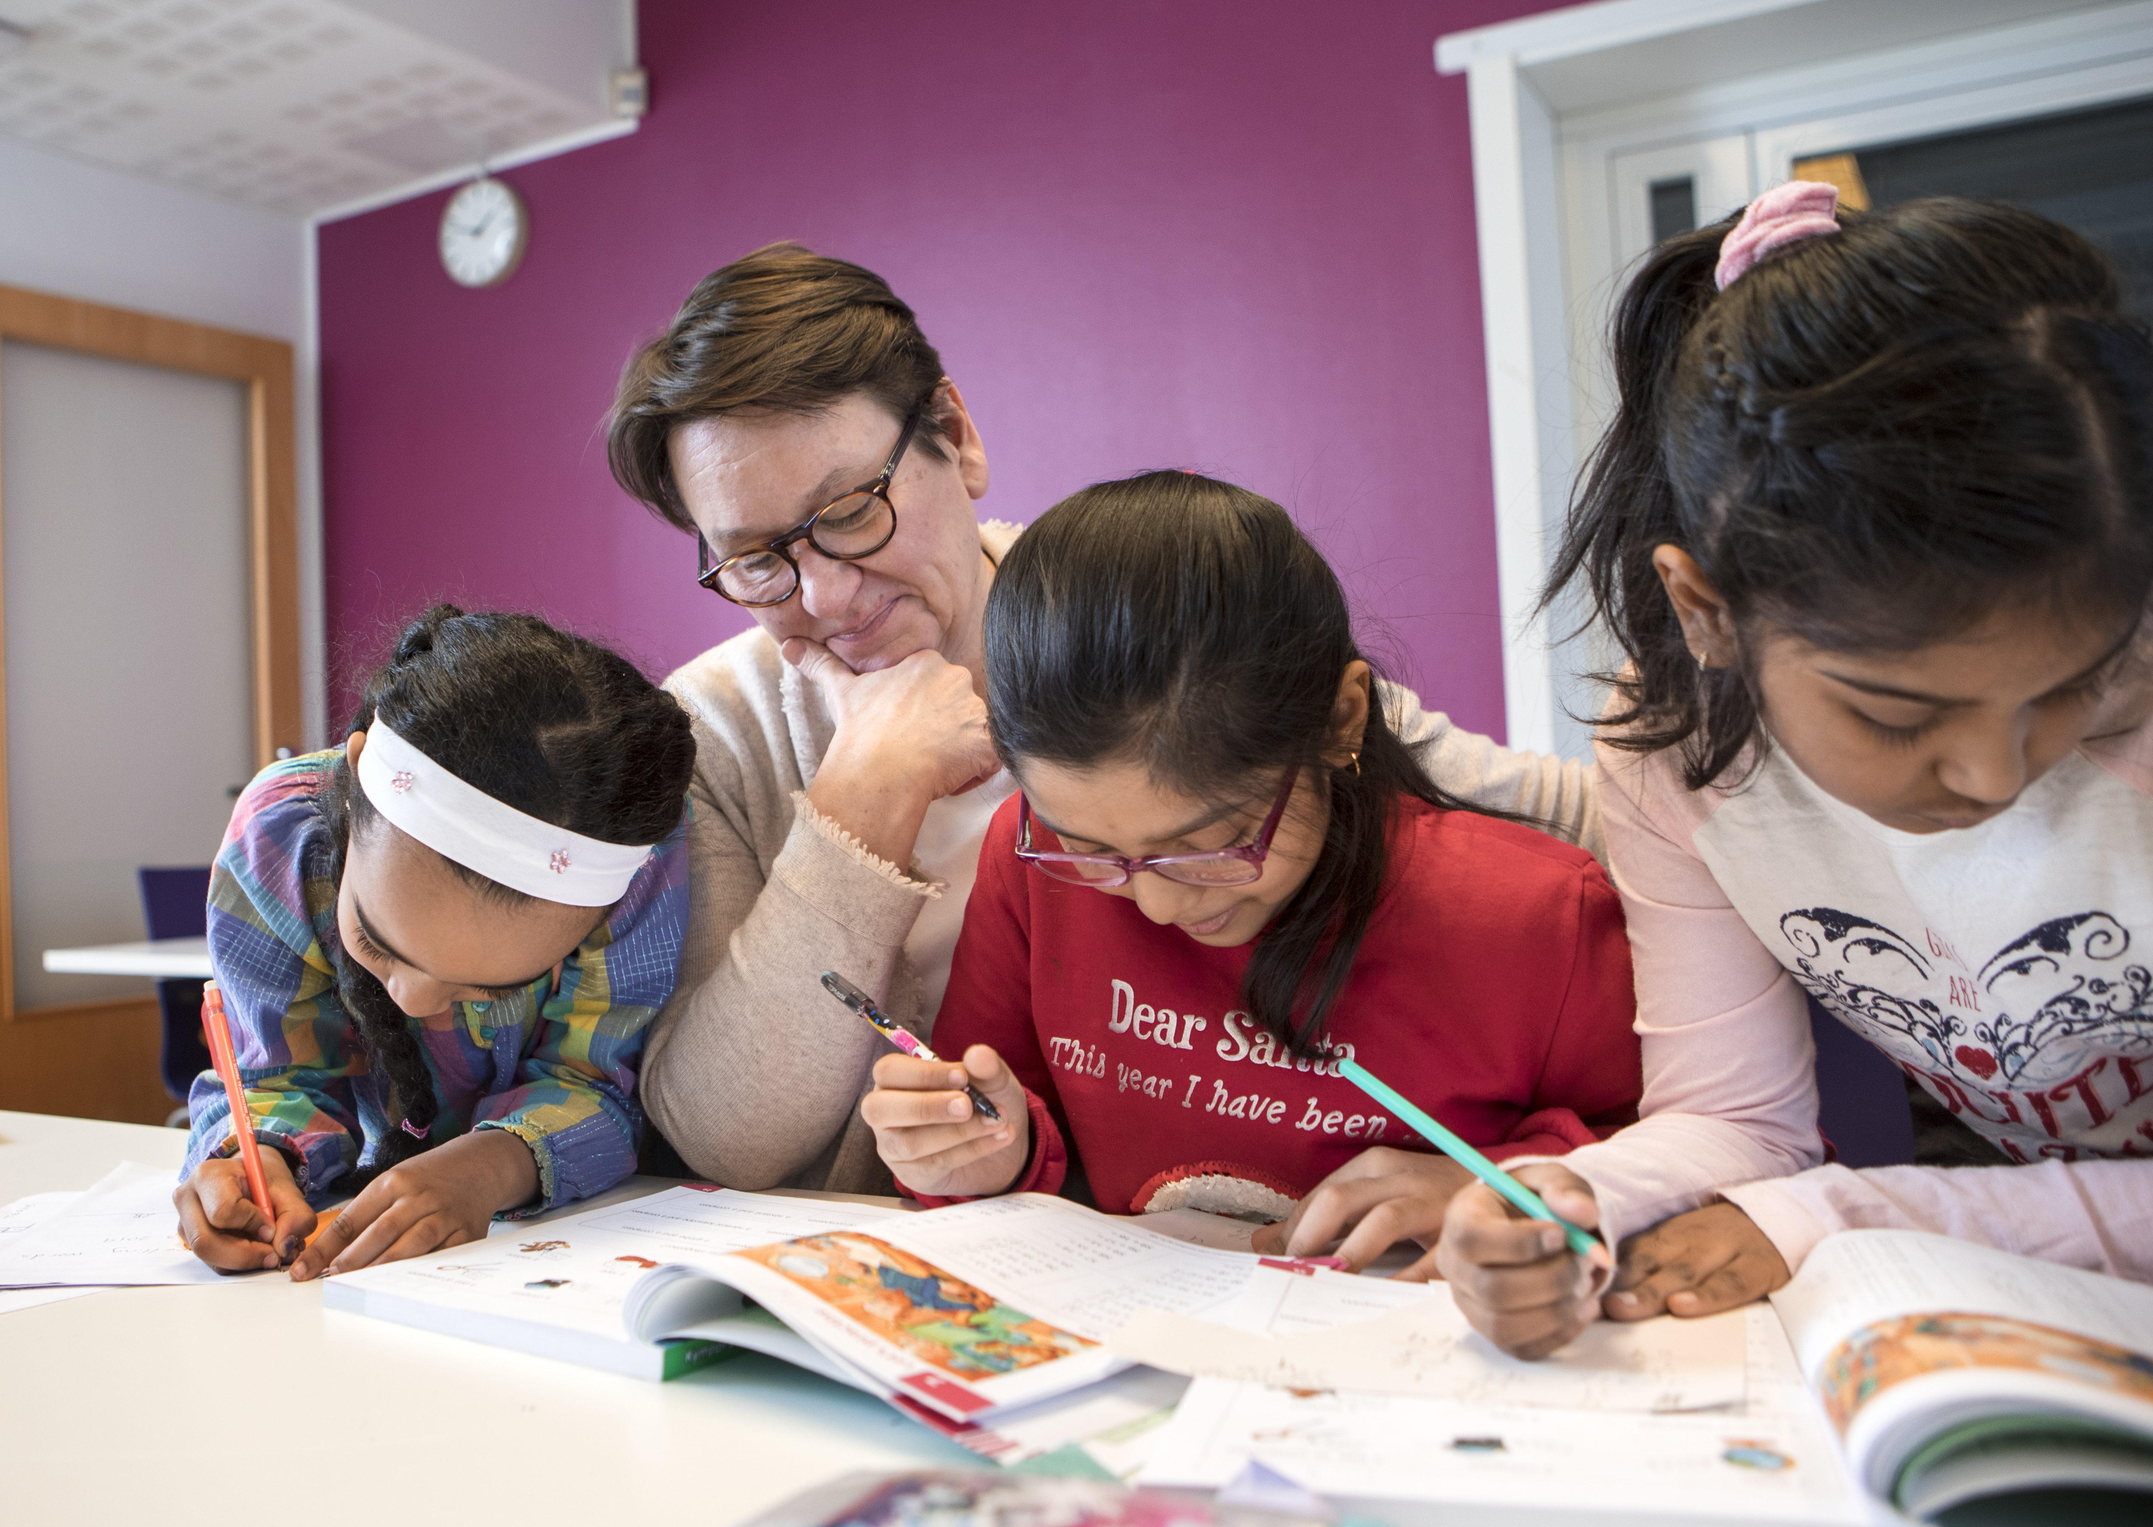
Homework Help – support with homework for children and young people
Photo: Susanna Kekkonen
The Finnish Red Cross
The Red Cross’s Homework Help activities help children and young people with their schoolwork. Homework Help instructors listen to the worries of children and young people and offer them encouragement when studying feels hard.
Homework Help welcomes all children and young people who need support with their schoolwork. In the Homework Help activities, instructors can also support Finnish language learning. Homework Help activities take place after the school day.
Date and location: xx Month xxxx
Contact person: xxxx, telephone number, e-mail
Welcome!
Organiser: The XX branch of the Finnish Red Cross

Slide 2
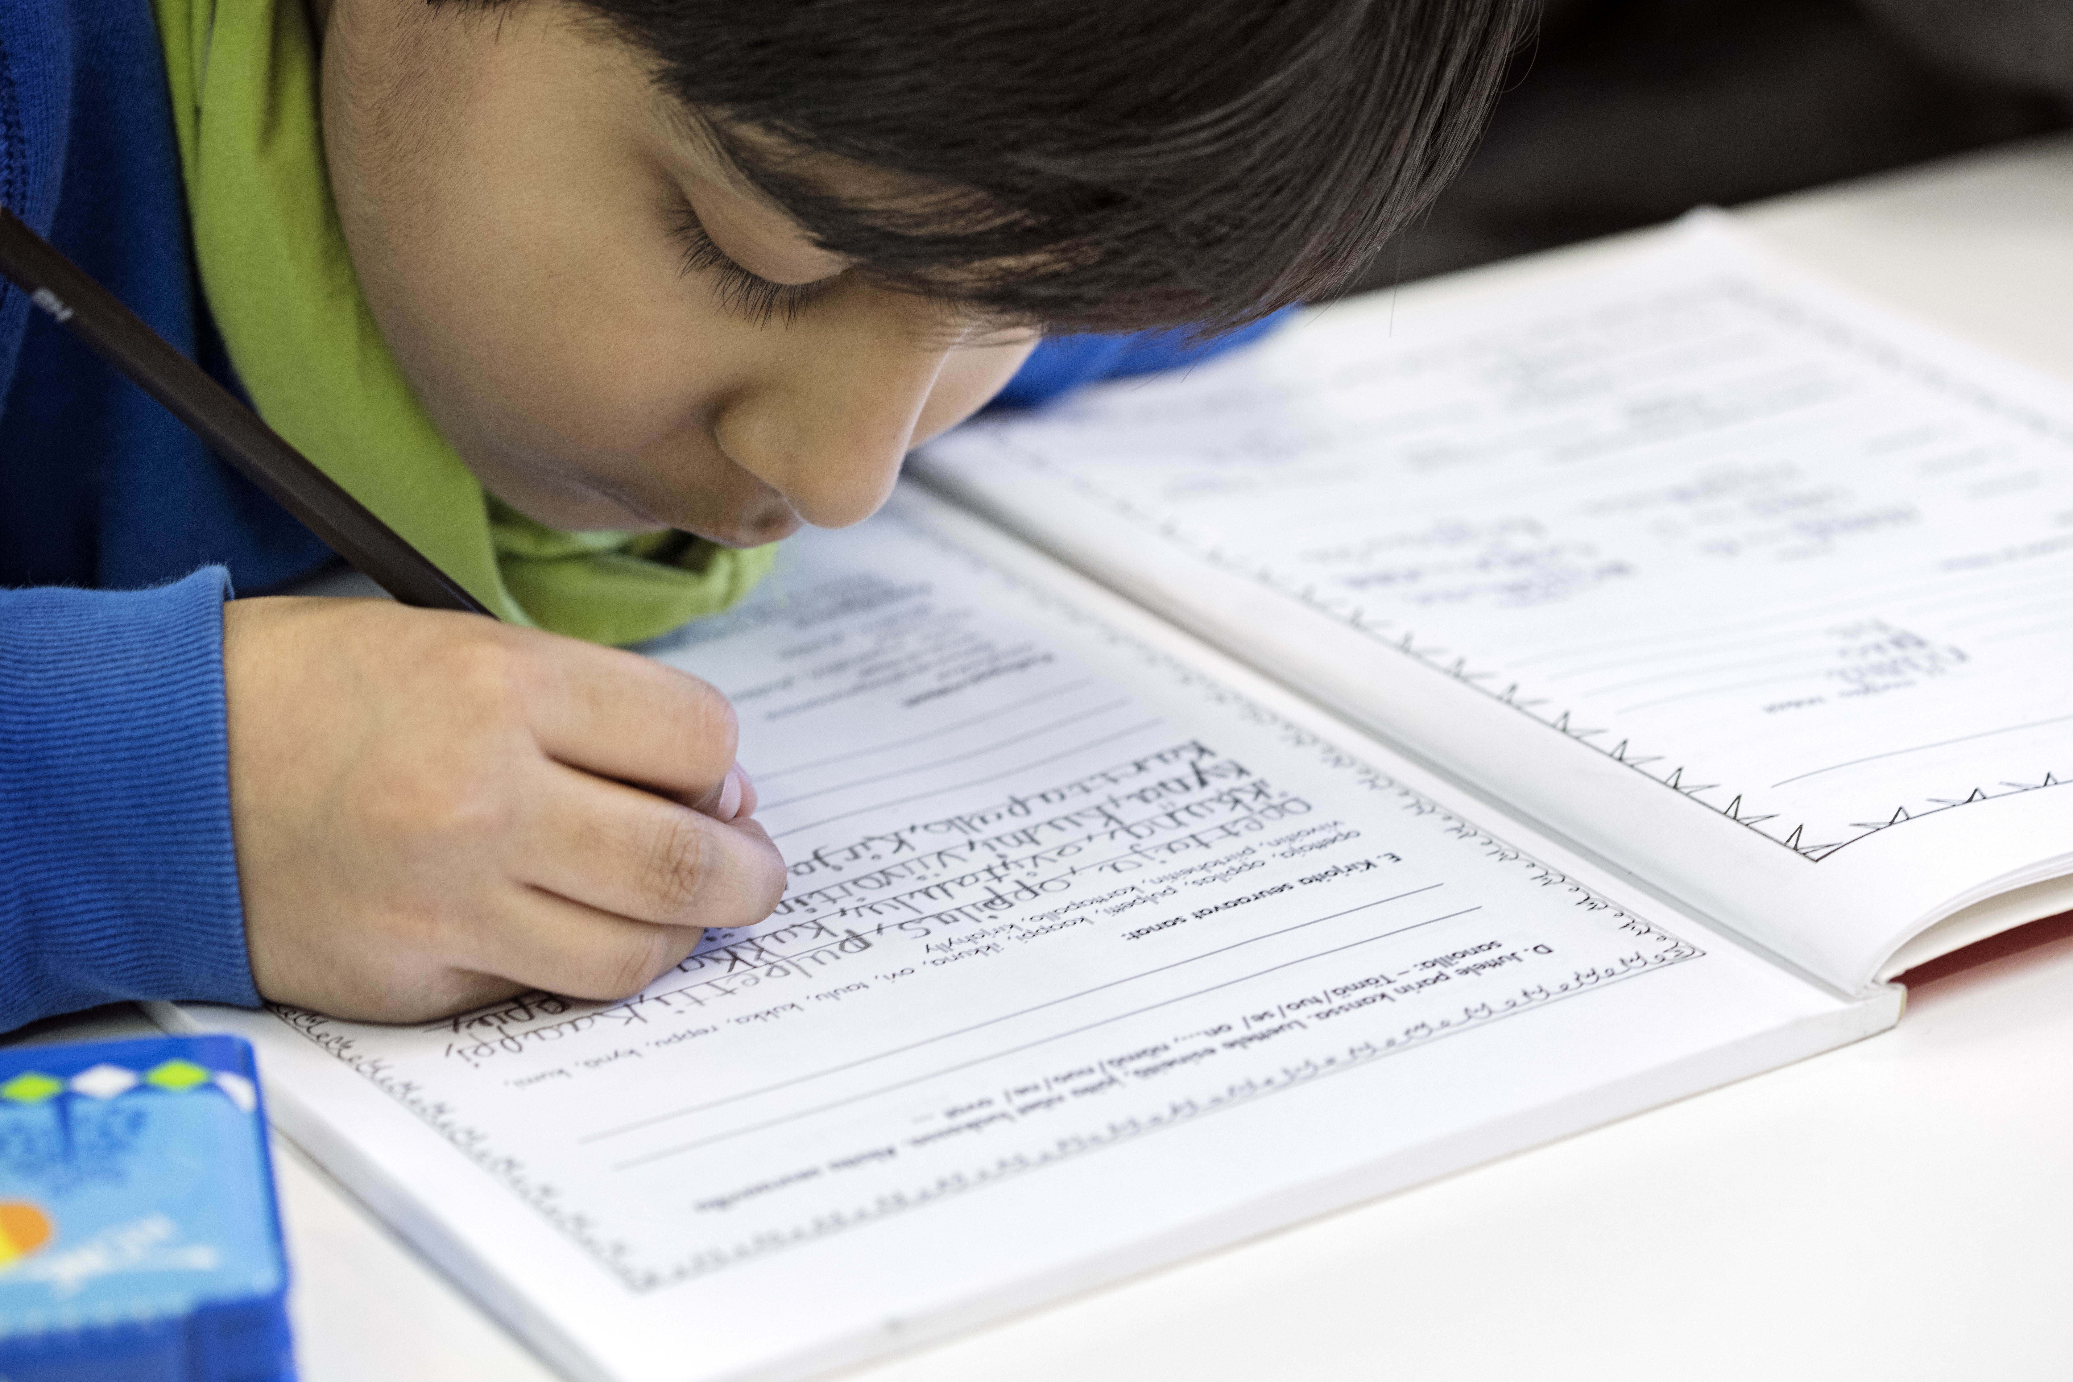
Would you like to support children and young people? Become a Homework Help instructor!
Photo: Susanna Kekkonen
The Finnish Red Cross
The Red Cross’s Homework Help activities help children and young people with their schoolwork. Homework Help instructors listen to the worries of children and young people and offer them encouragement when studying feels hard. Homework Help activities are open to all children and young people who need support with their schoolwork. In the Homework Help activities, instructors can also support Finnish language learning.
As instructors, we are looking for enthusiastic and responsible adults who know how to work with children of all ages. Young people can also become instructors for primary school-aged children.
Do you see yourself as a supporter of children and young people? Ask for more information!
Contact information: XXXXX

