Slide 1
Friends, food aid and online helping as part of preparedness to help
Notes:
The purpose of these slides is to
increase awareness of the Finnish Red Cross’s preparedness to help among those volunteering in friend activities and food aid
increase awareness of the role of volunteer friends and food aid volunteers as part of readiness to help, both among themselves and among volunteers working in preparedness and other types of activities
describe the special expertise of volunteer friends and food aid volunteers from the perspective of preparedness
describe concrete tasks that volunteer friends and food aid volunteers can perform in the event of disruptions and accidents.

Slide 2
Foundation and role of the Finnish Red Cross preparedness
The principles and values of the Red Cross are the foundation of preparedness and readiness. The Red Cross is prepared to be able to help as soon as something happens. These are called preparedness operations.
The Red Cross is obligated to support authorities and save human lives in various emergencies.
The operations are based on the Act on the Finnish Red Cross (238/2000) and the Presidential Decree on the Finnish Red Cross (827/2017).
Notes:
According to the Presidential Decree on the Finnish Red Cross (FRC) (827/2017), the FRC aims to (Section 2):
Section 2: PURPOSE OF THE ORGANISATION:
In accordance with the Fundamental Principles of the International Movement of the Red Cross and Red Crescent Societies (the Fundamental Principles of the Red Cross), the Society shall:
protect life and health and ensure respect for the human being and human rights in all circumstances;
promote cooperation and peace among all peoples;
save human lives within the country and abroad;
assist the most vulnerable in order to prevent and alleviate human suffering;
support and assist national authorities in times of both peace and war and during armed conflicts in order to promote human well-being;
promote solidarity and positive attitudes towards assistance work in society;
promote volunteer activities for helping people;
promote the preparedness to help; and
increase understanding of the work of the Red Cross and its humanitarian mandate.

Slide 3
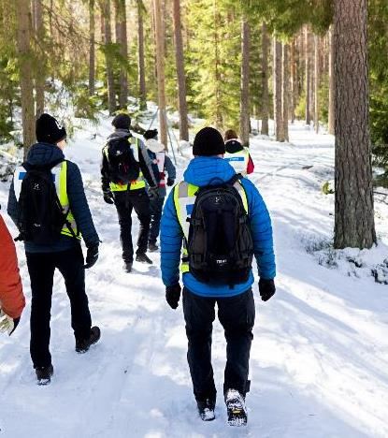
FRC preparedness resources in Finland
More than 400 branches throughout the entire country, with thousands of volunteers in the various forms of operations
The Disaster Relief Fund (help in sudden domestic emergencies, such as fires)
A total of more than 400 emergency teams (including first aid, psychosocial support) with over 4,000 volunteers in the teams
FRC coordinates the Voluntary Rescue Service (Vapepa), which covers 52 member organisations
The preparedness group of psychologists and disaster preparedness units (a national helpline and chat can be opened when necessary)
Youth Shelters, including Nettiturvis, SekasinChat, Kontti second-hand department stores, Blood Service, reception centres, Logistics Centre, Health Points
Notes:
In the Red Cross, you can be part of a comprehensive chain of helping and participate when necessary. The volunteer always free willingly decides on joining a preparedness situation. Further training is available for the assignments.
The FRC logistics centre is located in Tampere. The centre takes care of material acquisitions, packing, and storage (e.g. clothing aid, field hospitals, and other equipment). In addition to this, the FRC international aid delegates (also known as the disaster preparedness units, with approximately 900 active and trained individuals) are also available in domestic situations, if necessary (delegates were involved in founding reception centres in the autumn of 2015, for example). There are approximately 70 Health Points, which offer instructions in health-related matters, blood pressure measurements, and psychosocial support. If necessary, the volunteers can act as support in the identification of vulnerable groups and health hazards, e.g. COVID-19.
At a local level, the FRC can play an essential part in bringing together various operators and supporting communities during and after incidents.

Slide 4
Friends and food aid as part of preparedness
Friend activities and food aid are part of preparedness to help.
Volunteers from friend activities and food aid meet people in various situations in life. These include vulnerable people, such as lonely individuals, family caregivers and people in need of material aid.
Human interaction, listening, recognising the need for help and guiding people to services are part of the preparedness to help.
Local-level knowledge and awareness of other operators is important.

Slide 5
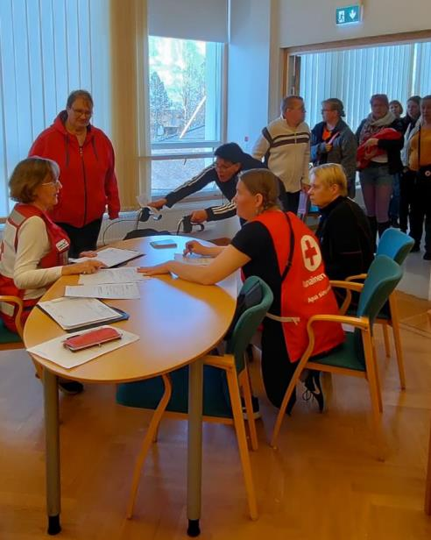
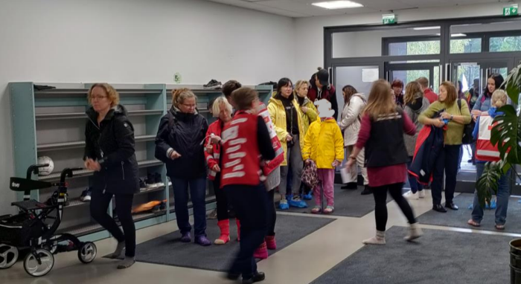
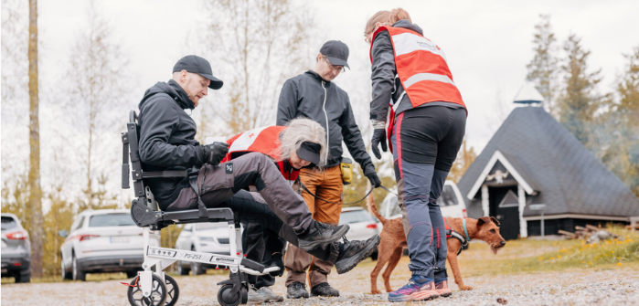
Notes:
Volunteers are needed for a variety of roles in accidents and disruptions. They train for these situations constantly. The photos are from exercises.

Slide 6
Community-based operations as part of preparedness to help
Community-based operations increase the community’s resilience or flexibility, i.e. the ability to prepare for, act in and recover from challenging situations.
This means that community-based operations are an important part of preparedness and readiness.
Community-based operations are needed in order to identify local needs for aid.
When the regional needs and resources are identified, the Red Cross aid can be targeted accordingly, and the activities can help those in the greatest need.
The community-based approach can also be used under normal conditions in order to activate and strengthen the community. This also improves the community’s ability to cope.
When an active community has identified the needs for aid and the vulnerable people beforehand, this speeds up aid activities in the case of accidents and disruptions as well.
There are various tools available for assessing the need for aid. Material is available on the Volunteer Info website (in Finnish)

Slide 7
Things to consider
How is your community doing?
Are there vulnerable people in your area with no aid or activities available to them?
How could volunteer friends and food aid volunteers in your branch reach them and support them?
Should something be done differently in order to reach them?
Notes:
These questions can also be considered from the perspective of past disruptions, such as the COVID-19 pandemic. Was some particular group left without aid then? What could have been done differently?

Slide 8
Emergency support services
Emergency support services refer to activities aiming to provide people with aid and support in sudden accidents or disruptions, or immediately thereafter.
Emergency support services take comprehensive care of the basic needs of people and, thus, support coping.
Emergency support services can be provided at the request of authorities, or the Red Cross can implement them on its own initiative based on the need for aid.
Emergency support services include assistance with emergency accommodation, the distribution of material aid, food supply, first aid and health checks, guidance and practical aid, presence and psychosocial support, the logging of people and events, the use of the Red Cross Disaster Relief Fund as well as family reunification and tracing work.

Slide 9
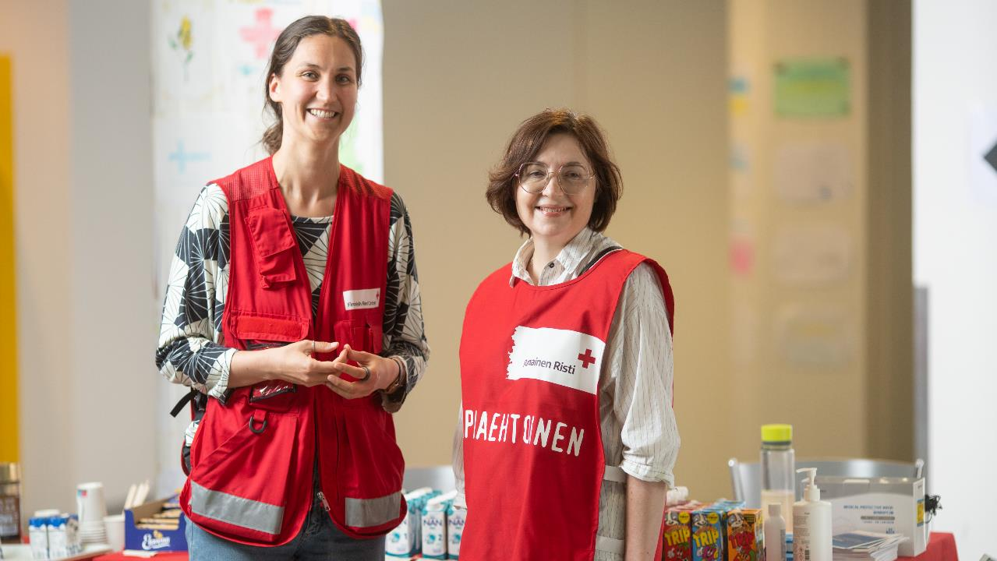
Notes:
PHOTO: Teemu Ullgren / FRC

Slide 10
Friends and food aid volunteers as part of preparedness
The Red Cross is a preparedness organisation, which means that willing volunteers from friend activities and food aid can be asked to help in various accidents and disruptions.
In the event of a large blackout, fire, water contamination or health threat, for example, volunteers can be invited to take on emergency support tasks and distribute supplies such as blankets, clothes, or food and water, or to convey information to people who cannot be reached otherwise.
Online friends can be invited to provide help online.
These tasks are primarily linked to emergency support services and psychosocial support.
Notes:
When establishing a reception unit, volunteers can assemble beds, help with food distribution, make coffee and sort donated clothes and goods, for example. Friends are also needed as conversational support and someone to talk to. Home care of the elderly may also request help with drink supplies during a summer heatwave, for example.
An example from Kainuu on 6 January 2018 (in Finnish): https://www.punainenristi.fi/uutiset/20180106/punainen-risti-auttaa-sahkokatkoista-karsivia-ihmisia-kainuussa
An example from the COVID-19 pandemic on 5 November 2021 (in Finnish): https://www.punainenristi.fi/vapaaehtoiseksi/vapaaehtoiseksi-lahteminen-tuntui-luontevalta/

Slide 11
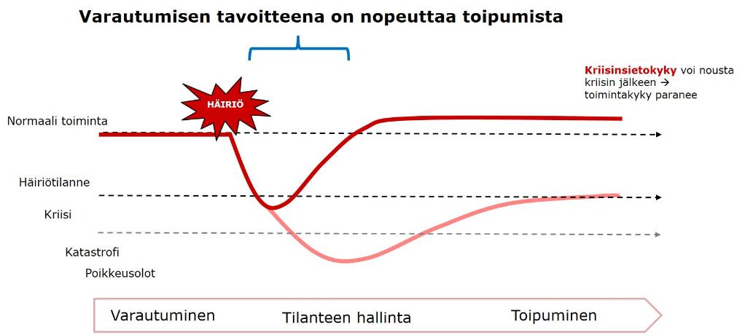
Friend activities, food aid and preparedness
Preparedness operations
Friend activities and food aid strengthening resilience, i.e. crisis tolerance
Preparedness tasks
Psychosocial support
Friend activities and food aid as support and volunteer resource
Long-term support from friend activities and food aid
Notes:
Friend activities and food aid have a role to play at all stages: when preparing for emergency situations or crises, during the situations themselves and at the recovery stage.
The objective of preparedness is to speed up recovery when something bad happens. For example, when volunteer friends support those experiencing loneliness, organise group activities that support community spirit and well-being as well as increase the sense of safety among the elderly by visiting them regularly, the support provided through these activities helps people to cope better with exceptional situations. Their resilience, i.e. crisis tolerance, is at a better level thanks to the support provided by volunteer friends.
In food aid, volunteers meet vulnerable and disadvantaged people and encounter and support them in many ways: by providing material aid, i.e. food, but also discussion support and information about services. They also organise activities that increase inclusion, such as meeting cafés. This support helps with everyday coping, increases well-being and helps in exceptional situations, as crisis tolerance has improved due to the support received.
When something unexpected happens, the volunteer friends and food aid volunteers are an important volunteer resource for the branch. In many branches, volunteer friends make up the largest volunteer group and have a variety of skills. During the COVID-19 pandemic, for example, there was a great need for friends and food aid volunteers as discussion support to those isolating, someone to talk to during vaccinations and in food home deliveries.
When the disruption is over, volunteer friends and food aid volunteers are important companions in recovery.

Slide 12
Red Cross psychosocial support in accidents and disruptions
Low-threshold encounters
– incl. volunteers from friend activities
Psychosocial support
– psychosocial support volunteers
– online volunteers (SekasinChat, AuttavaChat)
– Helpline
Strong professional support
– Preparedness group of psychologists
– Youth Shelters
Notes:
Support provided by volunteers from friend activities is part of psychosocial support.

Slide 13
Discussion – taking part in operations
How have volunteers from friend activities and food aid participated in helping in exceptional situations?
What kinds of needs for aid have there been?
Should something be done differently next time?

Slide 14
Special expertise of volunteer friends 1/2
The ability to meet and support people, calm companionship and presence, discussion support, the ability to support diversity
Extensive understanding of everyday routines and factors impacting them
Understanding of the possible barriers and limitations of beneficiaries, also in aid situations
Online friends have expertise in online encounters and the digital environments used in online aid

Slide 15
Special expertise of volunteer friends 2/2
Meeting vulnerable people, extensive contacts and the ability to reach disadvantaged people and those who would otherwise stay hidden
Knowledge of the neighbourhood: people, public transport, etc.
Local and regional network expertise – extensive cooperation networks, for example, patient organisations and organisations of persons with disabilities, assisted living facilities
Gaining situational awareness, the organisation and coordination of operations
Adapting to changing, urgent situations and functioning in them

Slide 16
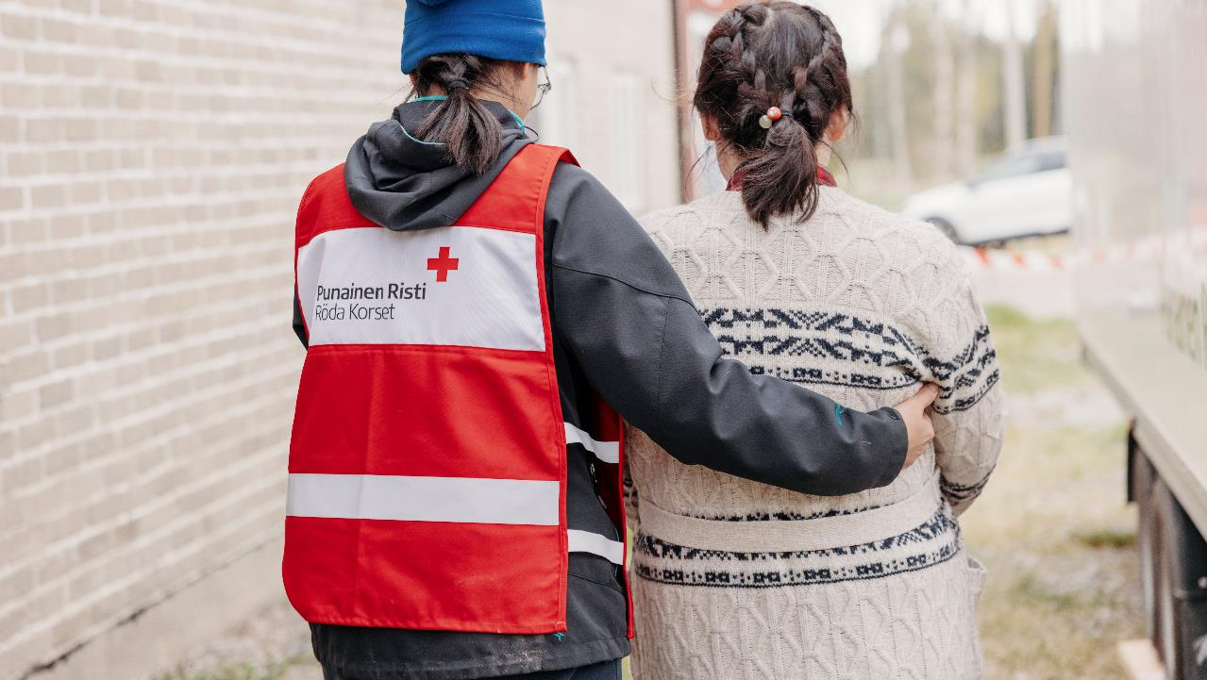
Notes:
Photo: Joonas Brandt / FRC

Slide 17
Concrete tasks that volunteer friends can take up in exceptional situations 1/2
Helping to keep contact with loved ones
Arranging a peaceful space for discussions and offering discussion support
Arranging a play area for children and taking young people into account
Guiding people to the correct information, information sharing
Providing unhurried presence in an exceptional situation, calm discussion, personal attention
Making use of extensive networks and cooperation partners, for example, meeting and assisting people with memory disorders or disabilities

Slide 18
Concrete tasks that volunteer friends can take up in exceptional situations 2/2
Tasks requiring language skills
Guiding bystanders and sharing information with them
Accompanying and assisting in an evacuation situation
Testing any digital services in practice
Communications tasks and information sharing, incl. social media
Logging and registration
Contacting your own friend clients and visiting places, such as assisted living facilities,, sharing information and checking up on the situation

Slide 19
Special expertise of food aid volunteers 1/2
Meeting vulnerable people, extensive contacts and the ability to reach disadvantaged people and those who would otherwise stay hidden
Food supply: food distribution and the organisation of food preparation, packing and distribution, assessing the sufficiency of food amounts
Strong expertise in the form of Hygiene Passports, etc.
Logistics competence, coordination skills in forming chains and issuing roles
Gaining situational awareness, the organisation and coordination of operations

Slide 20
Special expertise of food aid volunteers 2/2
Adapting to changing, urgent situations and functioning in them
Knowledge of the neighbourhood: people, public transport, etc.
Local and regional network expertise
Extensive understanding of everyday routines and factors impacting them
The ability to meet and support people, calm companionship and presence, discussion support, the ability to support diversity
Understanding of the possible barriers and limitations of beneficiaries, also in aid situations

Slide 21
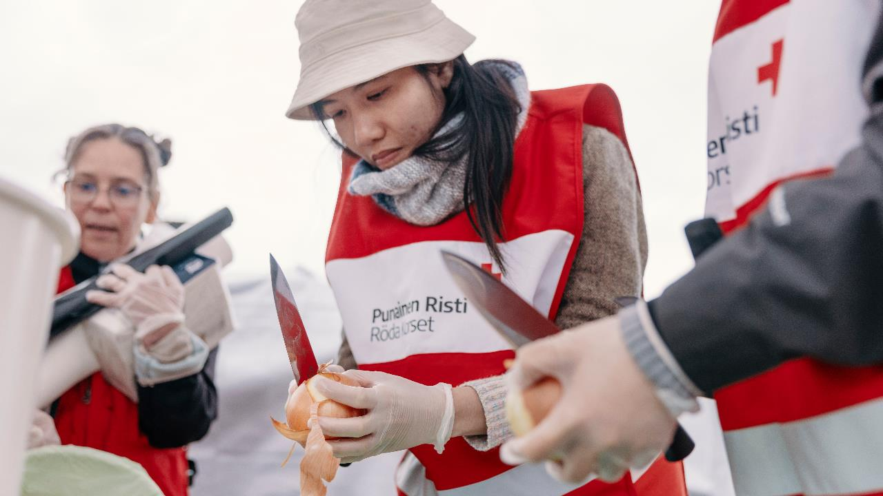
Notes:
Photo: Joonas Brandt / FRC

Slide 22
Concrete tasks that food aid volunteers can perform in exceptional situations 1/2
Food supply, provisioning, the distribution and manufacturing of food and drink, packing, logistics, supply distribution
Guiding people to the correct information, information sharing
Providing unhurried presence in an exceptional situation, calm discussion, personal attention, offering something to drink
Arranging a peaceful space for discussions and offering discussion support
Making use of networks, contacting partners and sharing information
Contacting and coordinating your own volunteer group as the designated volunteer in charge.

Slide 23
Concrete tasks that food aid volunteers can perform in exceptional situations 2/2
Tasks requiring language skills
Guiding bystanders and sharing information with them
Accompanying and assisting in an evacuation situation
Contacting and coordinating your own volunteer group as the designated volunteer in charge.
Communications tasks and information sharing, incl. social media
Logging and registration

Slide 24
Friendship coordinators and food aid contact persons as part of preparedness
Friendship coordinators and food aid contact persons have a key role in reaching their volunteers in the case of accidents and disruptions.
In practice, this can take place in the following manner:
  Authorities issue a support request to a FRC district/branch.
  The district/branch deems that volunteer friends and/or food aid volunteers could be of help in the situation.
  The district/branch alerts the friendship coordinator and/or food aid contact person and describes the tasks for which volunteers are needed.
  The friendship coordinator and/or food aid contact person contacts volunteers they deem to be suitable and agrees on participation with them.
  The selected volunteers take part in the aid situation or operation of the district/branch in tasks that suit them.

Slide 25









Friendship coordinator and food aid contact person as part of an emergency team
Friendship coordinator / food aid contact person in the OHTO emergency team of the branch/area
People who have received the alert and come to the emergency team meeting
Emergency team assesses whether more friends and/or food aid volunteers are needed
If so, the coordinators or contact persons alert the required number of volunteers from their groups
Friends and food aid volunteers take up different tasks
Disruption
The volunteer friends of the branch have given their permission to be asked to join other aid operations. They have ticked the box ‘I may be asked to participate in other aid activities’ in their OMA friend profile.
Notes:
The model is based on the model used in the Kehä-Espoo branch.
The goal is to adopt this model across other branches and areas. Preparing for a preparedness exercise offers a great opportunity to spread the model.
When the friendship coordinator or contact person and the food aid contact person are included in the official emergency team of the branch or area, volunteer friends and food aid volunteers are included in preparedness in the best way possible.
When something happens, the alert reaches the friend activity and food aid coordinators directly. Then, the coordinators receive information of whether their volunteers are needed immediately, in the second wave or at all.
If they are needed, the friendship and food aid coordinators can quickly alert members of their group to join. For example, the friendship coordinator can access the contact information of volunteers in the electronic friendship coordination system and contact them.

Slide 26

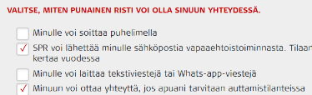


Create a profile in OMA!
It is important that all volunteer friends and food aid volunteers have created a profile in OMA Punainen Risti.
In your OMA profile, select all the tasks you are involved in. This allows us to make the most out of your expertise.
Volunteer friends must also have a profile in the electronic friendship coordination system. In your friend profile, you may also select ‘I may be asked to participate in other aid activities’. This information can be utilised in emergency situations. You can also check the box ‘I have training in social services / health care’. This helps us invite professionals to help, as necessary.

Slide 27
Become a part of online preparedness
The tasks of online preparedness include offering psychosocial support and/or distributing correct information to those in need online.
Online aid is coordinated nationally and can take place nationally or locally.
In crisis situations, we can
  initiate a one-on-one or group chat on the Red Cross website, when the adult population needs aid
  increase the number of trained volunteers and employees in the SekasinChat and Nettiturvis, when young people need aid. The number of users usually increases in the above-mentioned services in exceptional situations.
You can become an online preparedness volunteer by completing the Online helper at the Finnish Red Cross online training and the psychosocial support training. There is separate training for SekasinChat volunteers.
You can join the help chat volunteer reserve by joining the open activity group in OMA Punainen Risti: https://oma.punainenristi.fi/groups/group/2320

Slide 28
Get everyone involved in emergency team operations!
Each friendship coordination or food aid team should have at least one person who is included in the emergency team of the branch or area. This ensures that the emergency team receives information on the volunteer resources available for, e.g. emergency support services in accidents.
The emergency team practices vary by branch. Ask the emergency team coordinator of your branch what training is required to join the emergency team.
We recommend completing the basic course on psychosocial support.

Slide 29
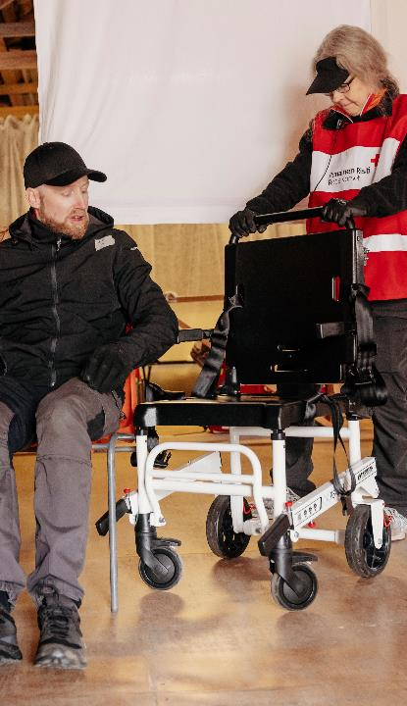
Social well-being tasks prior to a preparedness exercise
All volunteer friends and food aid volunteers should create a profile in OMA Punainen Risti.
  This links every volunteer into preparedness and ensures that they can be alerted if necessary.
Everyone already in OMA should update their profile, including the activities they are involved in, and tick the box: You can contact me if you need my help in an aid situation.
Everyone should join the national, regional and local groups in OMA
  Important channels for reaching volunteers.
  Friend activities volunteer group, friendship coordinator group, national food aid volunteer group, etc.
Everyone should take the basic courses on preparedness to help and psychosocial support
Together ensure that the branch has a designated food aid contact person in OSSI
Notes:
Photo: Joonas Brandt / FRC
This encouragement is intended for anyone willing to take part in preparedness exercises and aid operations. Not all volunteers need to join, for example, if their health does not allow it or they are not interested in preparedness. Volunteer activities in normal everyday life are just as important as helping in accidents, etc.

Slide 30
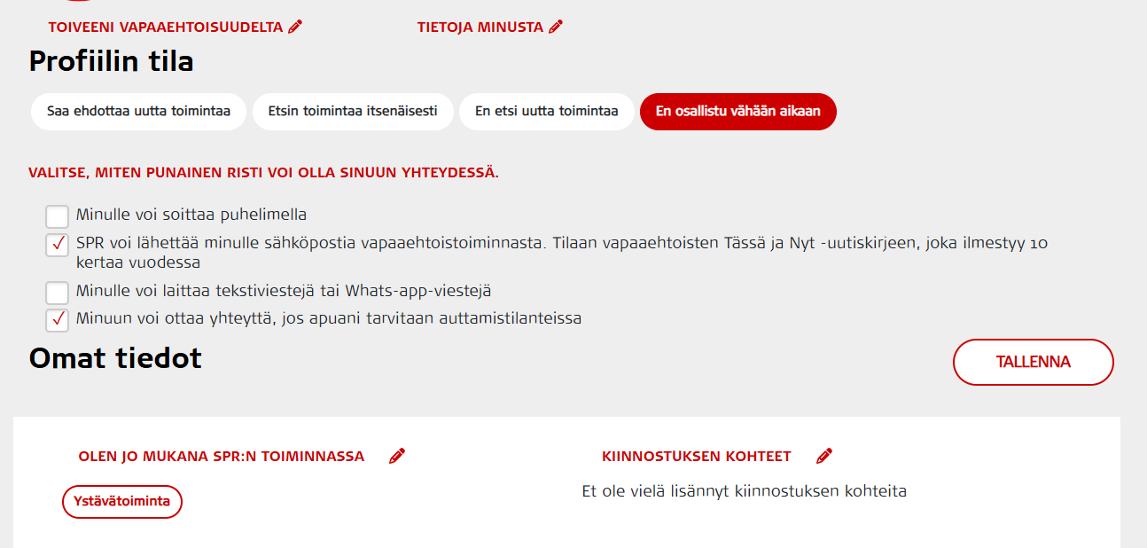

Slide 31
Food supply team

Slide 32
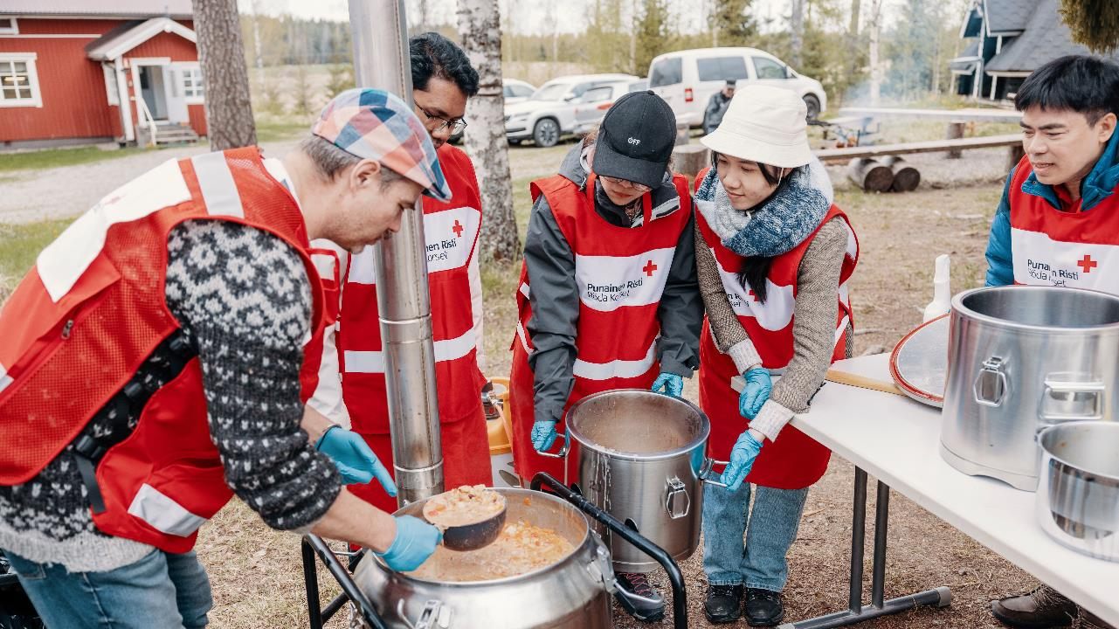
Notes:
Photo: Joonas Brandt / FRC Food supply team from the Tampere branch taking part in a preparedness exercise.

Slide 33
Food supply team – Making use of food aid volunteer expertise in preparedness
Developed in the Oulu branch, a model where the food aid volunteers of the branch make up a team that participates in food supply in connection with preparedness exercises and accidents and disruptions. The team is in the OHTO alert system.
The team operates as a part of the branch’s food aid and regularly makes food to be distributed to those in need. This develops and maintains expertise.
The team is experienced in the use of field kitchens and similar as well as preparing warm food for large groups of people. The team is available for different events throughout the district.
The team is also suitable for those interested in one-off volunteering tasks. The variety of tasks includes food preparation, distribution, cleaning up and discussion.

Slide 34
Consider the following: Should you set up a food supply team?
Food supply teams are set up at the discretion of branches.
Consider at least the following:
Regional needs and special features.
The food supply capability of other regional operators (e.g. the Martha Association). Could you cooperate instead of establishing a separate team?
However, there may be situations where no other operator can arrange a food supply. In such situations, the Red Cross food supply teams are vital.
Discuss the matter with the persons in charge of emergency teams in your branch.

Slide 35
Taking the food supply team to OHTO
We hope that as many food supply teams as possible are included as an emergency team in OHTO: OHTO alert system – Vapepa
Setting up an emergency team:
Persons in charge of the emergency operations of the branch are responsible for setting up the team. Together with them, consider whether the team can be added to OHTO and request them to create the team.
We encourage the establishment of emergency teams, as they allow us to use and view the volunteer resources and expertise in food aid. The alerted food supply teams strengthen preparedness for any exceptional situations.
The food supply teams in OHTO only work in food supply, and they cannot be alerted to other emergency support tasks.

Slide 36
Further information and instructions for volunteers (in Finnish):
https://vapaaehtoistieto.punainenristi.fi/ruoka-apu/ruoka-apu-osana-auttamisvalmiutta/
  Basic information on setting up a food supply team
  Basic information on the use of a field kitchen
Webinar recording on food supply in large-scale disruptions #AvunKetju2025 (Oulu district’s Pia Jylänki starts her presentation at 1:31:00)

Slide 37
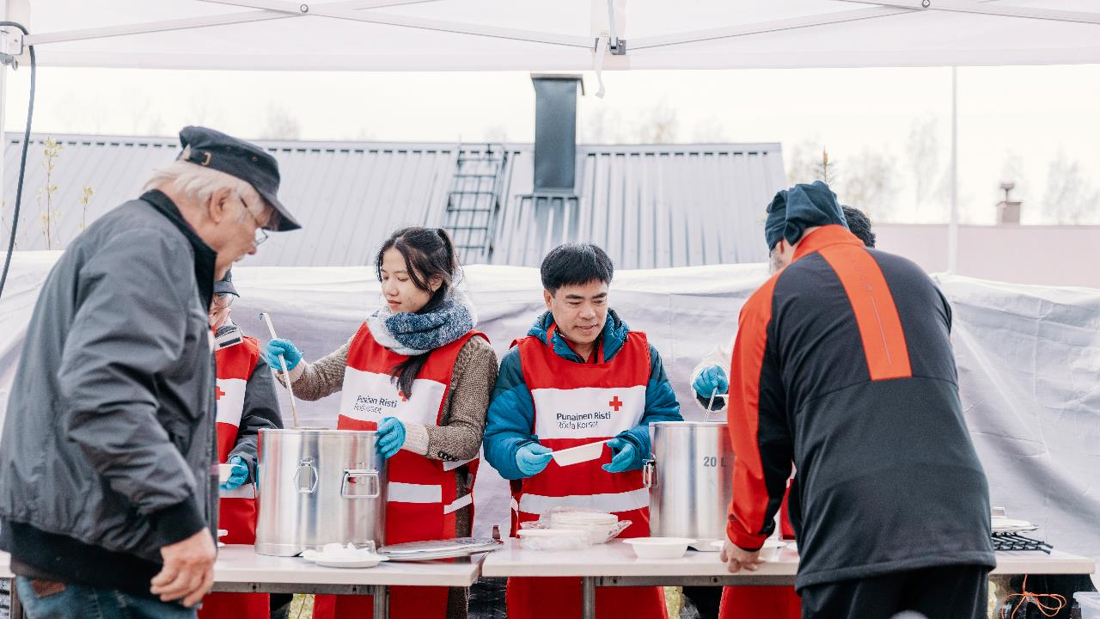
Thank you for participating!
Notes:
Photo: Joonas Brandt / FRC

